Slide 1

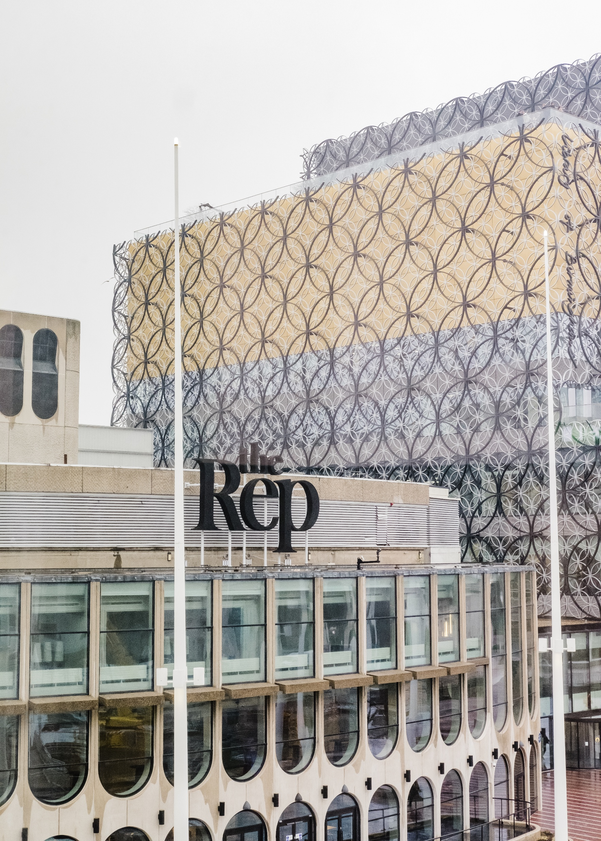
Visual Guide to Conference 2026: Museums Connecting Communities
2-4 November 2026
The Rep, Birmingham, and online

Slide 2
This visual guide will…
Provide you with more information about the Rep in Birmingham, where Conference 2026 takes place
Provide images and practical information about specific rooms and spaces at the Rep
Provide you with information, including photographs, of social events taking place during Conference
Provide you with information, including photographs, of the museum tours taking place during Conference (coming soon)

Slide 3
Conference 2026: At a glance…
Optional museum tours across Birmingham on Monday 2 November – venues to be confirmed in due course. Attendance is included in the cost of your in-person ticket.
Social events taking place in Birmingham city centre (venues to be confirmed) on the evenings of Monday 2, Tuesday 3 and Wednesday 4 November. Admission to all three social events is included in all in-person tickets.
Conference sessions on Tuesday 3 and Wednesday 4 November at the Rep in Birmingham.

Slide 4
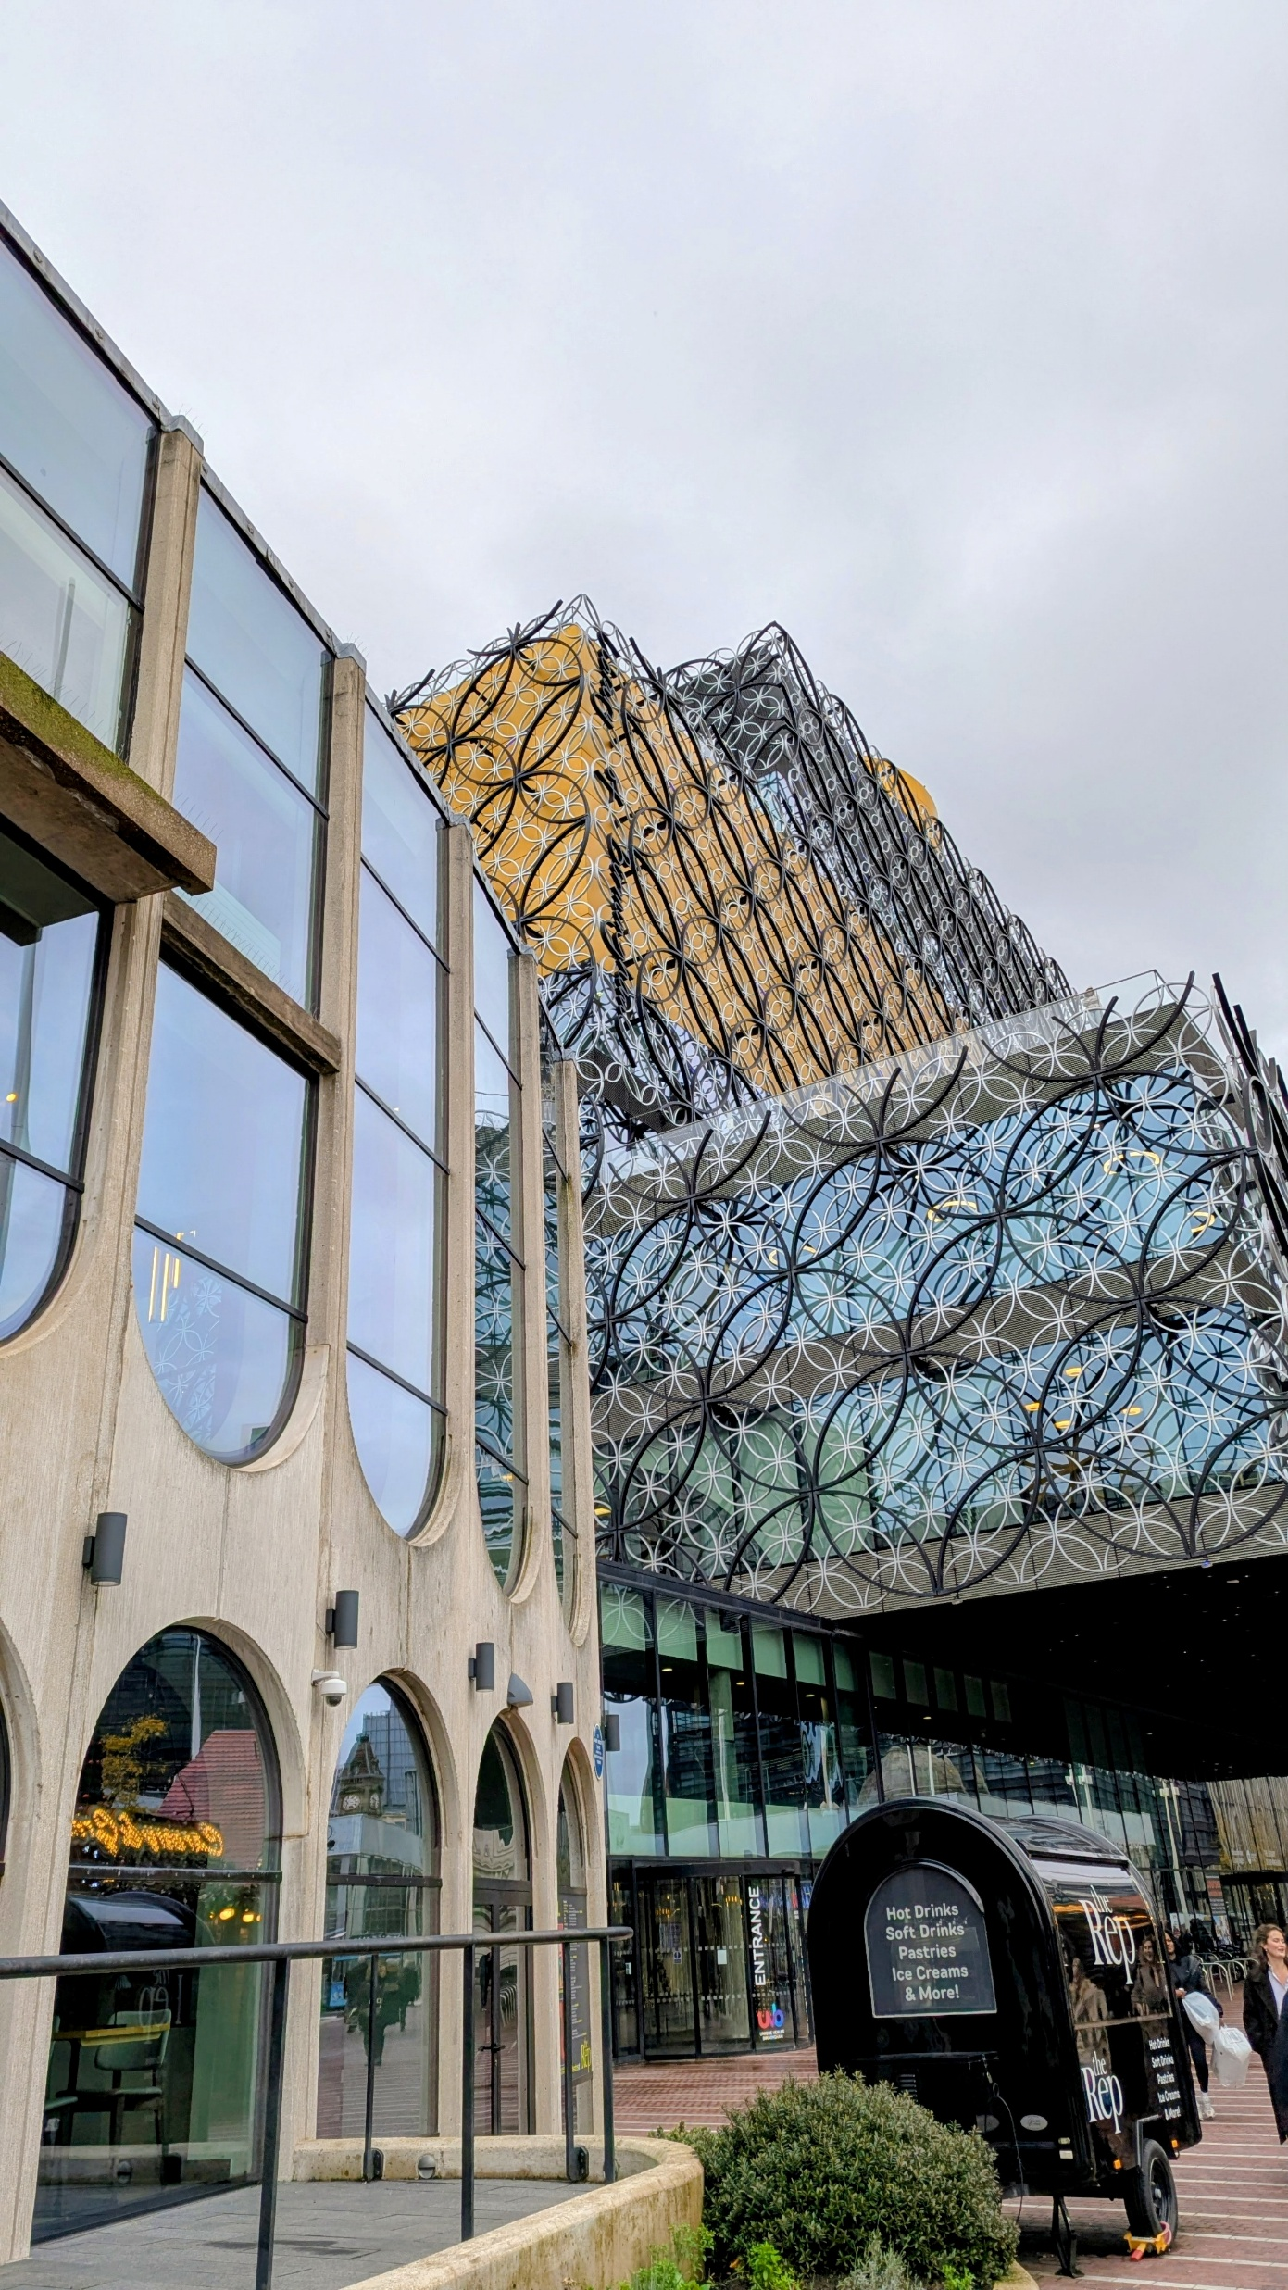
Conference 2026: The Rep
The Rep is a theatre located at 6 Centenary Square in Birmingham city centre (see map on next slide).
It is attached to the Library of Birmingham and next door to the ICC and Symphony Hall.
The Museums Association has exclusive use of the venue throughout Conference – this includes three large theatres as well as large meeting rooms and networking spaces.
Please be aware that there is a Christmas market directly outside the venue (from 1 November 2026). This may mean the square will be busier than usual at peak times.

Slide 5
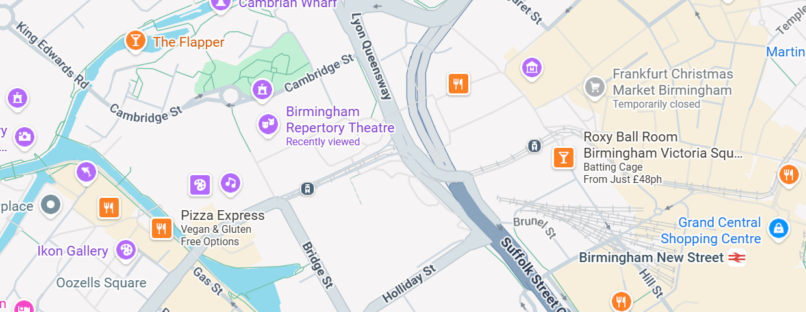
Conference 2026: Google Map of the Rep
Click here to see the Rep on Google Maps

Slide 6
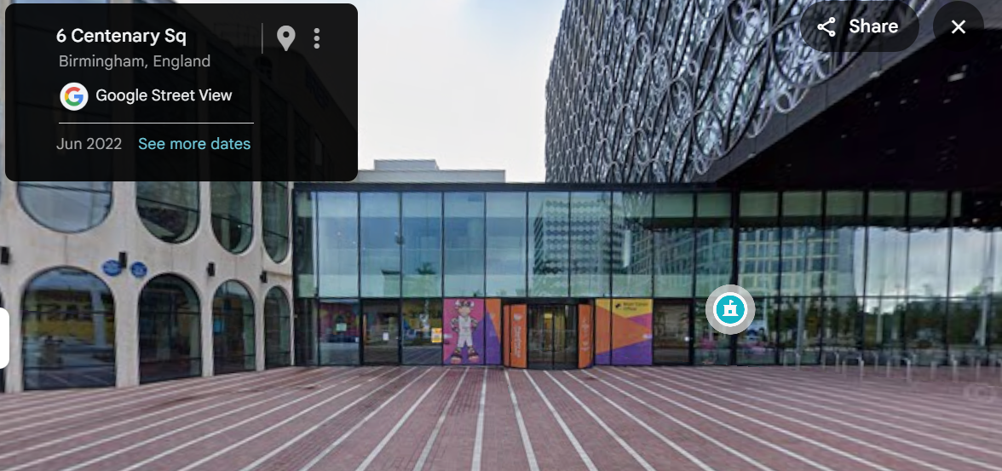


Conference 2026: Reception Entrance to the rep (level access)
We recommend all delegates enter the building via the level entrance at the front of the building on Centenary Square.
The photograph to the right (from Google Street View) shows two yellow circles around an automatic door (left) and a semi-circular automatic sliding door (right) – both doors open into the Rep Reception where the MA helpdesk and cloakroom will be located. The bottom photograph shows

Slide 7
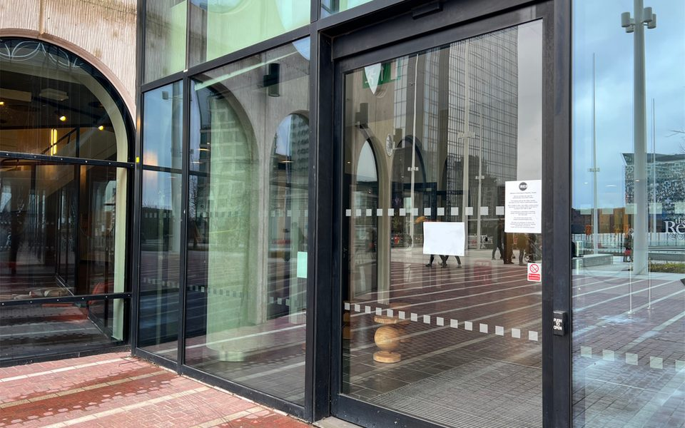
Conference 2026: Reception Entrance to the rep (level access)
The photograph to the right is a detailed shot of the level entrance door

Slide 8
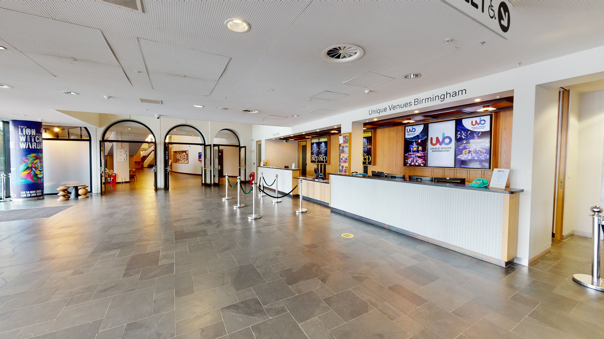
Conference 2026: Rep Reception (level access)
The photograph to the right shows the reception area of the Rep – this is where you’ll find the MA helpdesk and cloakroom for bags

Slide 9
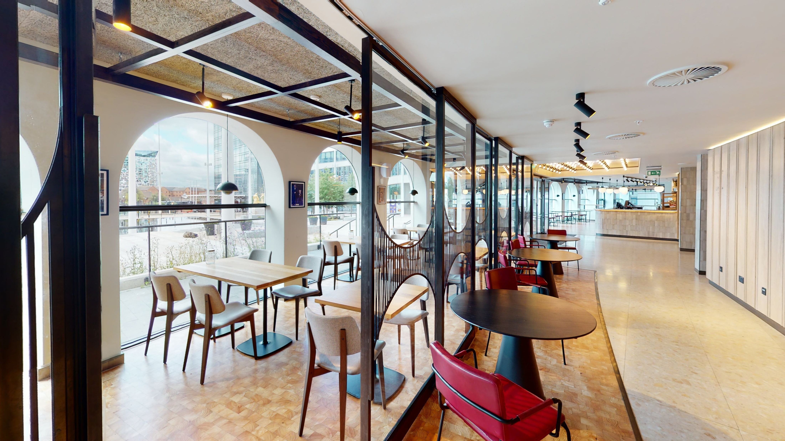
Conference 2026: Cafe (ground floor)
The cafe is a mixed-level area that will be open for delegates to use – there are lots of tables and chairs as well as plugs to charge laptops or phones.
It includes our Chat, Chill, Create area where MA reps will be on hand with creative activities and discussion.
There will also be a book swap.

Slide 10
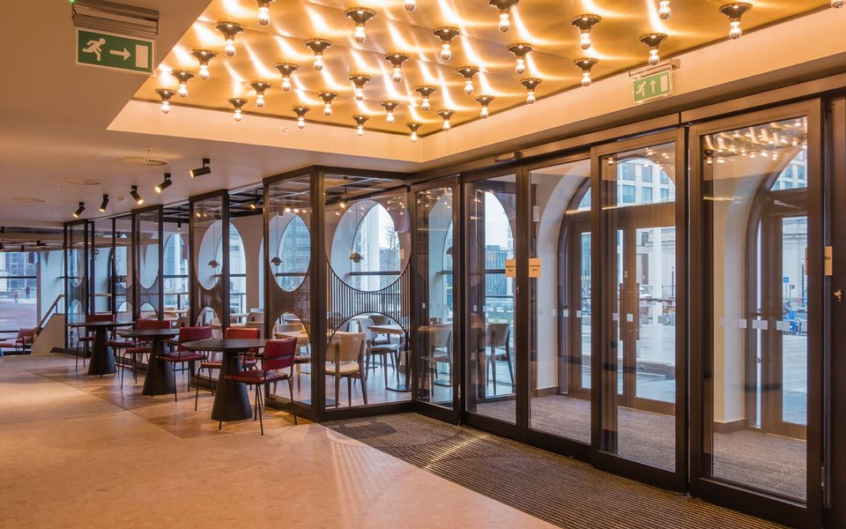
Conference 2026: Cafe (non-level area)
The cafe area will be used throughout Conference for informal networking and catering.
The cafe area is not completely level – however, a lift is available if people are unable to use the steps (see next slide)

Slide 11
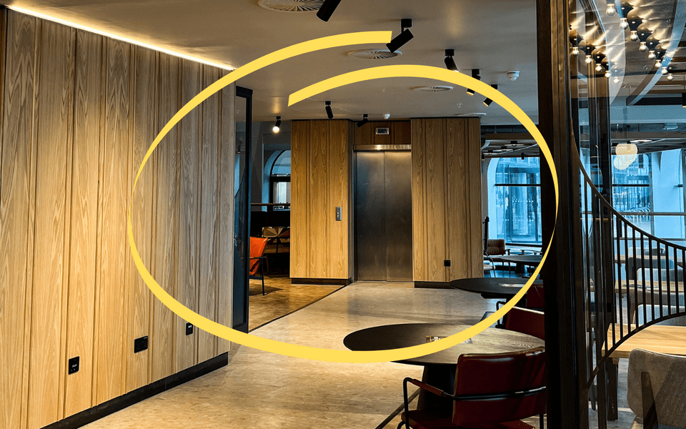
Conference 2026: Cafe lift
The photograph to the right shows the lift in the cafe.

Slide 12
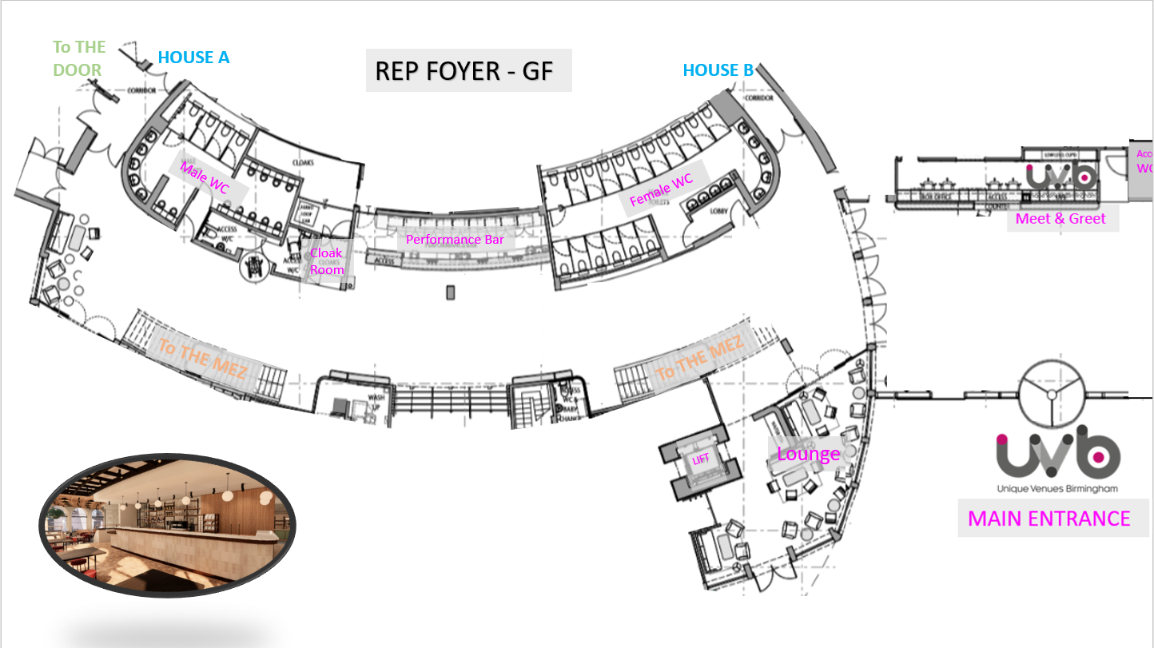
Conference 2026: Floor Plan (ground floor)
The photograph to the right is a floor plan of the ground floor of the Rep – this includes where toilets, lifts and stairs are located.

Slide 13
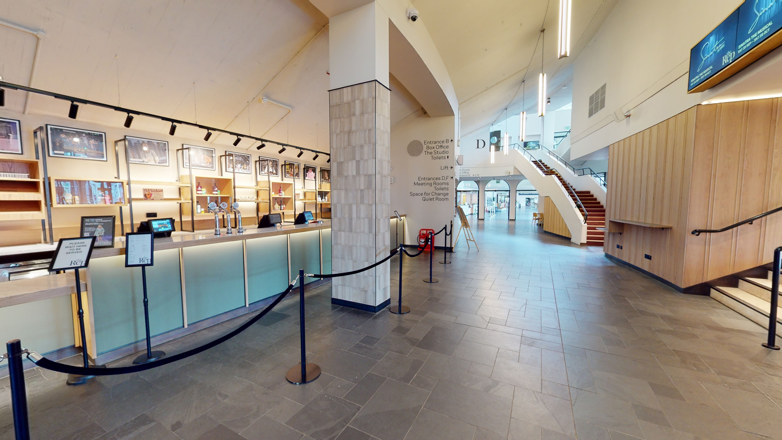
Conference 2026: The foyer (ground floor)
The Rep Foyer runs from the Reception all the way along the building – from this area, you’ll be able to gain access to some of the session rooms as well as stairs or a lift to the cafe and mezzanine level.
The photograph to the right includes a bar area which is where lunch will be served

Slide 14
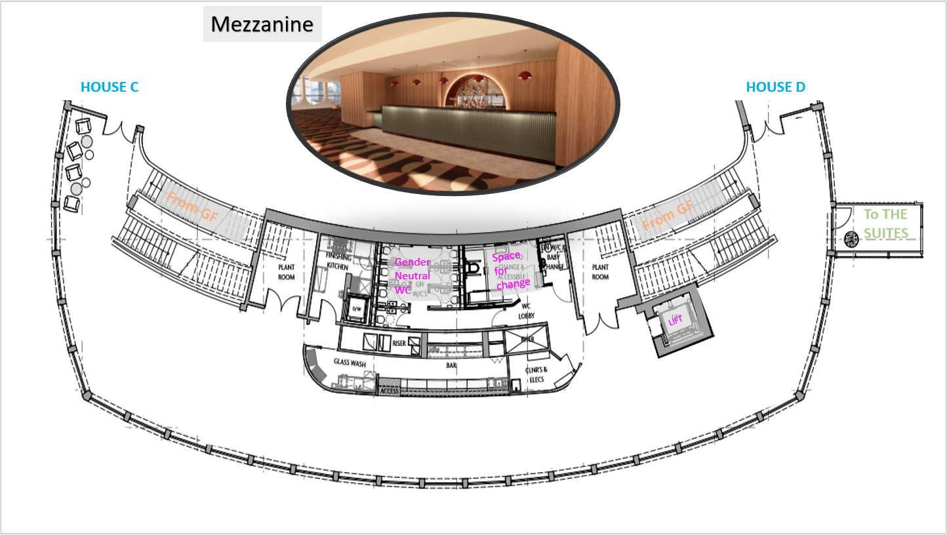
Conference 2026: Floor plan (mezzanine level 1)
The photograph to the right is a floor plan of the first floor of the Rep – known as the mezzanine. This is a walk-through area where we will have table-top displays from our sponsors as well as seating and networking spaces.

Slide 15
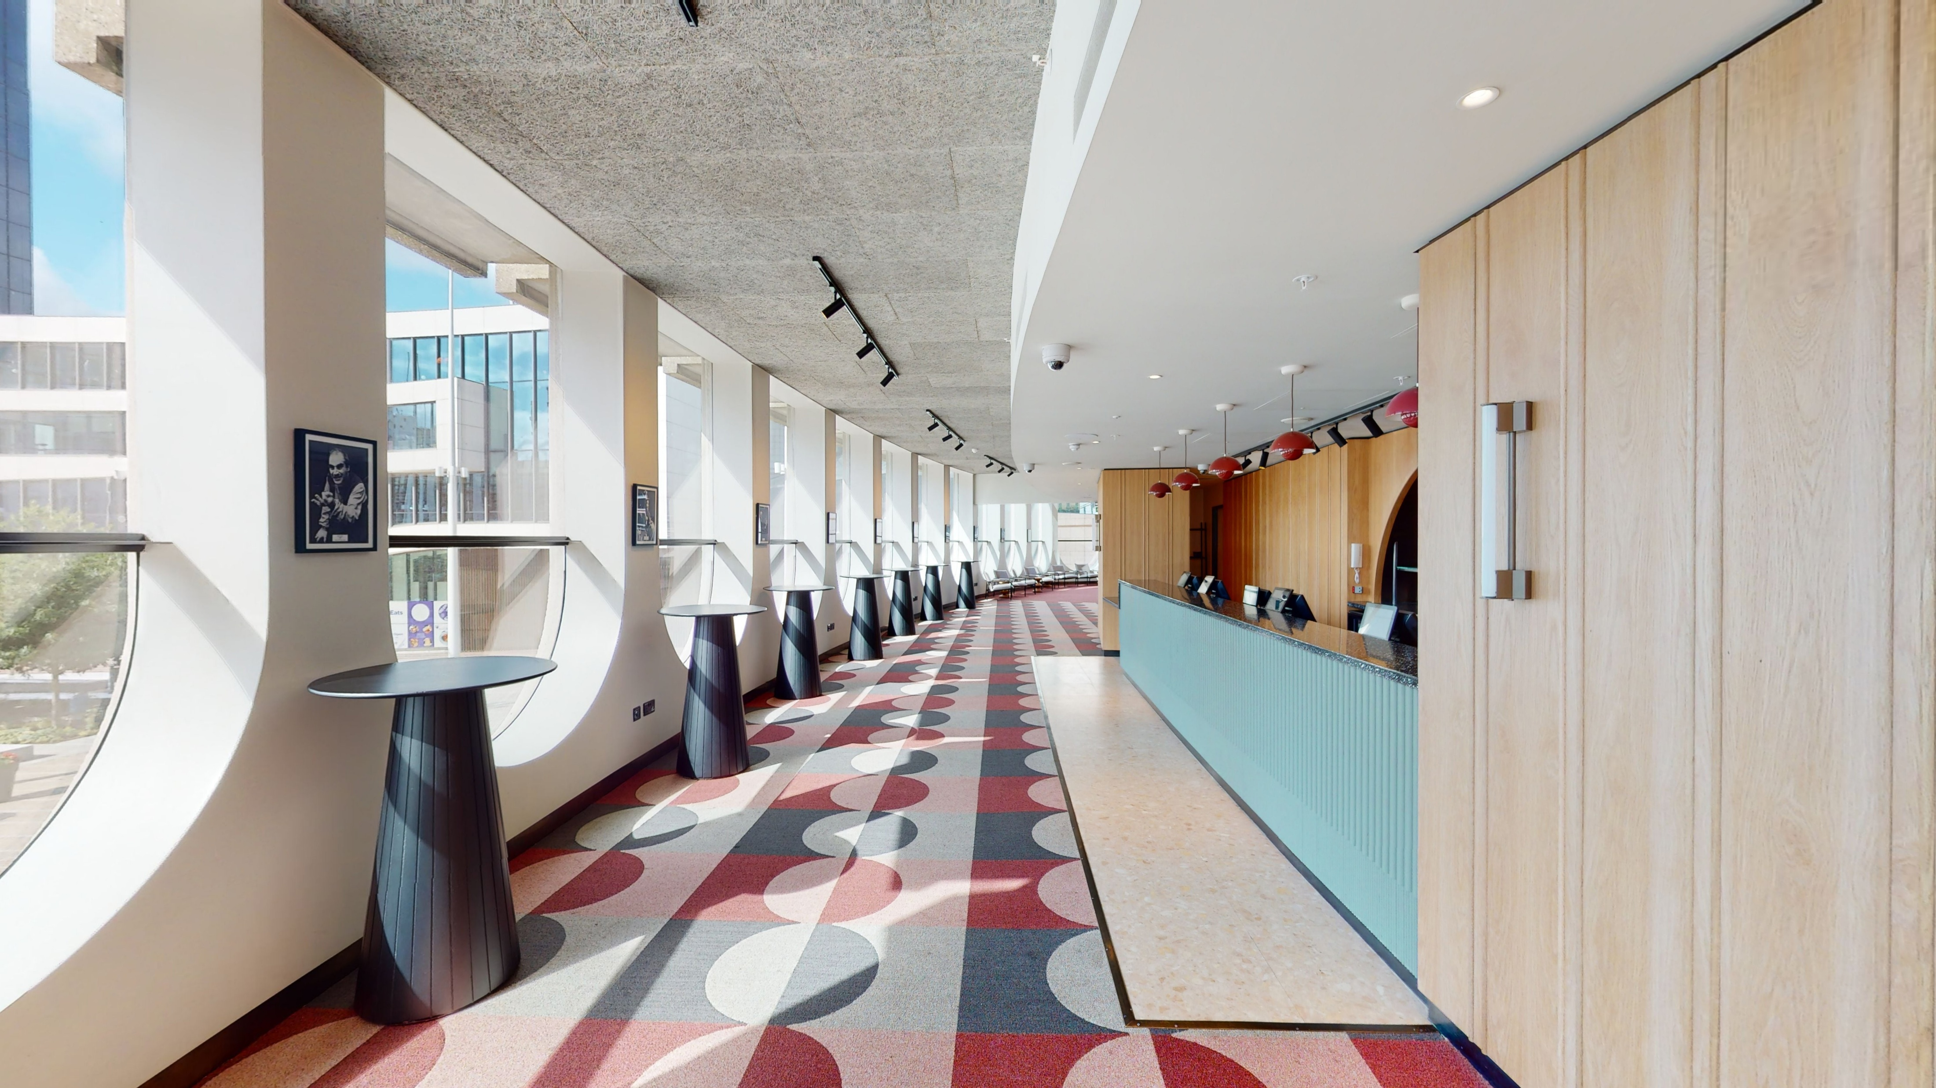
Conference 2026: Mezzanine (level 1)
On the first floor, there is a light-filled mezzanine – it runs above the cafe area.
We will have our tabletop displays from sponsors in this area as well as tables for networking.
This area can be accessed via two staircases from ground level or a lift.

Slide 16
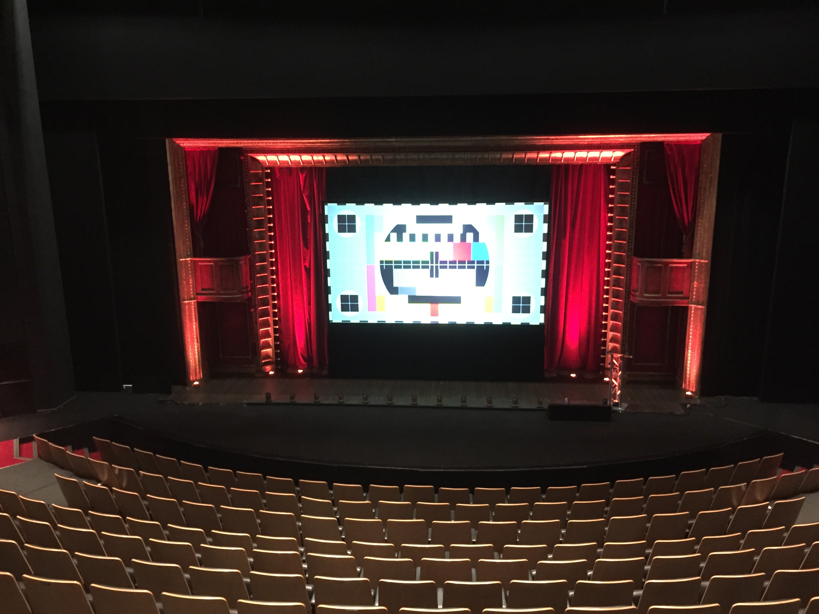
Conference 2026: Guide to the session rooms at The Rep (the House)
The House is the Rep's main theatre – it seats up to 820 in tiered, fixed theatre-style seating.
There is a dedicated seating areas for about five wheelchair users on Row D close to the stage, and priority seating at the end of rows for whoever requires these.
Please note this space is tiered – staff will be hand to support your access to the room if required.
Sessions in this room will include AI captions, and will also be streamed for online delegates and recorded.

Slide 17
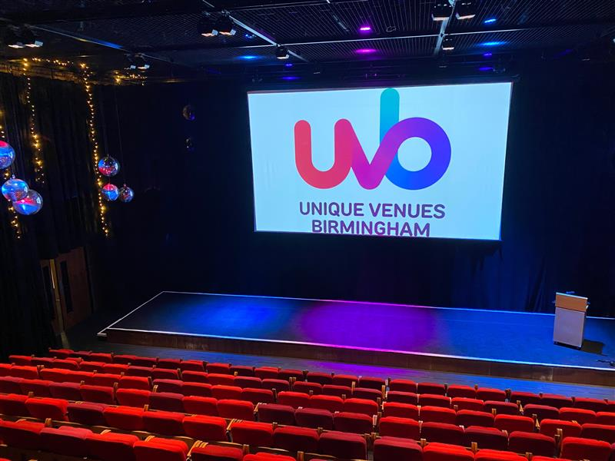
Conference 2026: Guide to the session rooms at The Rep (the Studio)
The Studio is another large session room – it seats 290 guests in tiered, fixed theatre-style seating.
There will be dedicated seating areas for about 10 wheelchair users at the front of the space, and priority seating at the end of rows for whoever requires it.
Sessions in this room will include AI captions, and will also be streamed for online delegates and recorded.

Slide 18
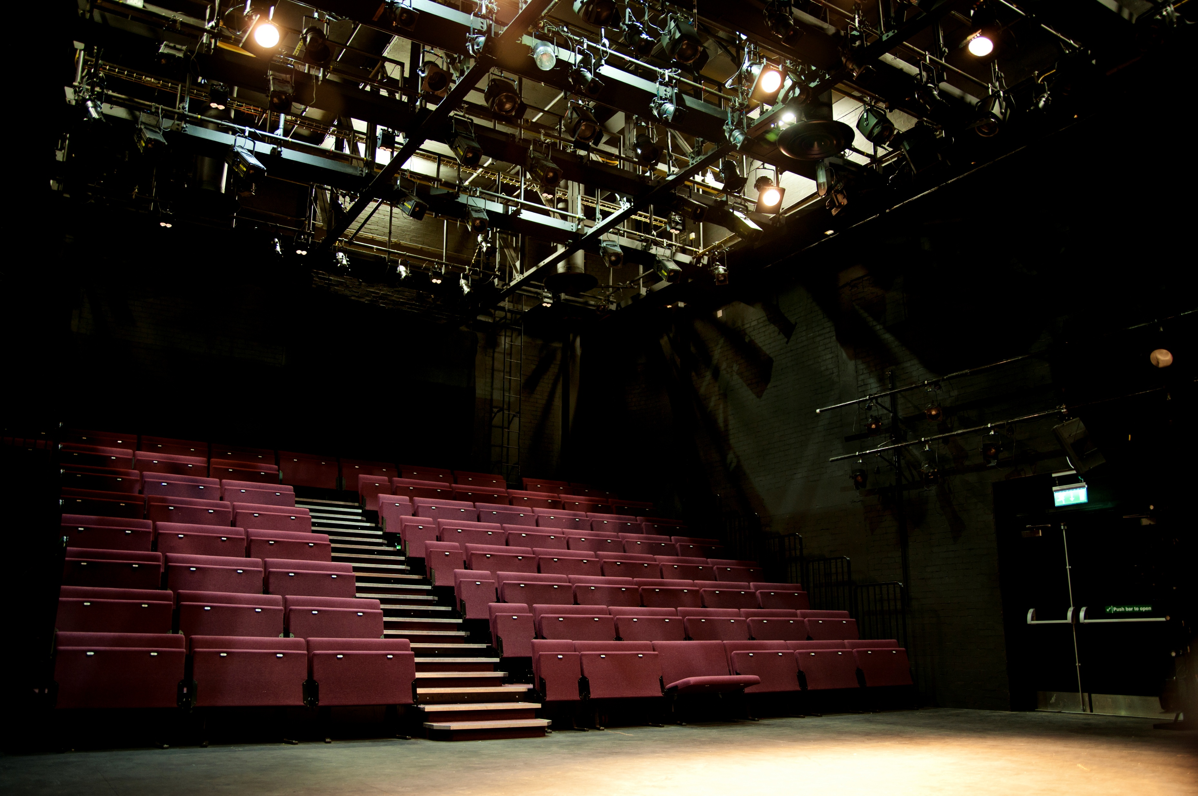
Conference 2026: Guide to the session rooms at The Rep (the Door)
The Door is a large session room – it seats 140 guests in tiered, fixed theatre-style seating.
There will be dedicated seating areas for about 10 wheelchair users at the front of the space. There will also be priority seating at the end of rows for whoever requires it.
Sessions in this room will include AI captions.

Slide 19
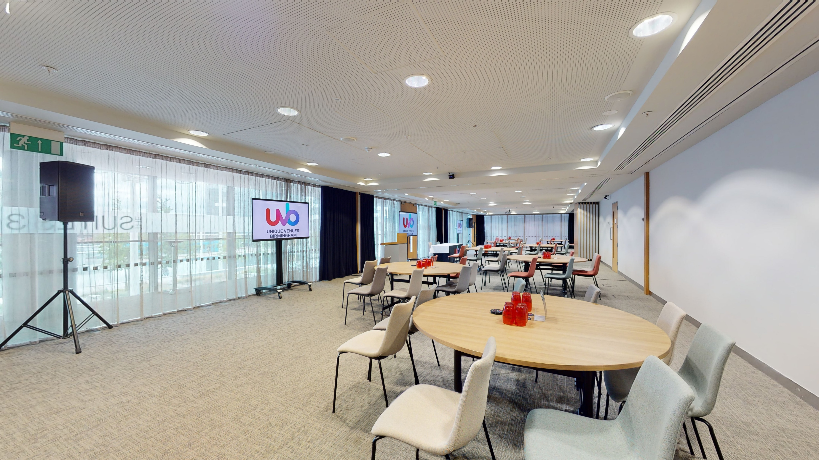
Conference 2026: Guide to the session rooms at The Rep (Meeting Room 1-3)
Meeting Rooms 1-3 will be combined to create a large workshop space with roundtable seating for 140 people.
Wheelchair users are invited to sit wherever they want (there will also be some dedicated space closest to the doors).
Sessions in this room will include AI captions.

Slide 20
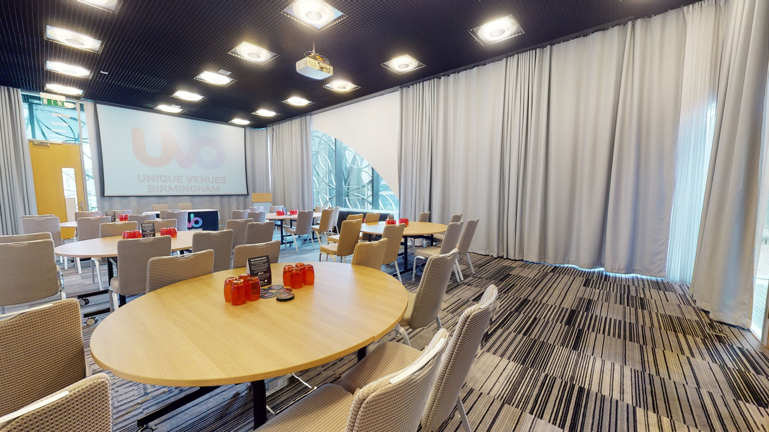
Conference 2026: Guide to the session rooms at The Rep (LOB 101)
Library of Birmingham (LOB) 101 is a meeting room that will be used for concurrent sessions. It seats 120 in theatre layout.
It is accessible via the stairs off the Rep Reception – there is also a lift in the reception that can be used.
Wheelchair users are invited to sit wherever they like, with some priority seating at the tables closest to the doors.
Sessions in this room will include AI captions.

Slide 21
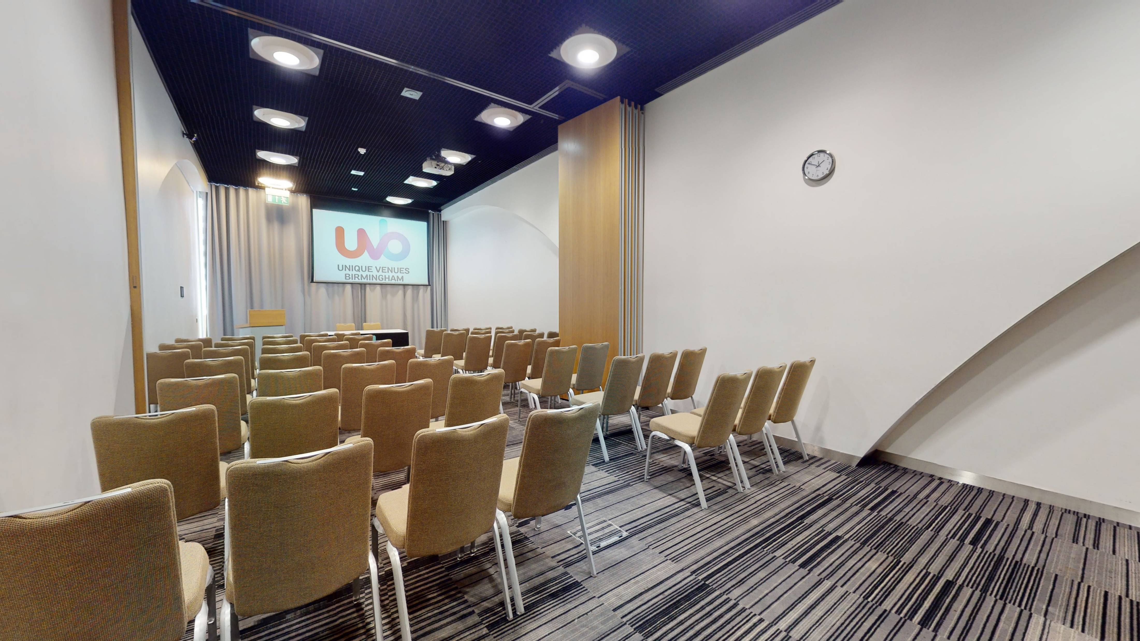
Conference 2026: Guide to the session rooms at The Rep (LOB 103)
Library of Birmingham (LOB) 103 is a meeting room that will be used for training sessions. It seats 70 in theatre layout.
It is accessible via the stairs off the Rep Reception – there is also a lift in the reception that can be used.
Wheelchair users are invited to sit wherever they like, with some priority seating at the tables closest to the doors.
Sessions in this room will include AI captions.

Slide 22
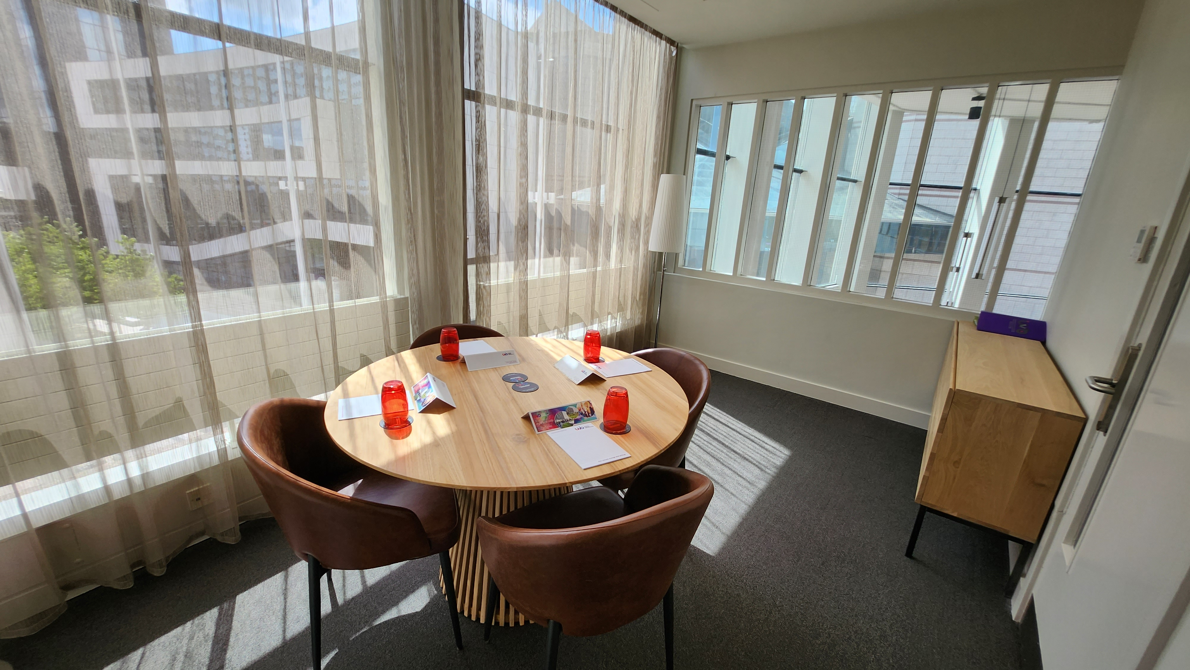
Conference 2026: Guide to other rooms at The Rep (Quiet Room)
Front-of-house (FOH) 1 is a dedicated quiet room. It is light and includes seating and we will provide some fidget toys and colouring sheets.
Please do not use this space for conversations with others or phone calls. If you use electronic equipment, please ensure the volume is turned off or use headphones with the volume turned down to ensure you don’t disturb others.
It is located on the upper mezzanine level – two floors above the cafe – and is accessible via stairs or a lift.

Slide 23
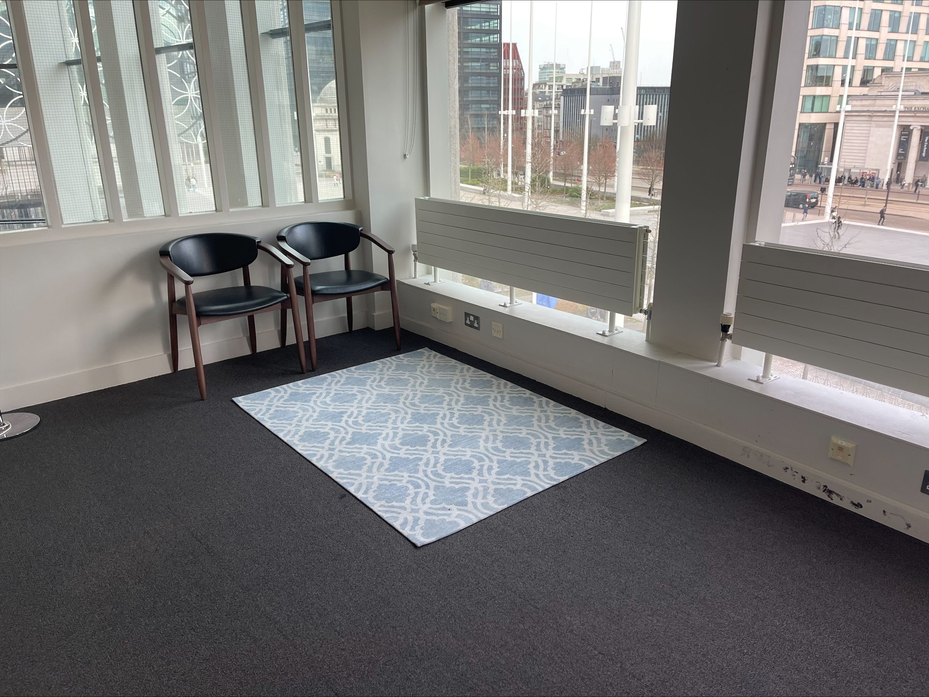
Conference 2026: Guide to other rooms at The Rep (Prayer Room)
The Rep has a dedicated for individuals to engage in prayer, reflection or quiet contemplation.
It is located on the upper mezzanine level – two floors above the cafe – and is accessible via stairs or a lift.

Slide 24
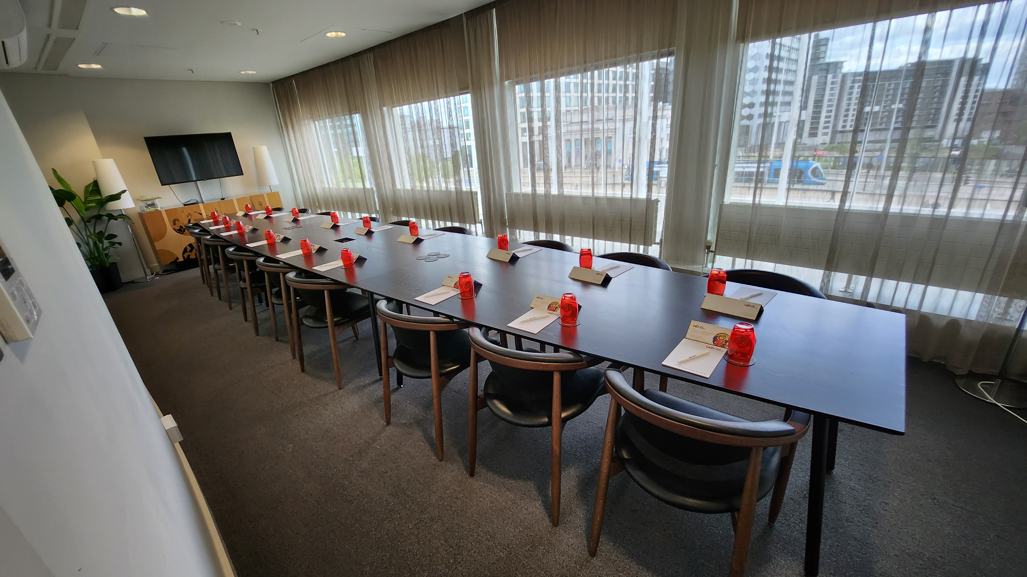
Conference 2026: Guide to other rooms at The Rep (Speaker preview room)
The speaker preview room is located in the Winteringham Room on the upper mezzanine level – two floors above the cafe – and is accessible via stairs or a lift.
Speakers at Conference can use this to access or check their slides, and speak to venue technicians.

Slide 25
Conference 2026: overview of social events
Your in-person ticket includes attending our social events on the day/s selected.
Monday 4 November | Opening party at Thinktank Birmingham Science Museum (1800-2000)
Tuesday 5 November | Main party at Birmingham Museum & Art Gallery (1830-2000)
Wednesday 6 November | Closing party at The Exchange (1815-2000)

Slide 26
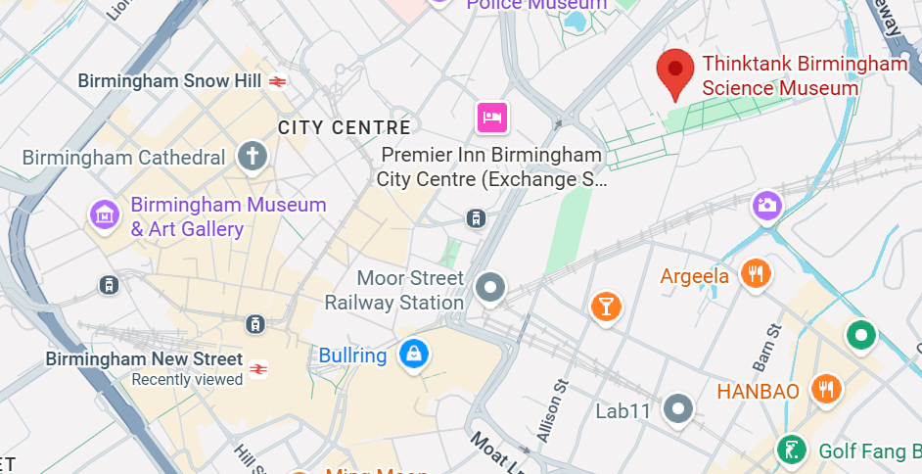
Conference 2026: Monday 2 November | Opening party at Thinktank (travel information)
Thinktank is located at Millennium Point, B4 7XG
It is approximately a 15-minute walk from central Birmingham New Street station – use Google Maps to plot your route
The closest car park is Millennium Point car park (Sat Nav postcode B4 7AP). Blue Badge parking is free.
You can catch buses or the tram from Birmingham city centre to Thinktank – see Thinktank’s website for detailed travel information.

Slide 27
Conference 2026: Monday 2 November | Opening party at Thinktank (venue accessibility)
The entrance to Thinktank is on the ground floor (level 0).
There are central lifts to all floors within Thinktank and Millennium Point as well as stairs.
The floor surface of the museum is smooth, plastic coated and non-slip. In some places there are carpet tiles.
There are accessible toilets on all levels. The adult changing facility on Level 1 includes a hydraulic changing table (no hoist).
Some parts of the museum have low-lighting including our Planetarium and Futures Gallery. Braille signs are used extensively around the museum.
Some area of have fixed hearing loops installed.
There is seating available in all areas.
There will be a quiet space on the 2nd floor (signposted) and a music free zone on Level 1 in the Curie classroom and on Level 3 in Minibrum.
You can download a floor plan of the museum or explore 360 degree tour
More access information is available on Thinktank’s website

Slide 28
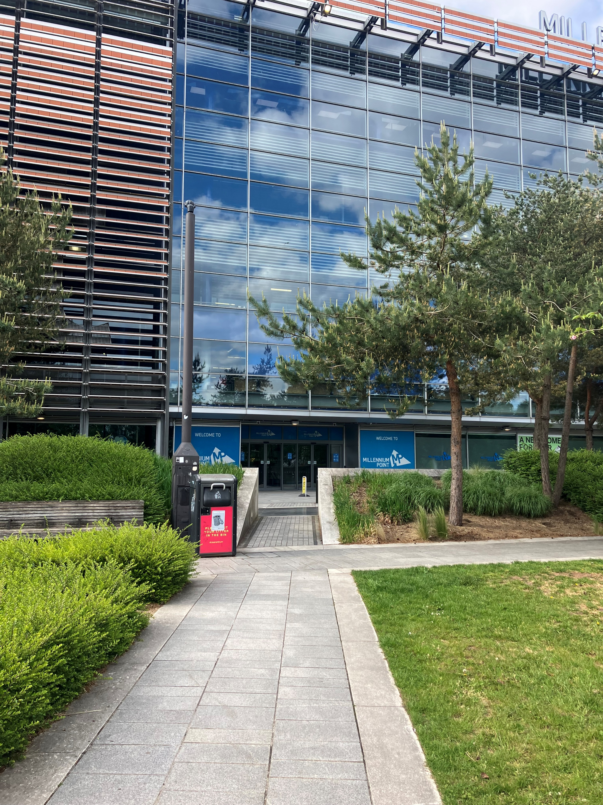
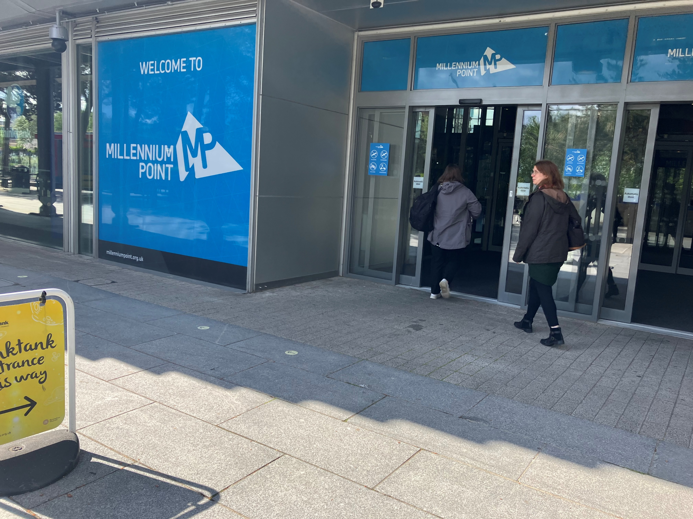
Conference 2026: Monday 2 November | Opening party at Thinktank (entrance photos)
Left: from Curzon Stret, cross the grassy area
(level pathway) to reach the entrance to Thinktank (via Millenium Point)
Right: Go through the
automatic doors to
enter the museum

Slide 29
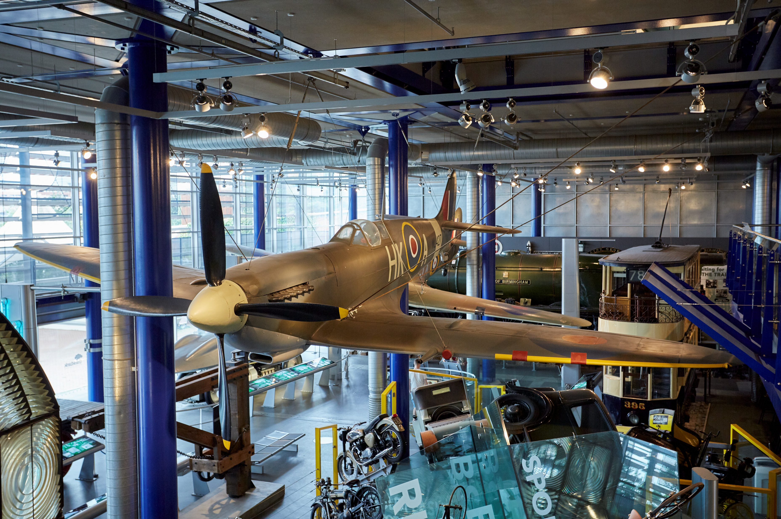
Conference 2026: Monday 2 November | Opening party at Thinktank (what to expect)
1800: Event begins with networking drinks on 2nd floor.
1830: Speech from Rachael Rogers, MA vice president
2000: Event ends
Thinktank’s galleries will remain open throughout the event. There will also be regular Planetarium shows.

Slide 30
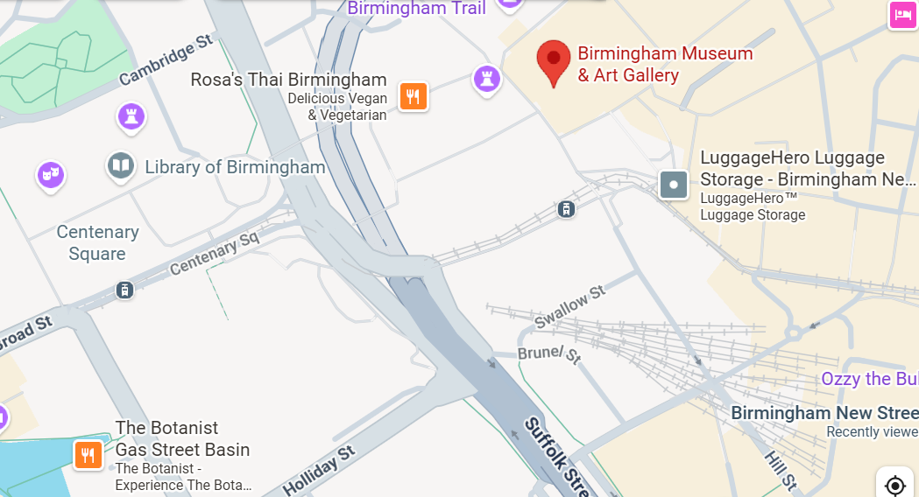
Conference 2026: Tuesday 3 November | Main party at Birmingham Museum & Art Gallery (travel information)
Birmingham Museum is located on Chamberlain Square, B3 3DH
It is approximately a 6-minute walk from the Rep – use Google Maps to plot your route
The main entrance on Chamberlain Square contains two flights of stairs. There is a lift entrance at the Gas Hall on Edmund Street.
See the museum website for detailed travel information.

Slide 31
Conference 2026: Tuesday 3 November | Main party at Birmingham Museum & Art Gallery (access information)
Please note that the main entrance on Chamberlain Square includes 10 external steps followed by an additional 42 steps to reach the galleries.
There lift entrance at the Gas Hall on Edmund Street which provides lift access to the main building and Gas Hall. The Lift door width is 43” or 109cm.
The museum is a historic building with smooth flooring, primarily consisting of Victorian tiles. The galleries are light, airy, and spacious.
The museum includes a dedicated accessible toilet at the back of the Gas Hall – the first entrance door is 80cm wide, the toilet door is 91cm wide, and the toilet space measures is 150cm wide and 202cm in length.
This is also an accessible toilet is near the Edmund Street lift entrance.
There is seating throughout the museum.
A quiet room is available upstairs from main galleries in a draped-off space, with the Wild City Galleries a music-free zone. You can download a floor plan of the museum or its social story (aimed at school groups)
More access information is available on Birmingham Museum & Art Gallery's website

Slide 32
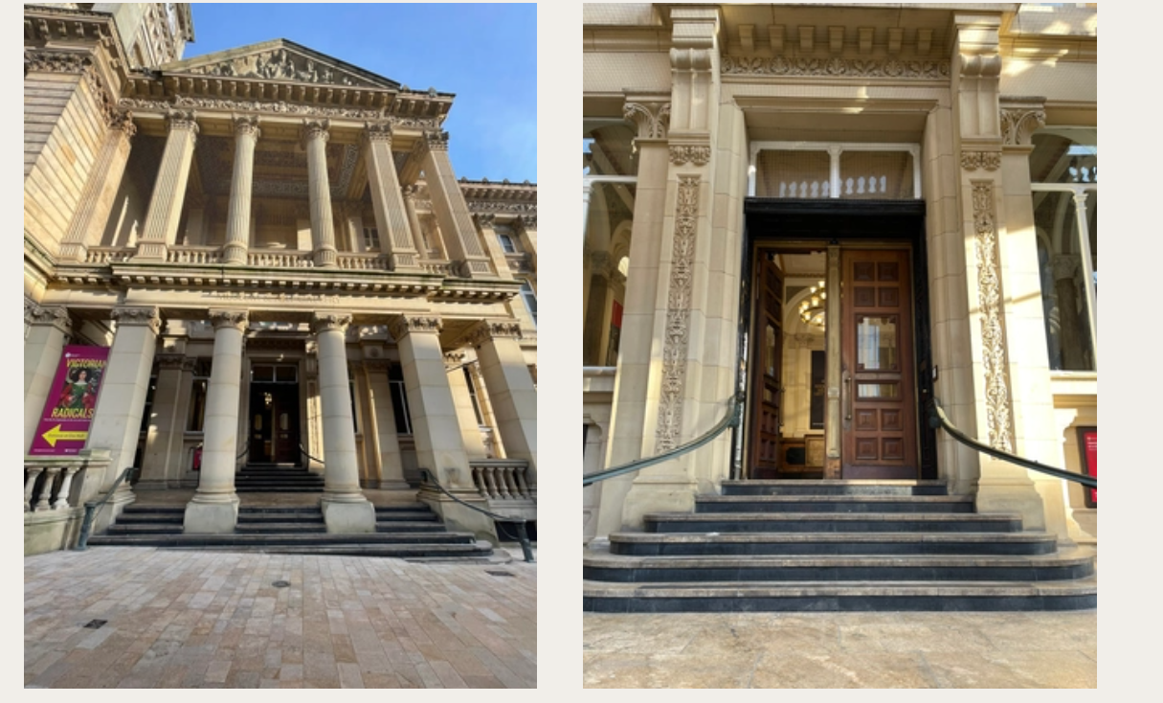
Conference 2026: Tuesday 3 November | Main party at Birmingham Museum & Art Gallery (entrance photos)
The two photos to the right show the external view of the museum from the main entrance on Chamberlain Street – there are 10 stone steps from the flat pavement area and historical wooden doors (non-automatic)

Slide 33
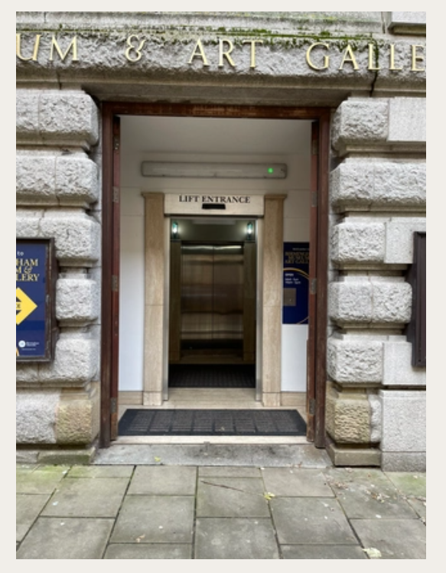
Conference 2026: Tuesday 3 November | Main party at Birmingham Museum & Art Gallery (entrance photos – lift access)
There lift entrance at the Gas Hall on Edmund Street which provides lift access to the main building and Gas Hall. The Lift door width is 43” or 109cm.

Slide 34
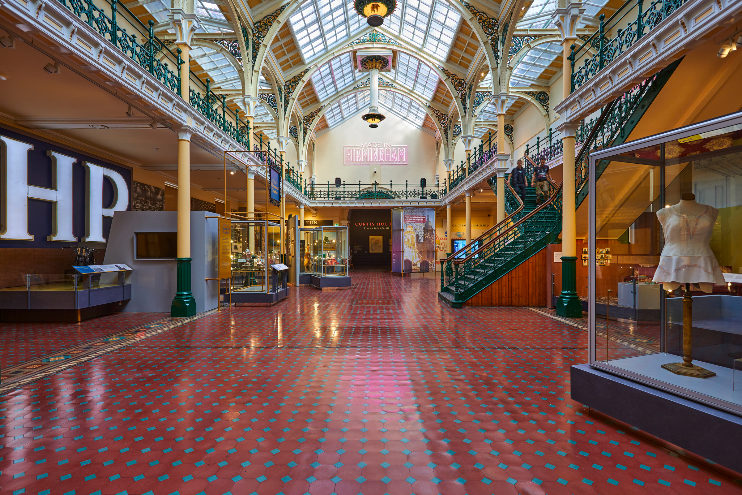
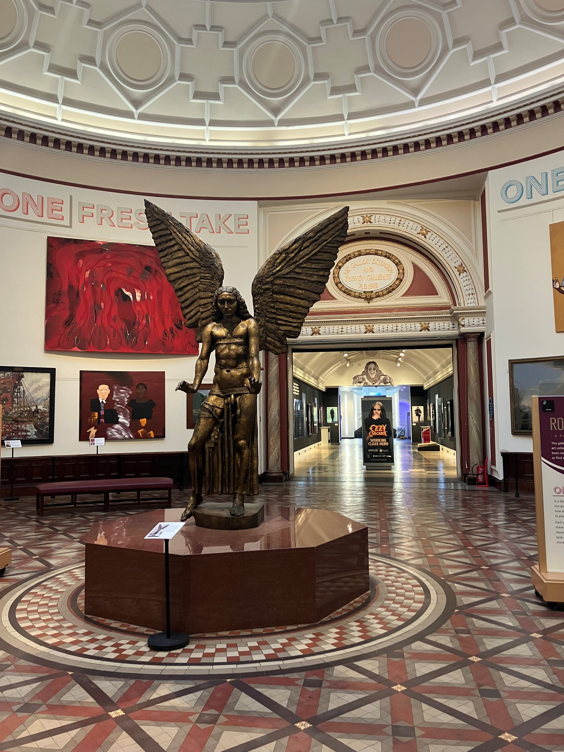
Conference 2026: Tuesday 3 November | Main party at Birmingham Museum & Art Gallery (gallery photos)
Left: The Industrial Gallery on Level 2
Right: The Round
Room on Level 2

Slide 35
Conference 2026: Tuesday 3 November | Main party at Birmingham Museum & Art Gallery (what to expect)
1830: Event starts, welcome drinks from bar areas
1900: Speeches in the Industrial Gallery
1930: Chill DJ in the Industrial Gallery
2030: Event ends
Please note all the museum’s galleries will be open to delegates throughout the event. There will also be drop-in curator tours of: the Pre-Raphaelite collection; Joe Lycett’s Everything Must Go exhibition; Elephant in the Room gallery; and the Staffordshire Hoard gallery.

Slide 36
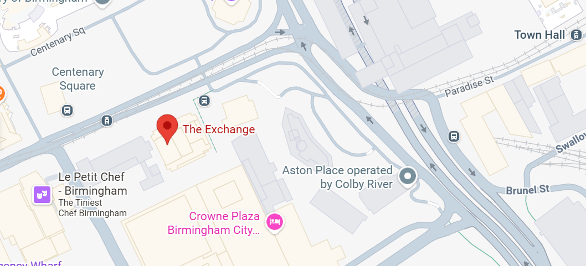
Conference 2026: Wednesday 4 November | Closing party at The Exchange(travel information)
The Exchange is located at 3 Centenary Square, B1 2DR, directly opposite the Rep – it’s approximately a one-minute walk and involves crossing a road.
From the Exchange, it’s about an 11-minute walk to Birmingham New Street.
Use Google Maps to plot your route

Slide 37
Conference 2026: Wednesday 4 November | Closing party at The Exchange(access information)
There is ramped/sloped and stepped access at the building entrance.
Once inside, the area is level with lift and stair access to all floors.
There are accessible toilets on all floors, as well as a Changing Places toilet on the basement level.
A designated quiet space will be available (location TBC) and a music-free zone will be located in the south entrance at the back of the main events space. Seating will be available in both spaces.
Please note the Changing Places toilet has a radar key
There is detailed accessibility information about the building on AccessAble

Slide 38
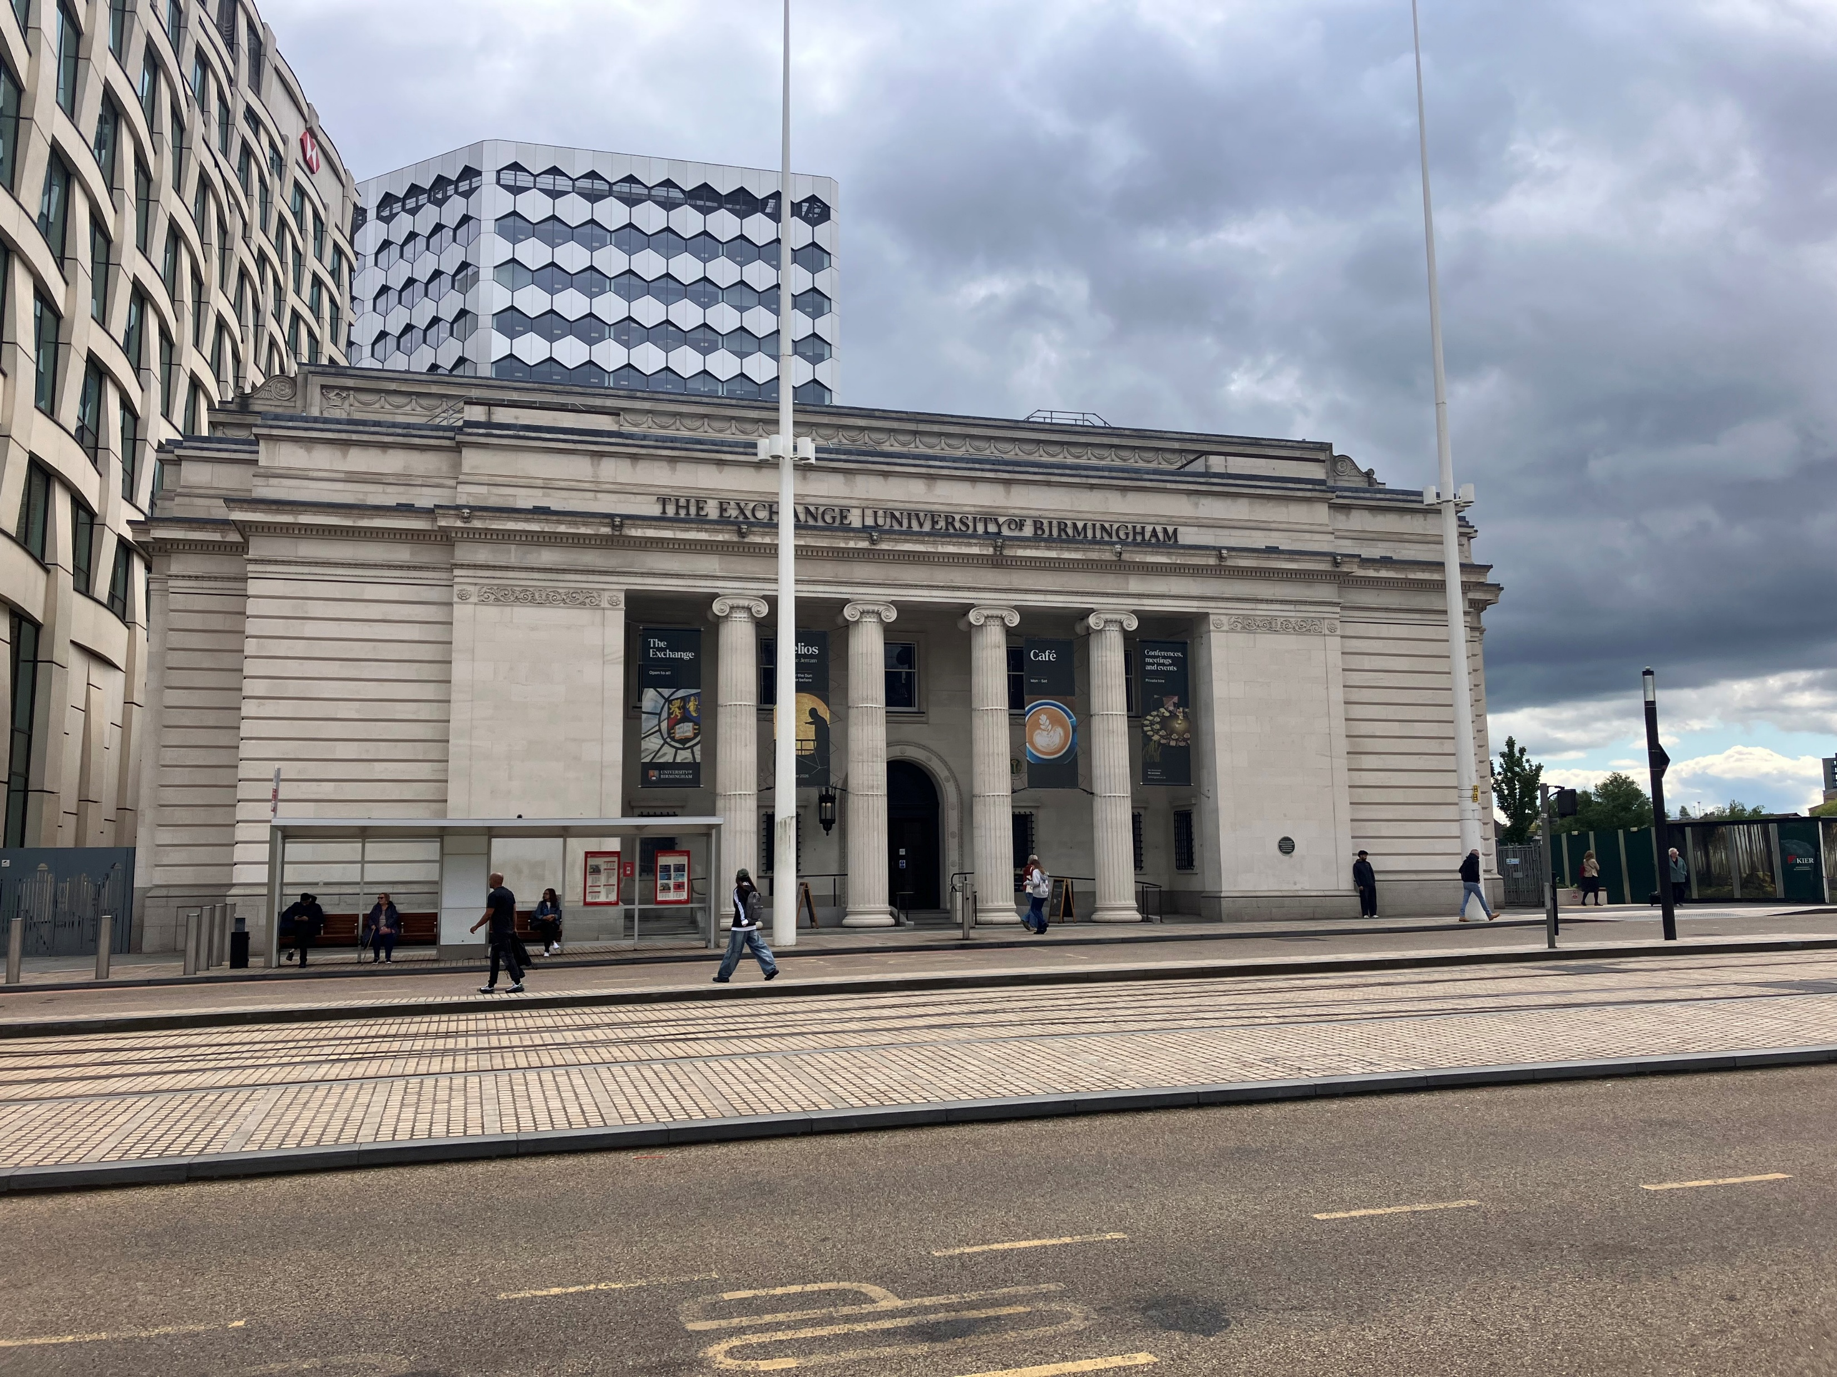
Conference 2026: Wednesday 4 November | Closing party at The Exchange (entrance photos)
External view of the Exchange from the main road / Centenary Square

Slide 39
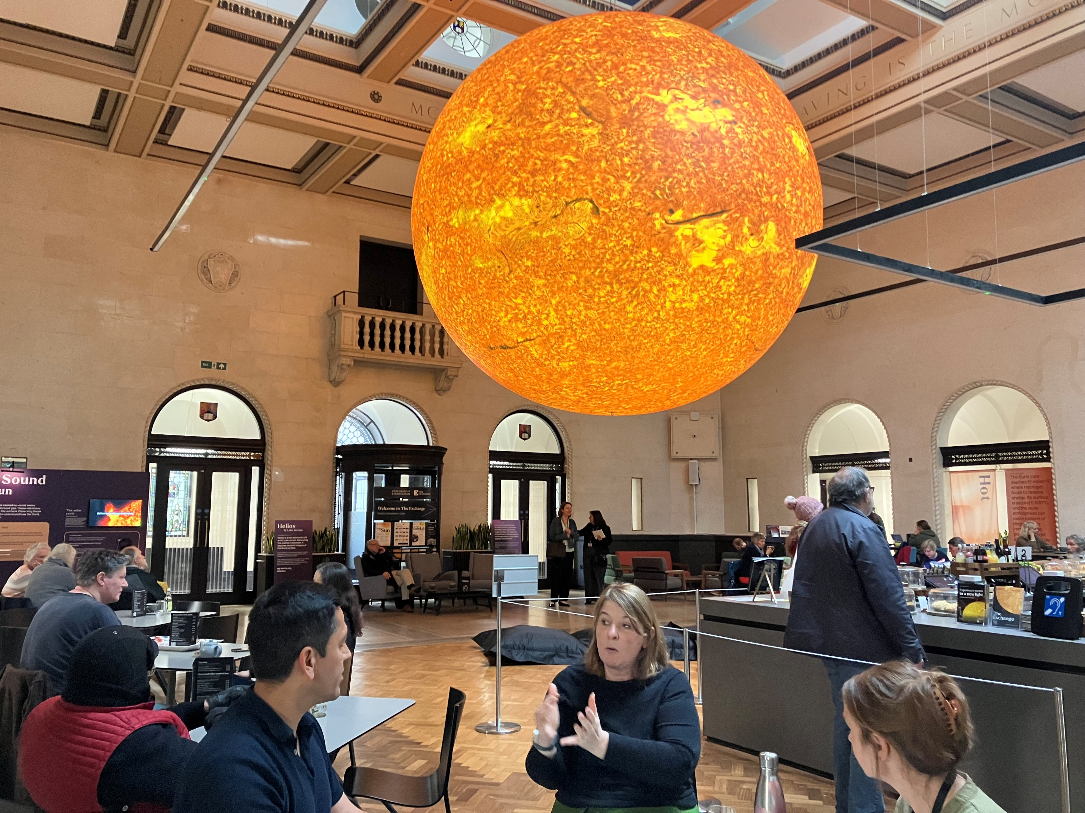
Conference 2026: Wednesday 4 November | Closing party at The Exchange (internal photos)
Once inside, the Exchange is a large square space - Luke Jerram’s artwork Helios (illuminated sculpture of the sun) will be hanging from the ceiling

Slide 40
Conference 2026: Wednesday 4 November | Closing party at The Exchange (what to expect)
1815: Party starts, background music in main space, drinks served
1845: Speeches from Sharon Heal, director of the Museums Association and Cassie Chadderton, director of culture, collections and public engagement at the University of Birmingham
1900 and 1930: Two drop-in tours of Banking Vault
2000: Event ends

