Slide 1

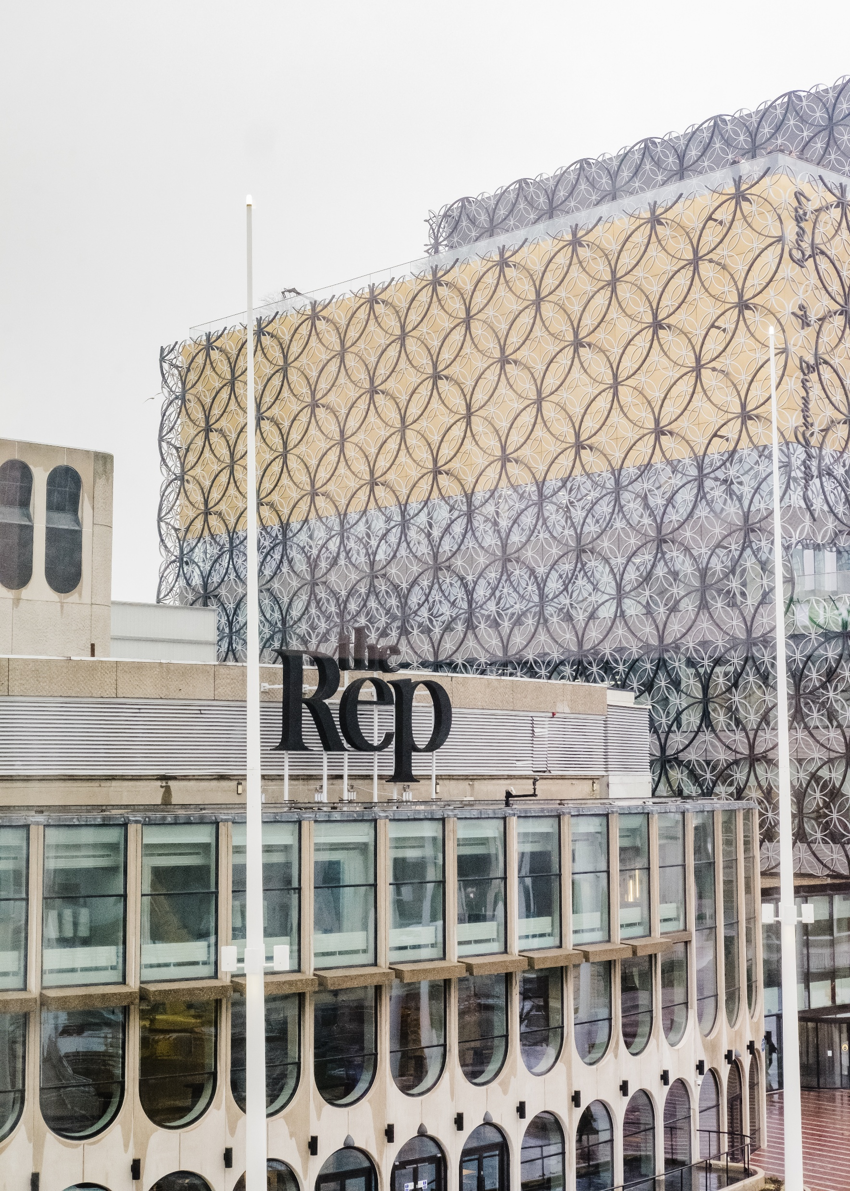
Visual Guide to Conference 2026: Museums Connecting Communities
2-4 November 2026
The Rep, Birmingham, and online

Slide 2
This visual guide will…
Provide you with more information about the Rep in Birmingham, where Conference 2026 takes place
Provide images and practical information about specific rooms and spaces at the Rep
Provide you with information, including photographs, of social events taking place during Conference
Provide you with information, including photographs, of the museum tours taking place during Conference (coming soon)

Slide 3
Conference 2026: At a glance…
Optional museum tours across Birmingham on Monday 2 November – venues to be confirmed in due course. Attendance is included in the cost of your in-person ticket.
Social events taking place in Birmingham city centre (venues to be confirmed) on the evenings of Monday 2, Tuesday 3 and Wednesday 4 November. Admission to all three social events is included in all in-person tickets.
Conference sessions on Tuesday 3 and Wednesday 4 November at the Rep in Birmingham.

Slide 4
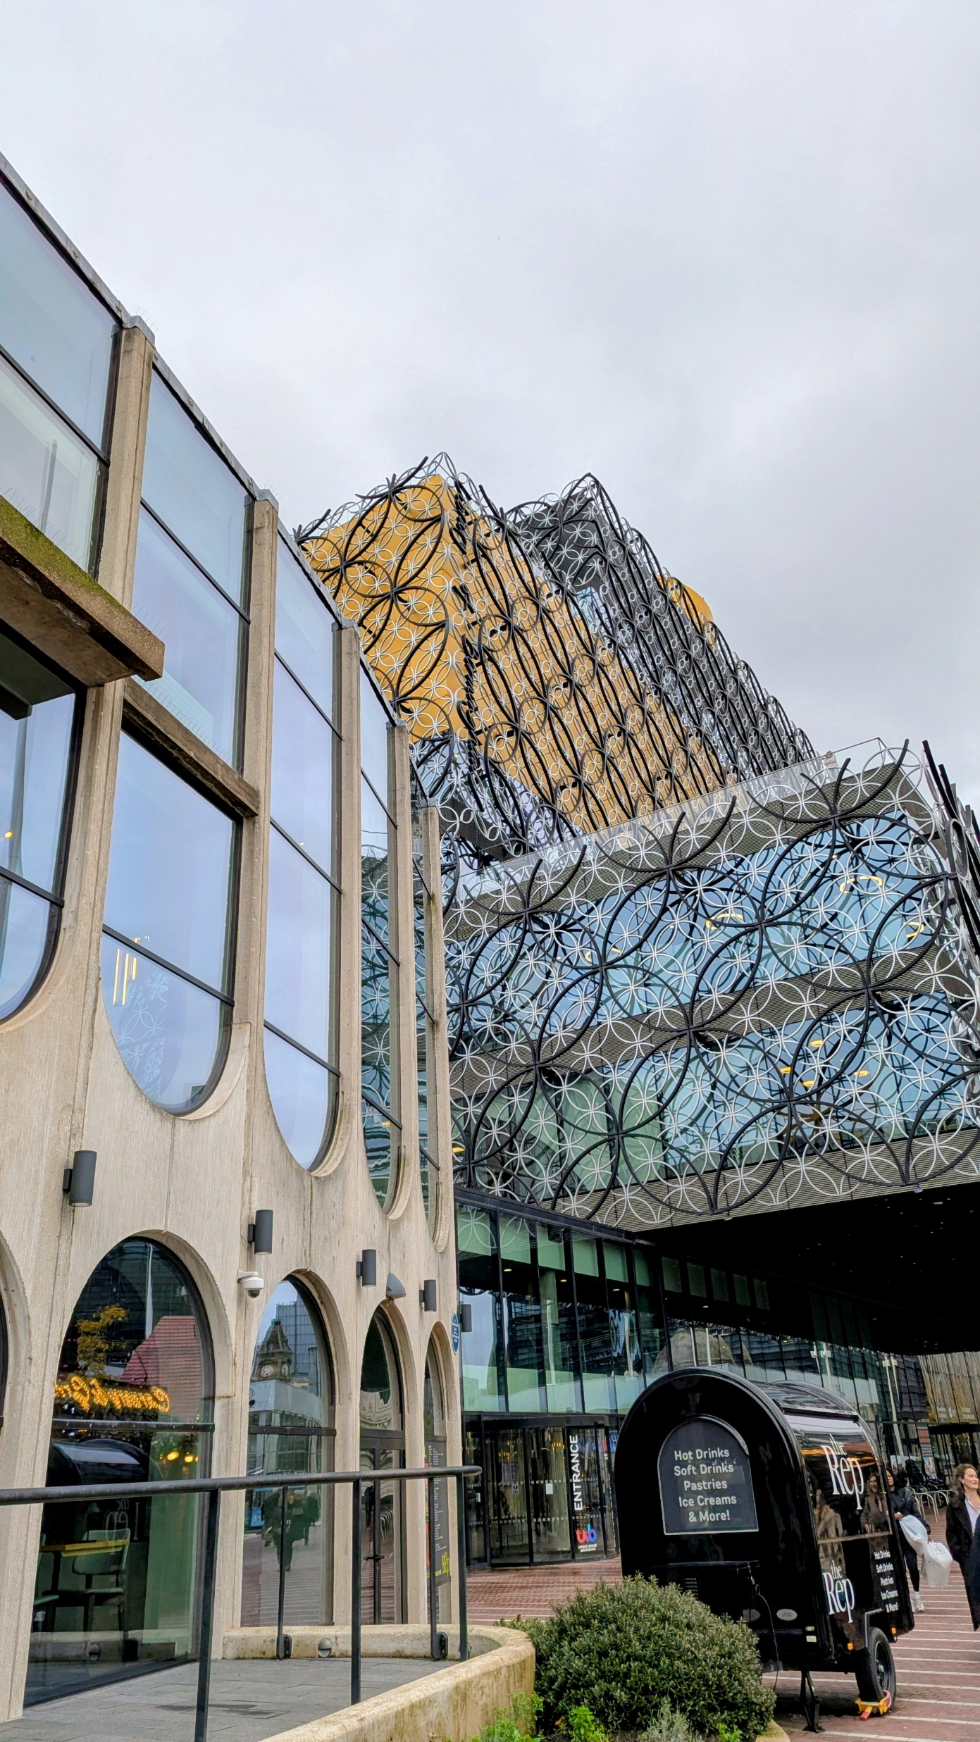
Conference 2026: The Rep
The Rep is a theatre located at 6 Centenary Square in Birmingham city centre (see map on next slide).
It is attached to the Library of Birmingham and next door to the ICC and Symphony Hall.
The Museums Association has exclusive use of the venue throughout Conference – this includes three large theatres as well as large meeting rooms and networking spaces.
Please be aware that there is a Christmas market directly outside the venue (from 1 November 2026). This may mean the square will be busier than usual at peak times.

Slide 5
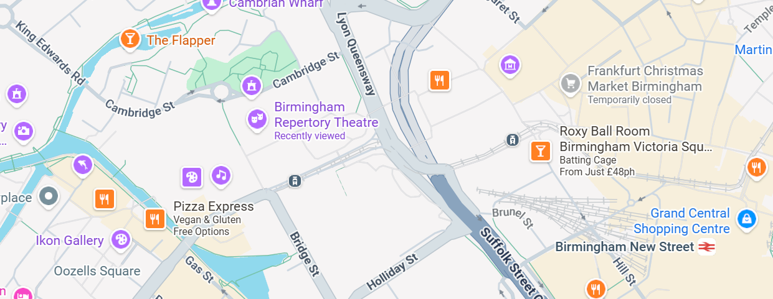
Conference 2026: Google Map of the Rep
Click here to see the Rep on Google Maps

Slide 6
Conference 2026: Guide to the entrances at the rep
There are two entrances – both on Centenary Square
One has level access and will take you directly into the Foyer
The other is ramped access and will take you directly into the cafe – please note that the cafe is split level with steps and a lift available
All doors are automatic

Slide 7
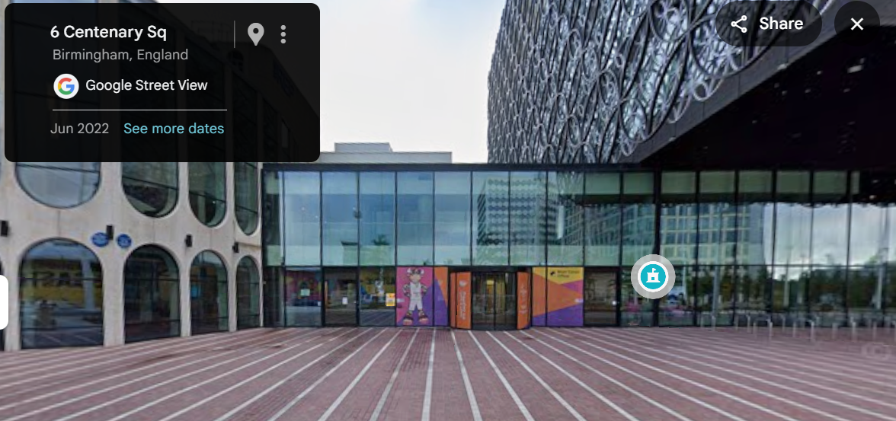


Conference 2026: Reception Entrance to the rep (level access)
We recommend all delegates enter the building via the level entrance at the front of the building on Centenary Square.
The photograph to the right (from Google Street View) shows two yellow circles around an automatic door (left) and a semi-circular automatic sliding door (right) – both doors open into the Rep Reception where the MA helpdesk and cloakroom will be located. The bottom photograph shows

Slide 8
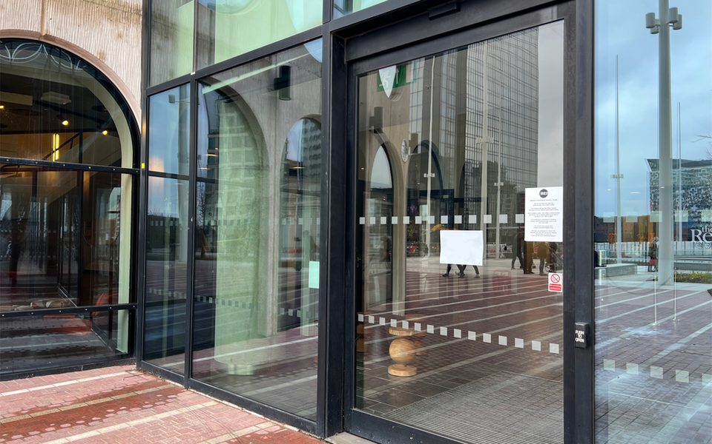
Conference 2026: Reception Entrance to the rep (level access)
The photograph to the right is a detailed shot of the level entrance door

Slide 9
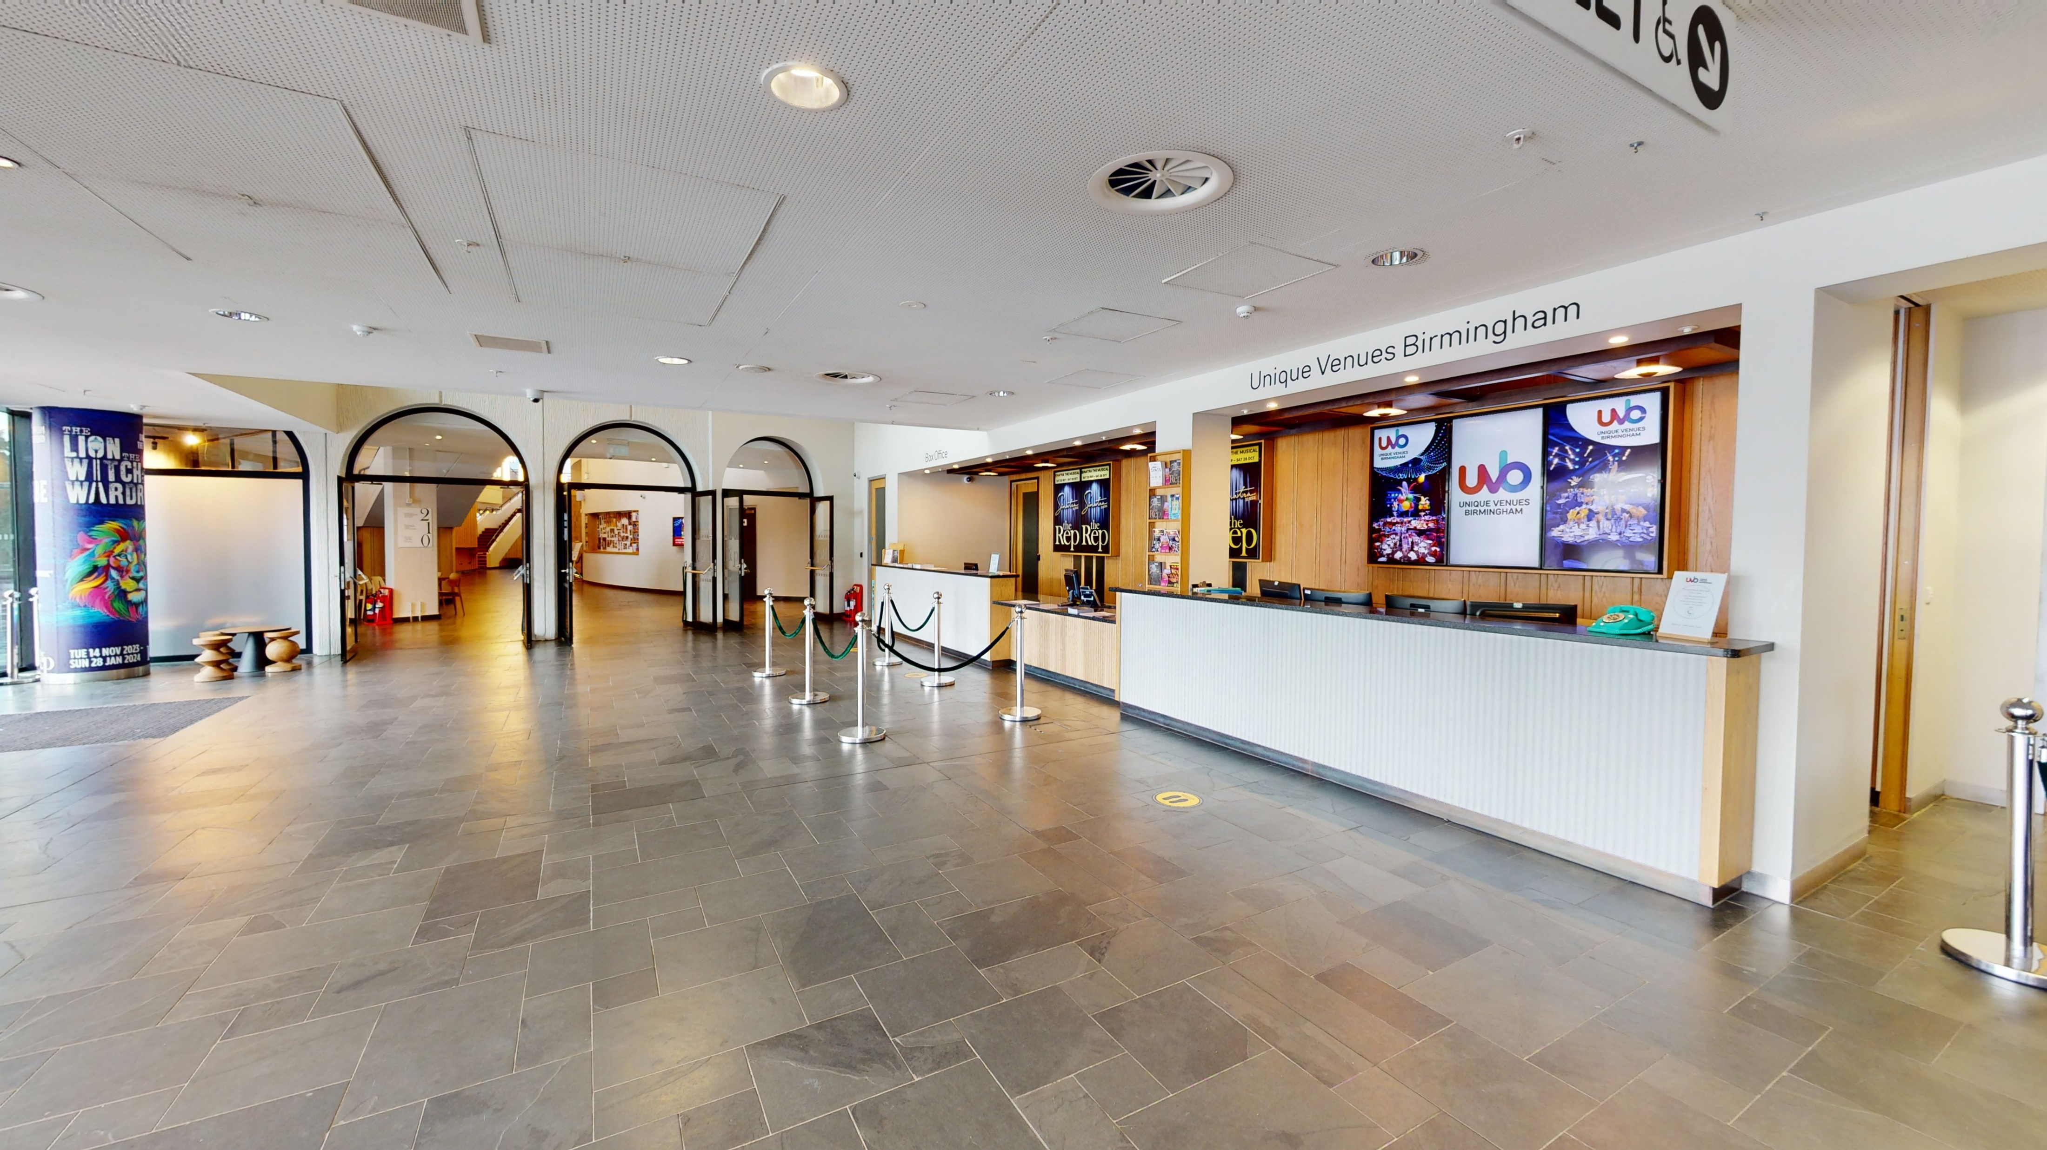
Conference 2026: Rep Reception (level access)
The photograph to the right shows the reception area of the Rep – this is where you’ll find the MA helpdesk and cloakroom for bags

Slide 10
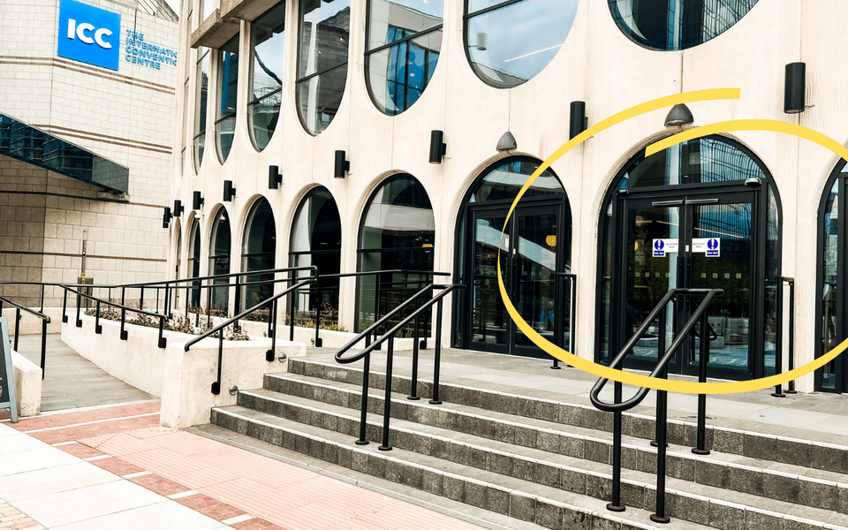
Conference 2026: Cafe Entrance to the rep (ramped access)
Delegates can also enter the building via a ramped entrance – this is also at the front of the building on Centenary Square.
The photograph to the right shows a yellow circle around an automatic door. A curved ramp is visible to the left (detailed photo on next slide)

Slide 11
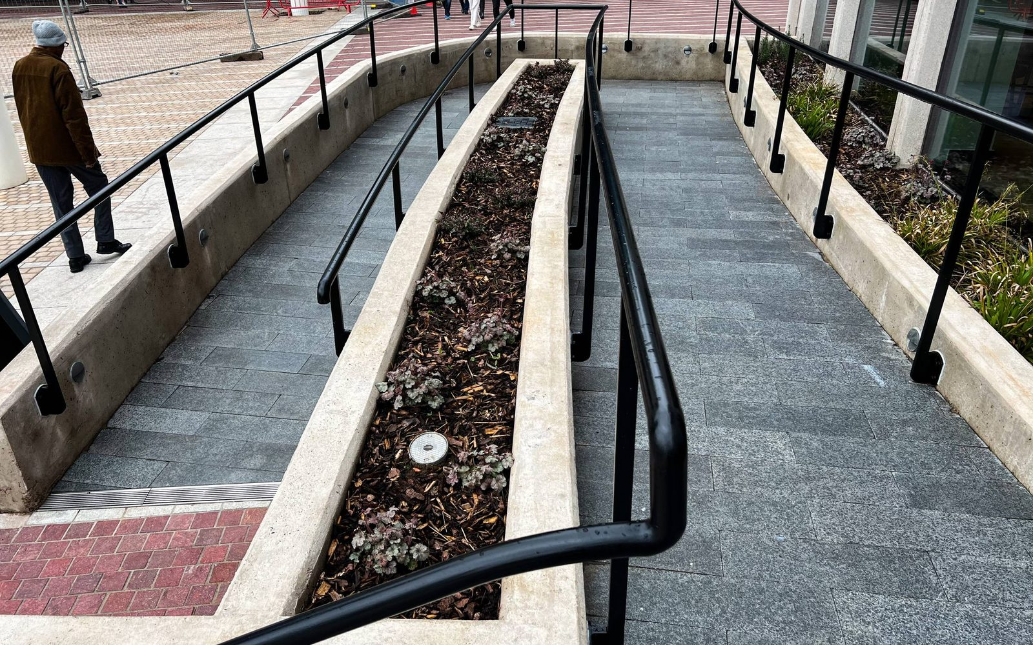
Conference 2026: Cafe Entrance to the rep (ramped access)
The photograph to the right shows the curved ramp in more detail.

Slide 12
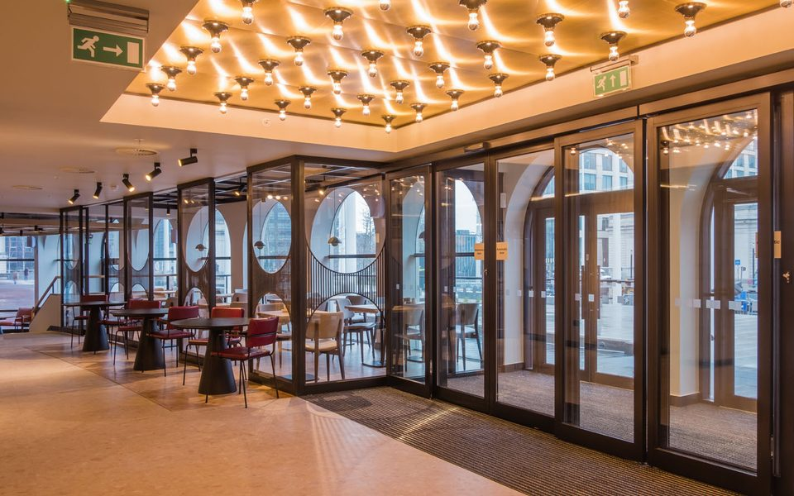
Conference 2026: Cafe (non-level area)
Once inside, you’ll be in the cafe area – this will be used throughout Conference for informal networking and catering
The cafe area is not completely level – however, a lift is available if people are unable to use the steps (see next slide)

Slide 13
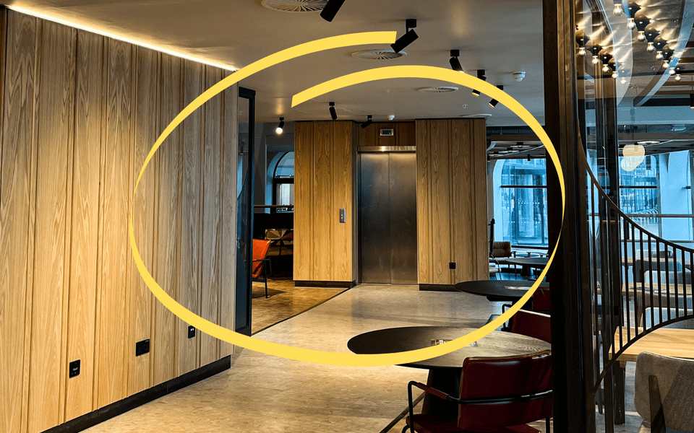
Conference 2026: Cafe lift
The photograph to the right shows the lift in the cafe.

Slide 14
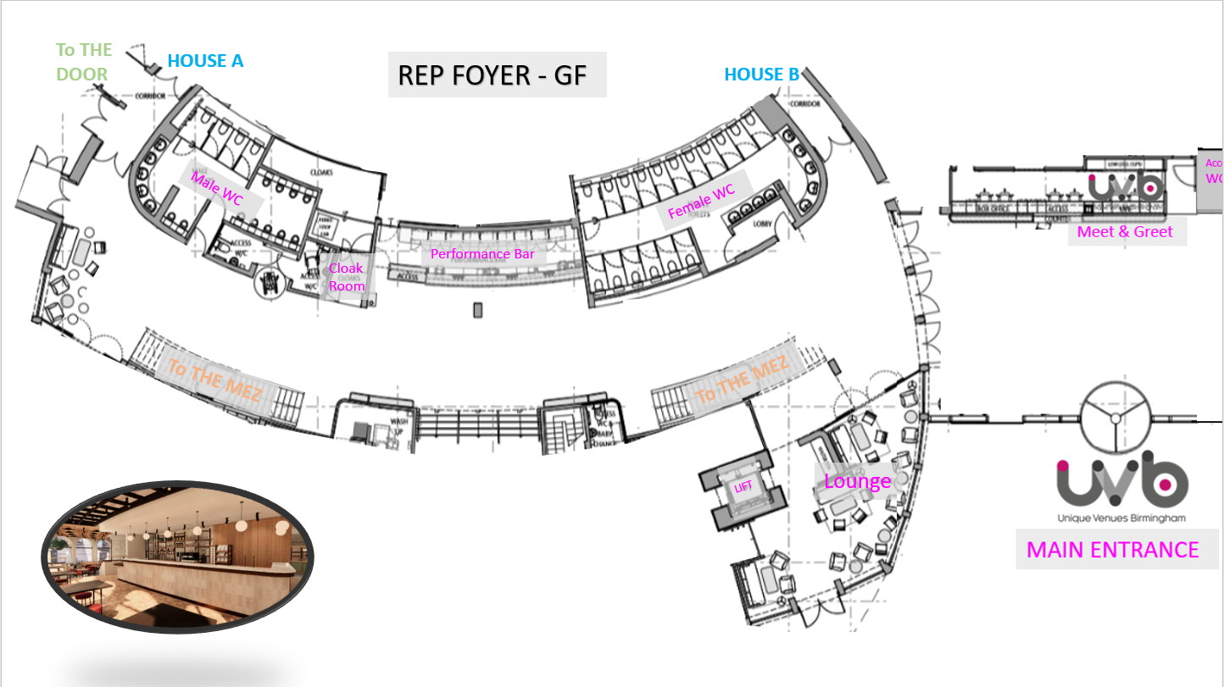
Conference 2026: Floor Plan (ground floor)
The photograph to the right is a floor plan of the ground floor of the Rep – this includes where toilets, lifts and stairs are located.

Slide 15
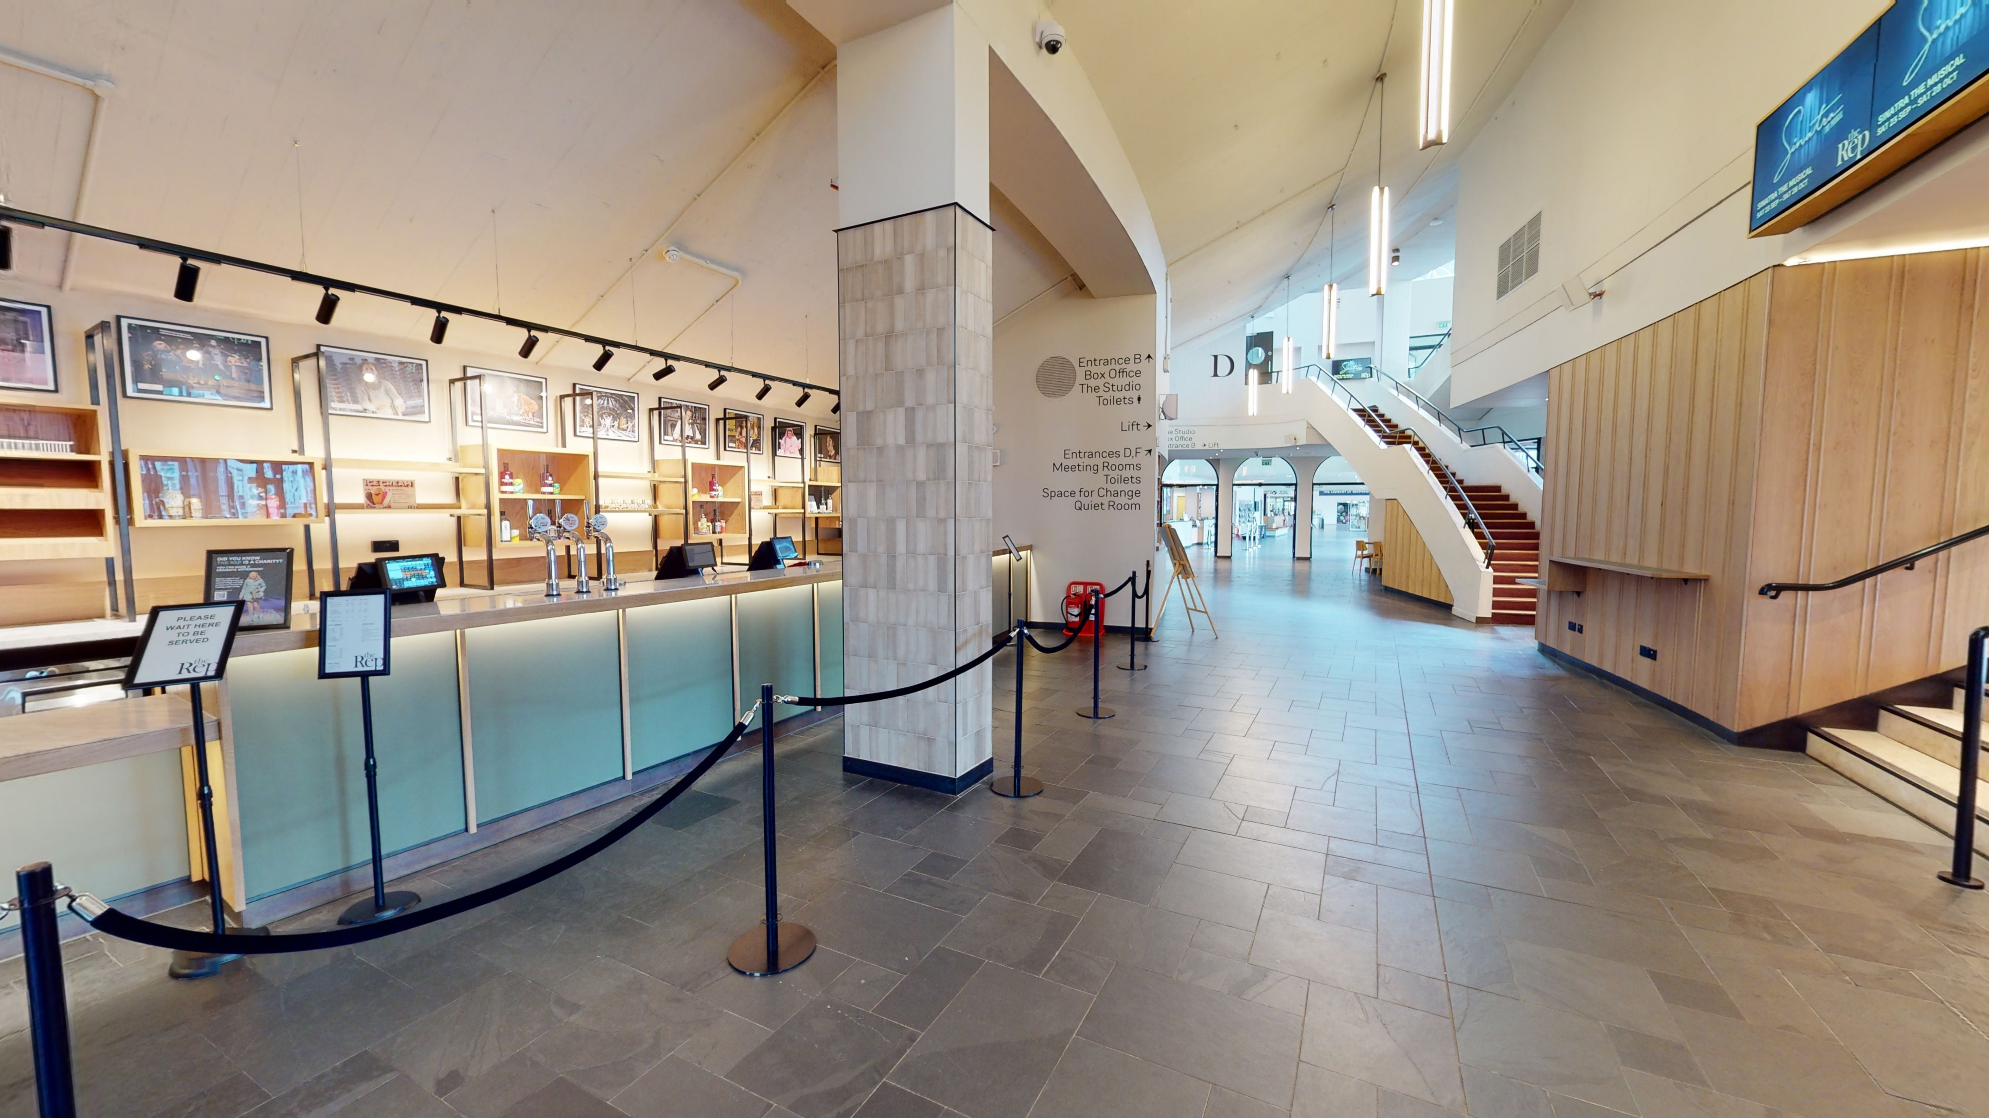
Conference 2026: The foyer(ground floor)
The Rep Foyer runs from the Reception all the way along the building – from this area, you’ll be able to gain access to some of the session rooms as well as stairs or a lift to the cafe and mezzanine level.
The photograph to the right includes a bar area which is where lunch will be served

Slide 16
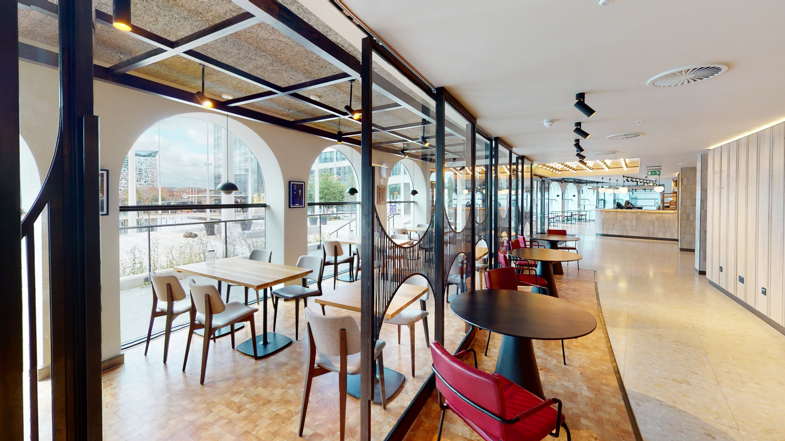
Conference 2026: Cafe (ground floor)
The cafe is a mixed-level area that will be open for delegates to use – there are lots of tables and chairs as well as plugs to charge laptops or phones.
Please note that the cafe is not level – there are some steps that connect separate areas. There is a lift that can be used for those unable to use the stairs (see photo on slide 13).

Slide 17
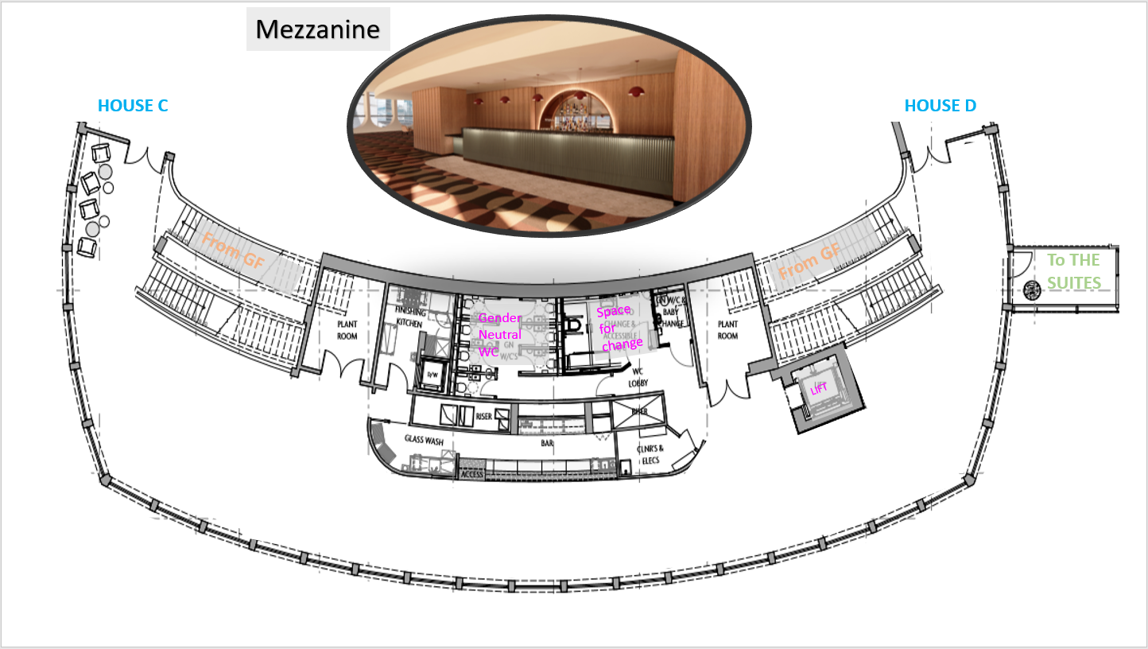
Conference 2026: Floor plan (mezzanine level 1)
The photograph to the right is a floor plan of the first floor of the Rep – known as the mezzanine. This is a walk-through area where we will have table-top displays from our sponsors as well as seating and networking spaces.

Slide 18
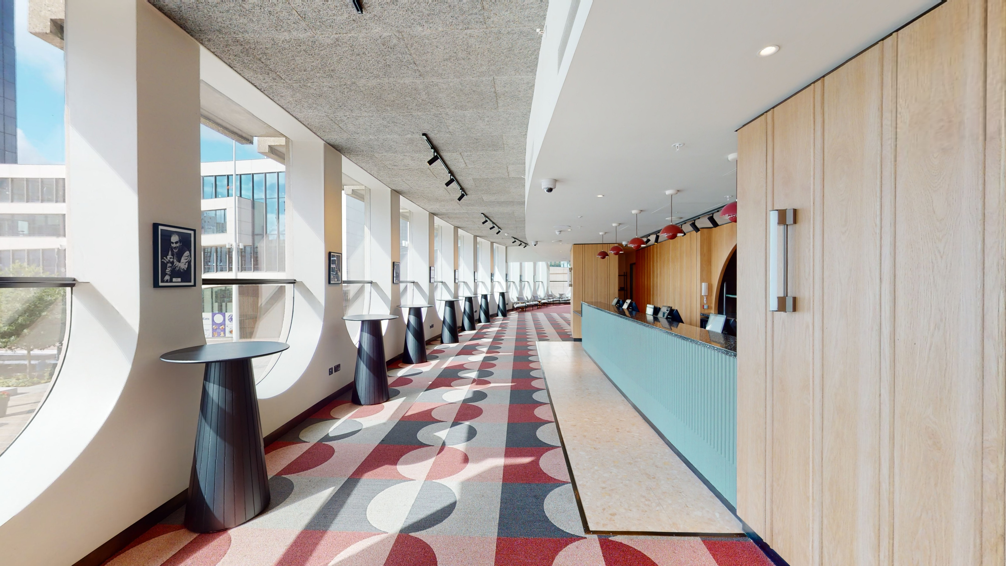
Conference 2026: Mezzanine (level 1)
On the first floor, there is a light-filled mezzanine – it runs above the cafe area.
We will have our tabletop displays from sponsors in this area as well as tables for networking.
This area can be accessed via two staircases from ground level or a lift.

Slide 19
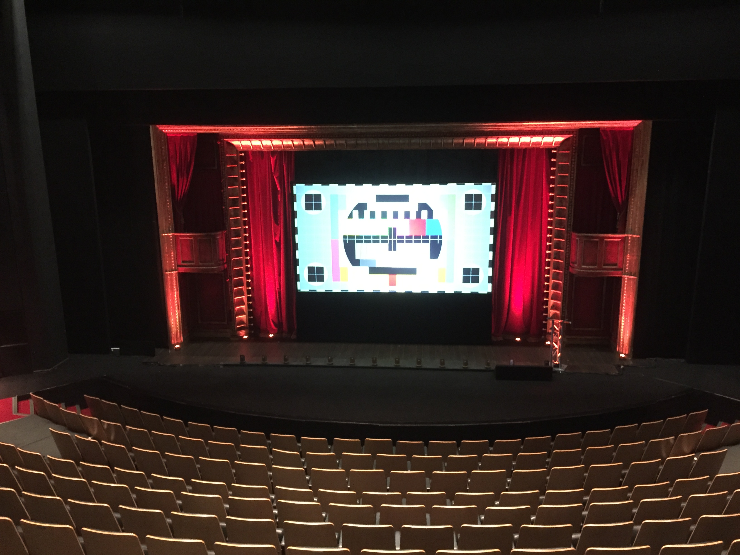
Conference 2026: Guide to the session rooms at The Rep (the House)
The House is the Rep's main theatre – it seats up to 820 in tiered, fixed theatre-style seating.
There is a dedicated seating areas for about five wheelchair users close to the stage, and priority seating at the end of rows for whoever requires these.
Please note this space is tiered – staff will be hand to support your access to the room if required.
Sessions in this room will include AI captions, and will also be streamed for online delegates and recorded.

Slide 20
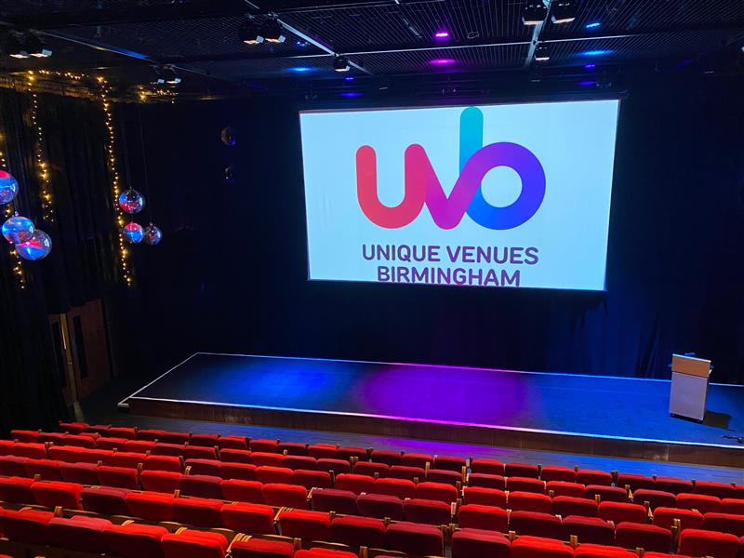
Conference 2026: Guide to the session rooms at The Rep (the Studio)
The Studio is another large session room – it seats 290 guests in tiered, fixed theatre-style seating.
There will be dedicated seating areas for about 10 wheelchair users at the front of the space, and priority seating at the end of rows for whoever requires it.
Sessions in this room will include AI captions, and will also be streamed for online delegates and recorded.

Slide 21
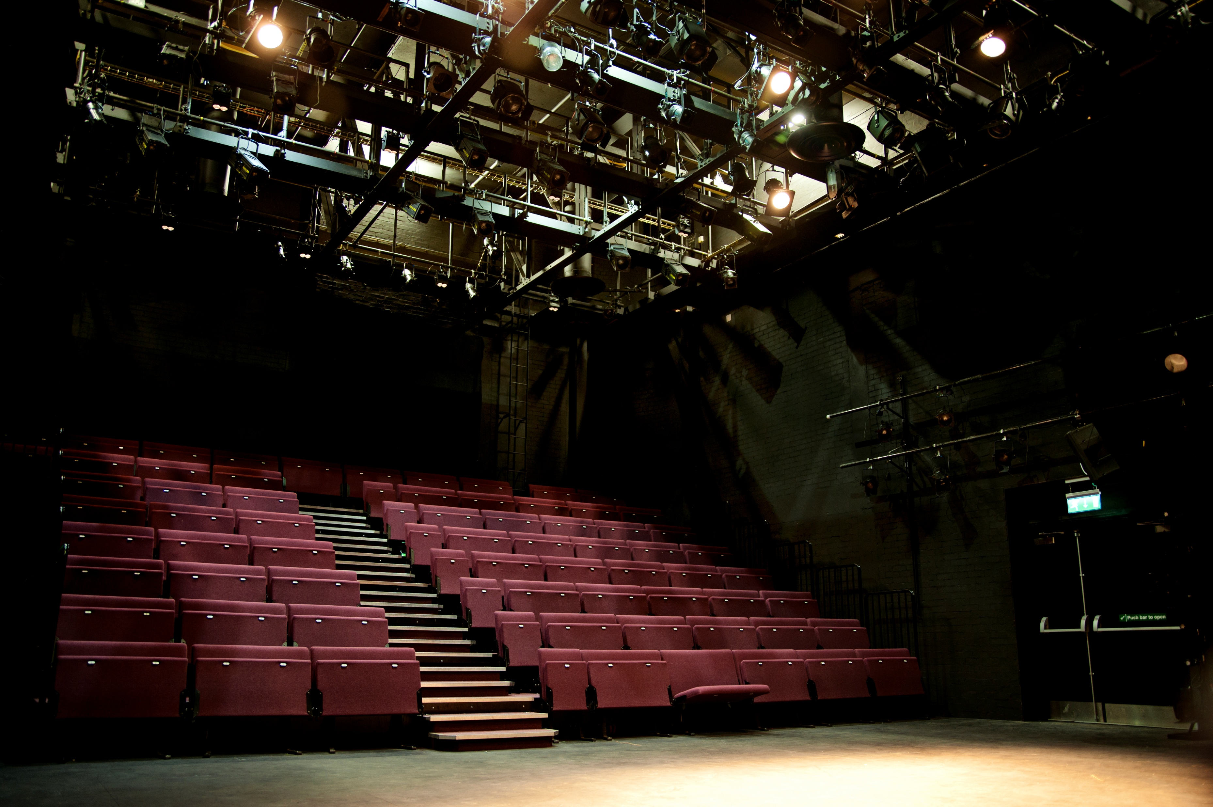
Conference 2026: Guide to the session rooms at The Rep (the Door)
The Door is a large session room – it seats 140 guests in tiered, fixed theatre-style seating.
There will be dedicated seating areas for about 10 wheelchair users at the front of the space. There will also be priority seating at the end of rows for whoever requires it.
Sessions in this room will include AI captions.

Slide 22
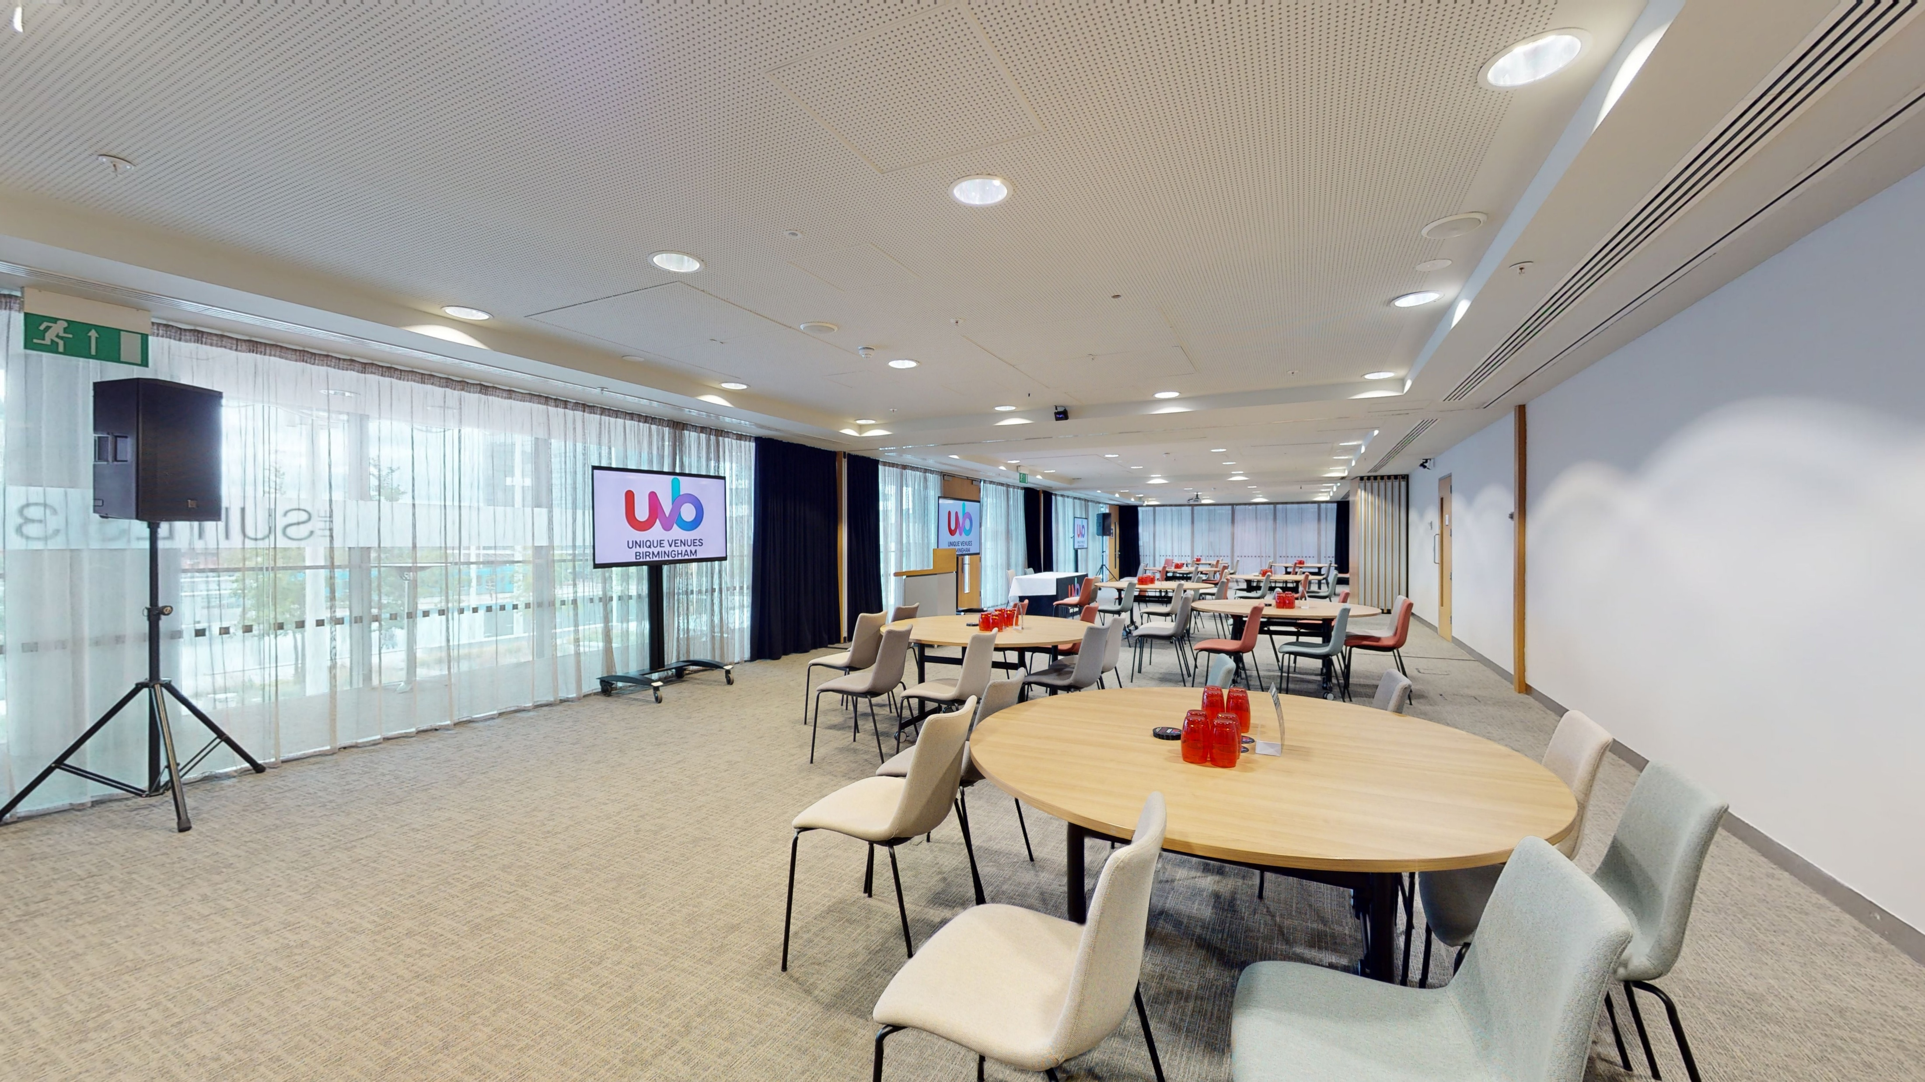
Conference 2026: Guide to the session rooms at The Rep (Meeting Room 1-3)
Meeting Rooms 1-3 will be combined to create a large workshop space with roundtable seating for 140 people.
Wheelchair users are invited to sit wherever they want (there will also be some dedicated space closest to the doors).
Sessions in this room will include AI captions.

Slide 23
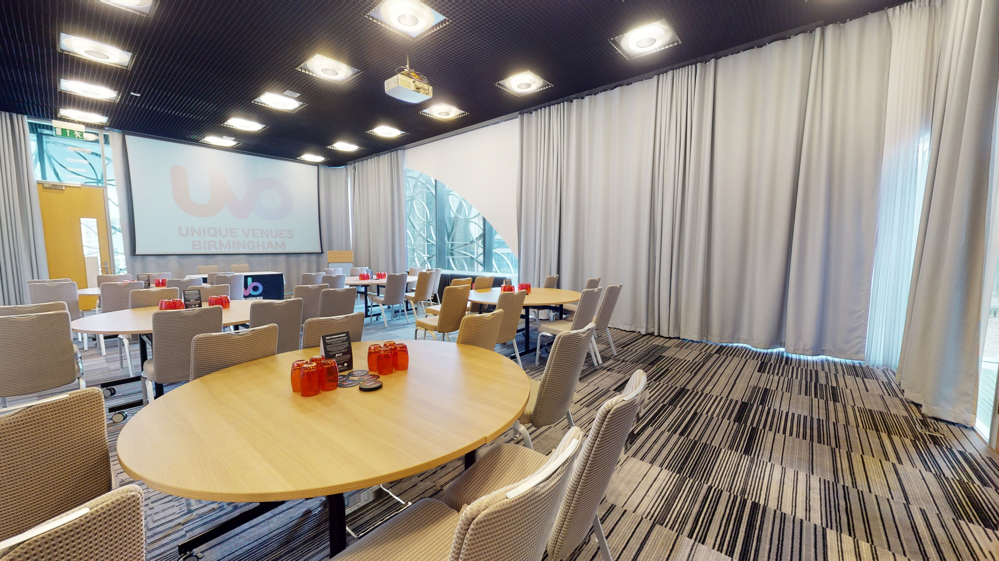
Conference 2026: Guide to the session rooms at The Rep (LOB 101)
Library of Birmingham (LOB) 101 is a meeting room that will be used for concurrent sessions. It seats 120 in theatre layout.
It is accessible via the stairs off the Rep Reception – there is also a lift in the reception that can be used.
Wheelchair users are invited to sit wherever they like, with some priority seating at the tables closest to the doors.
Sessions in this room will include AI captions.

Slide 24
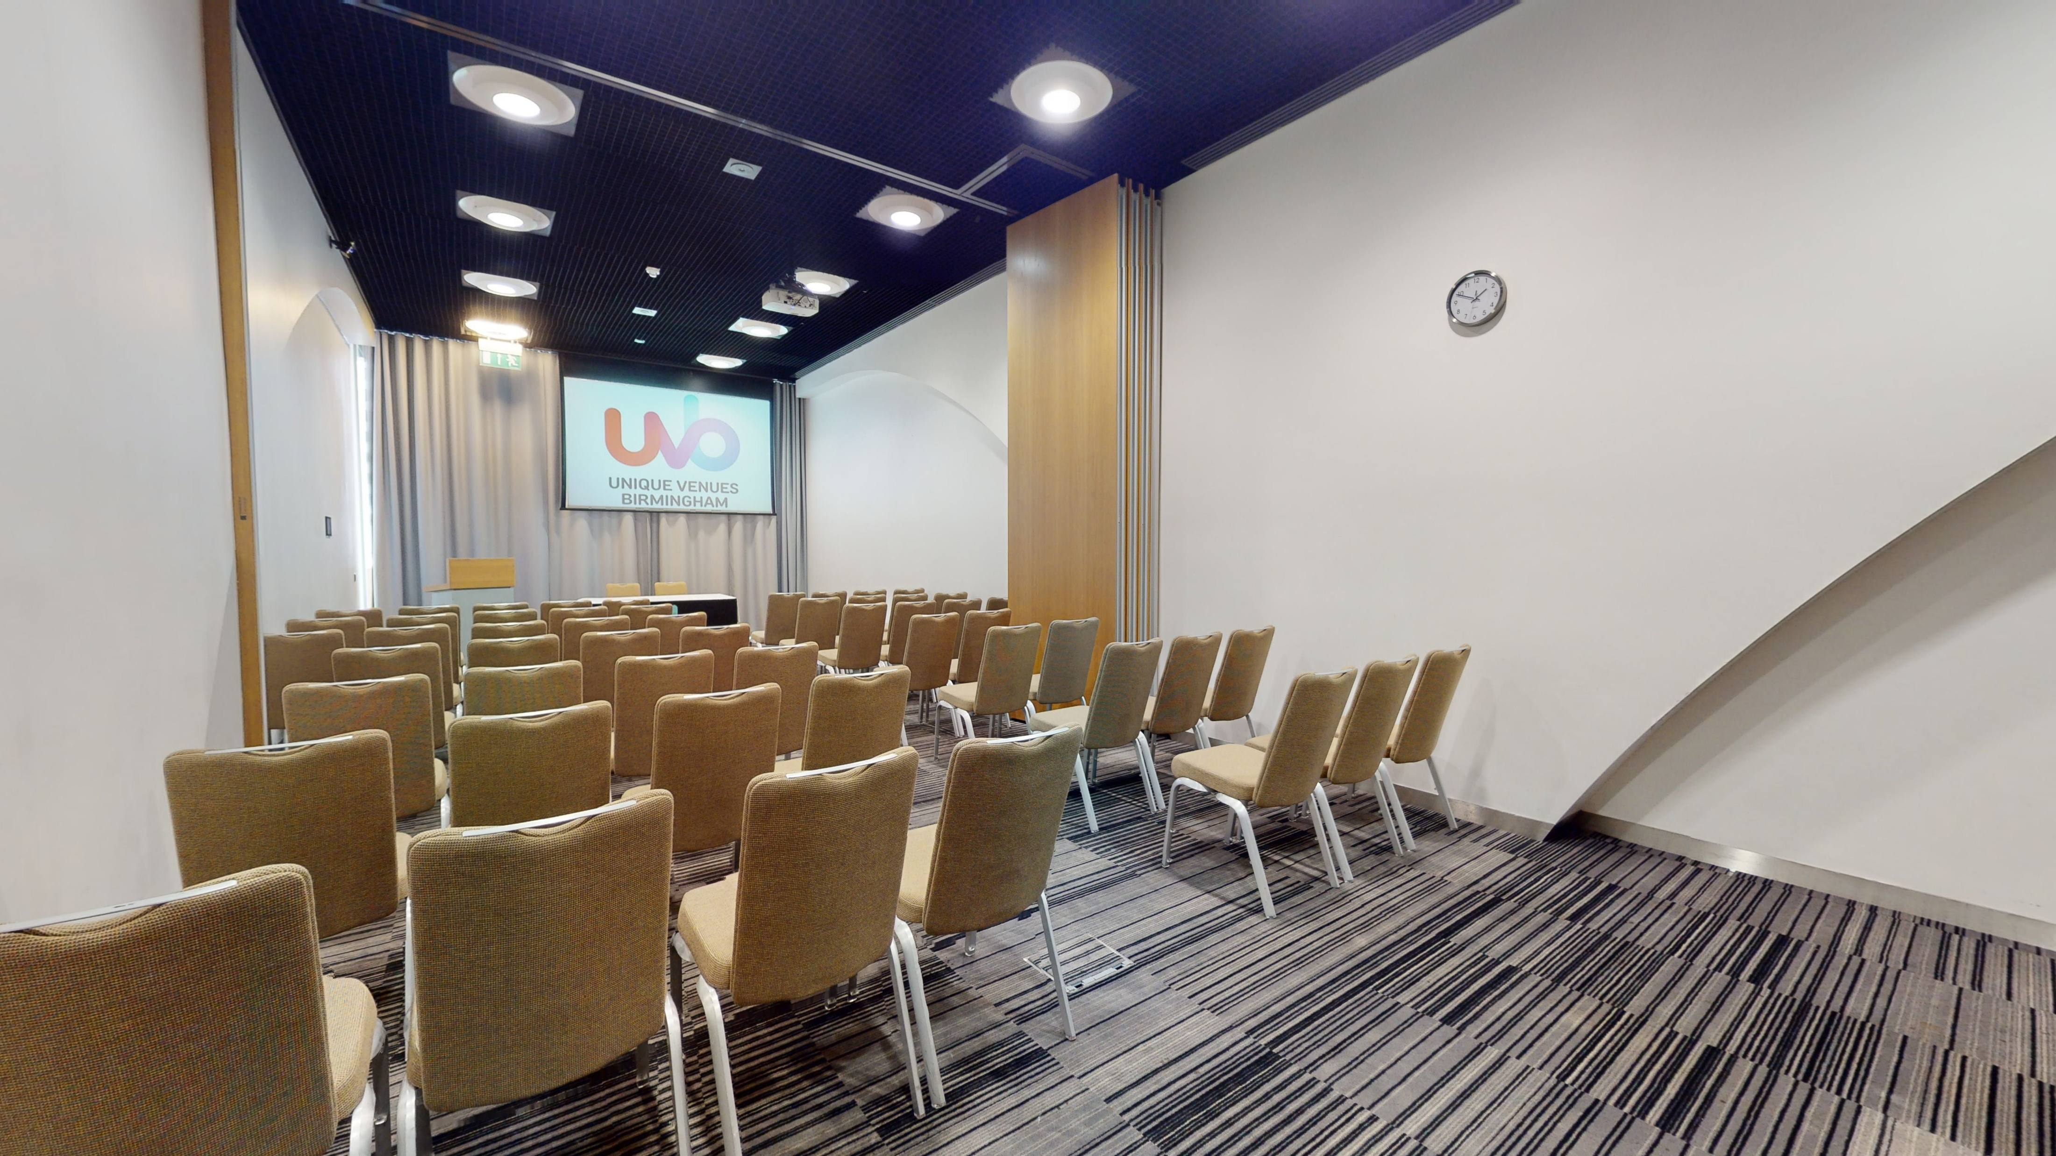
Conference 2026: Guide to the session rooms at The Rep (LOB 103)
Library of Birmingham (LOB) 103 is a meeting room that will be used for training sessions. It seats 70 in theatre layout.
It is accessible via the stairs off the Rep Reception – there is also a lift in the reception that can be used.
Wheelchair users are invited to sit wherever they like, with some priority seating at the tables closest to the doors.
Sessions in this room will include AI captions.

Slide 25
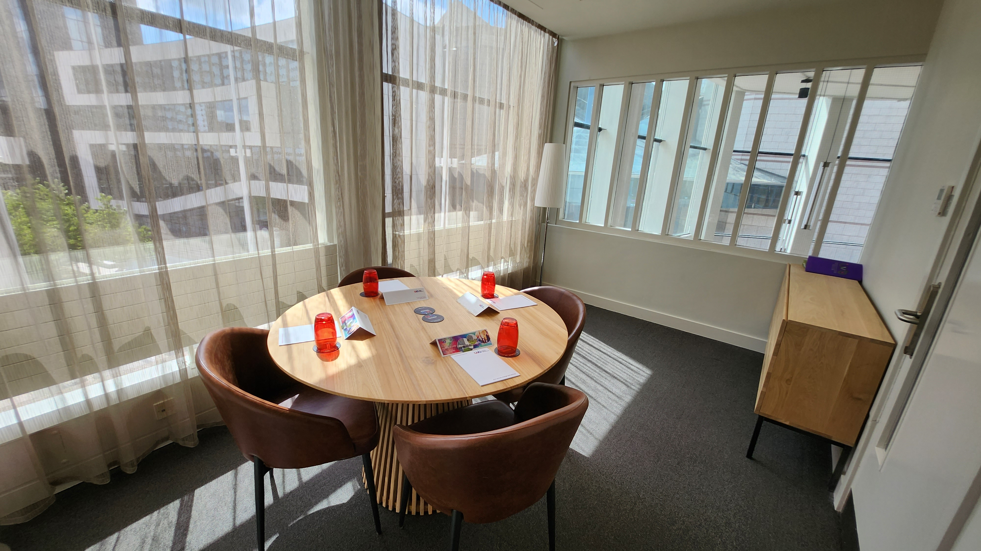
Conference 2026: Guide to other rooms at The Rep (Quiet Room)
Front-of-house (FOH) 1 is a dedicated quiet room. It is light and includes seating and we will provide some fidget toys and colouring sheets.
Please do not use this space for conversations with others or phone calls. If you use electronic equipment, please ensure the volume is turned off or use headphones with the volume turned down to ensure you don’t disturb others.
It is located on the upper mezzanine level – two floors above the cafe – and is accessible via stairs or a lift.

Slide 26
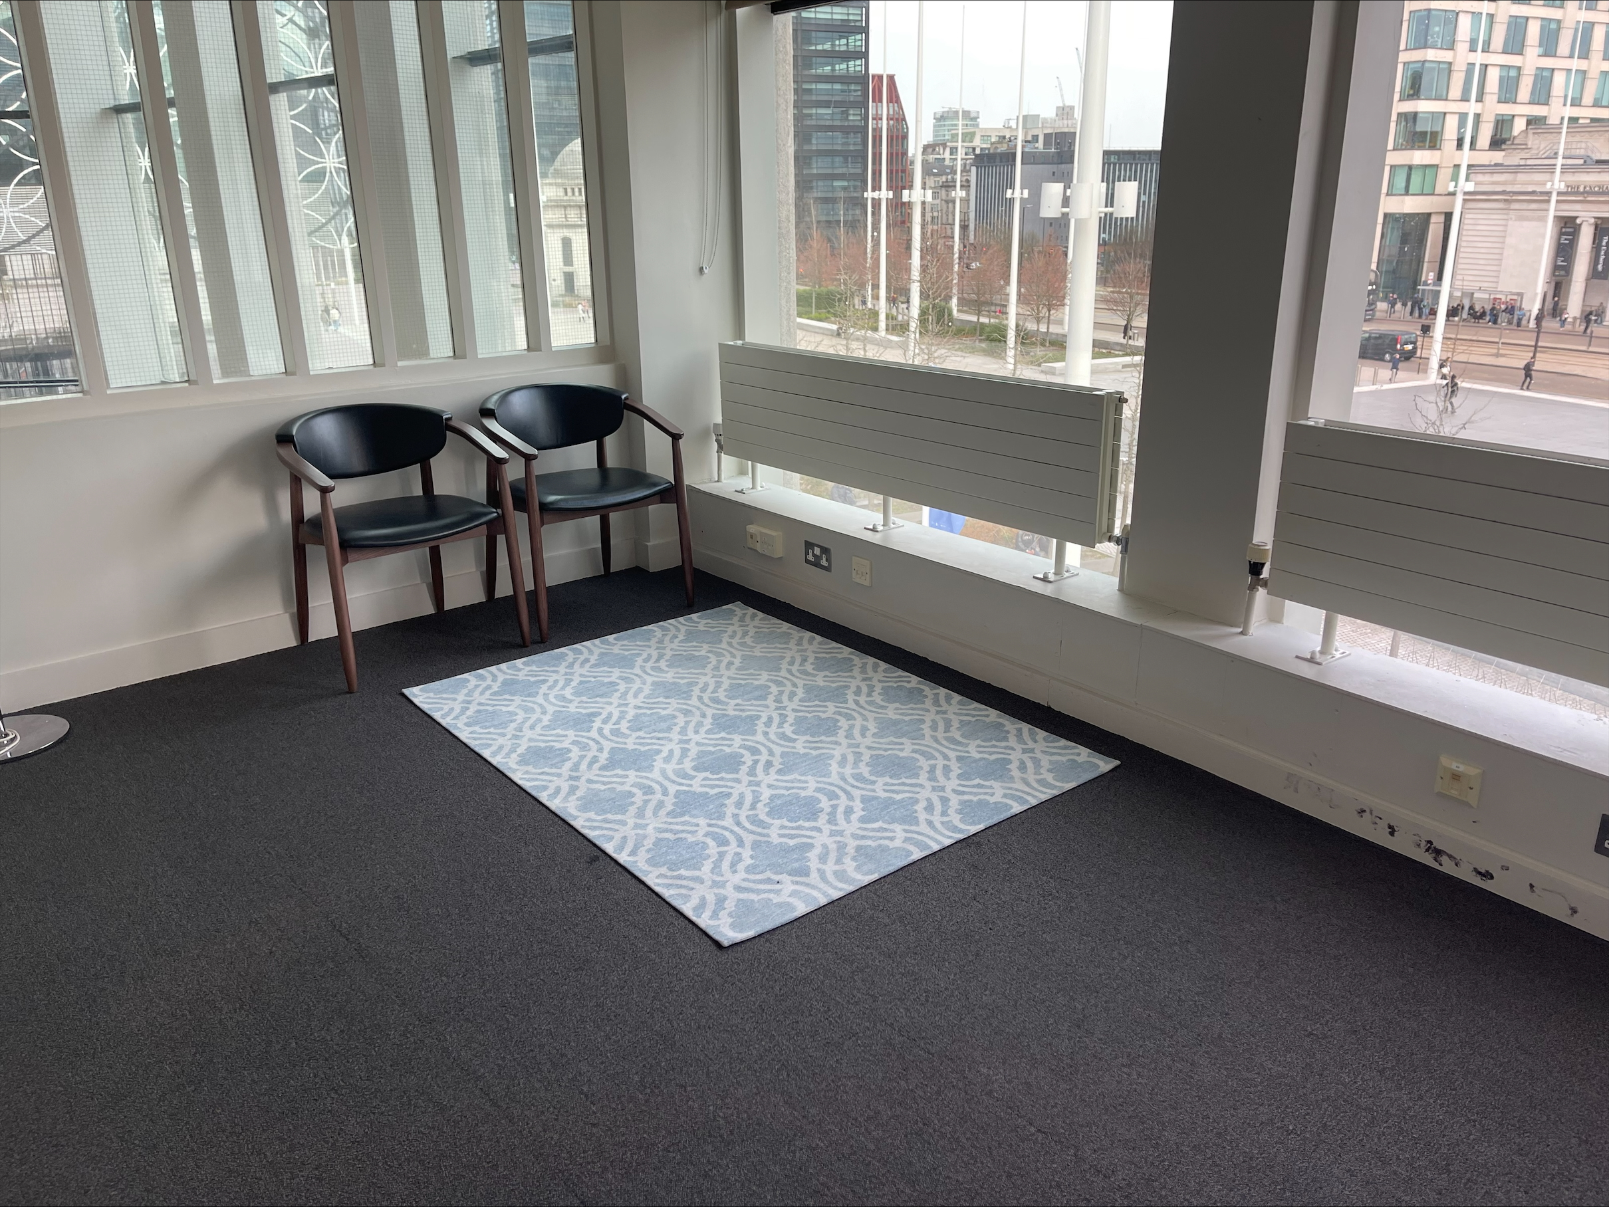
Conference 2026: Guide to other rooms at The Rep (Prayer Room)
The Rep has a dedicated for individuals to engage in prayer, reflection or quiet contemplation.
It is located on the upper mezzanine level – two floors above the cafe – and is accessible via stairs or a lift.

Slide 27
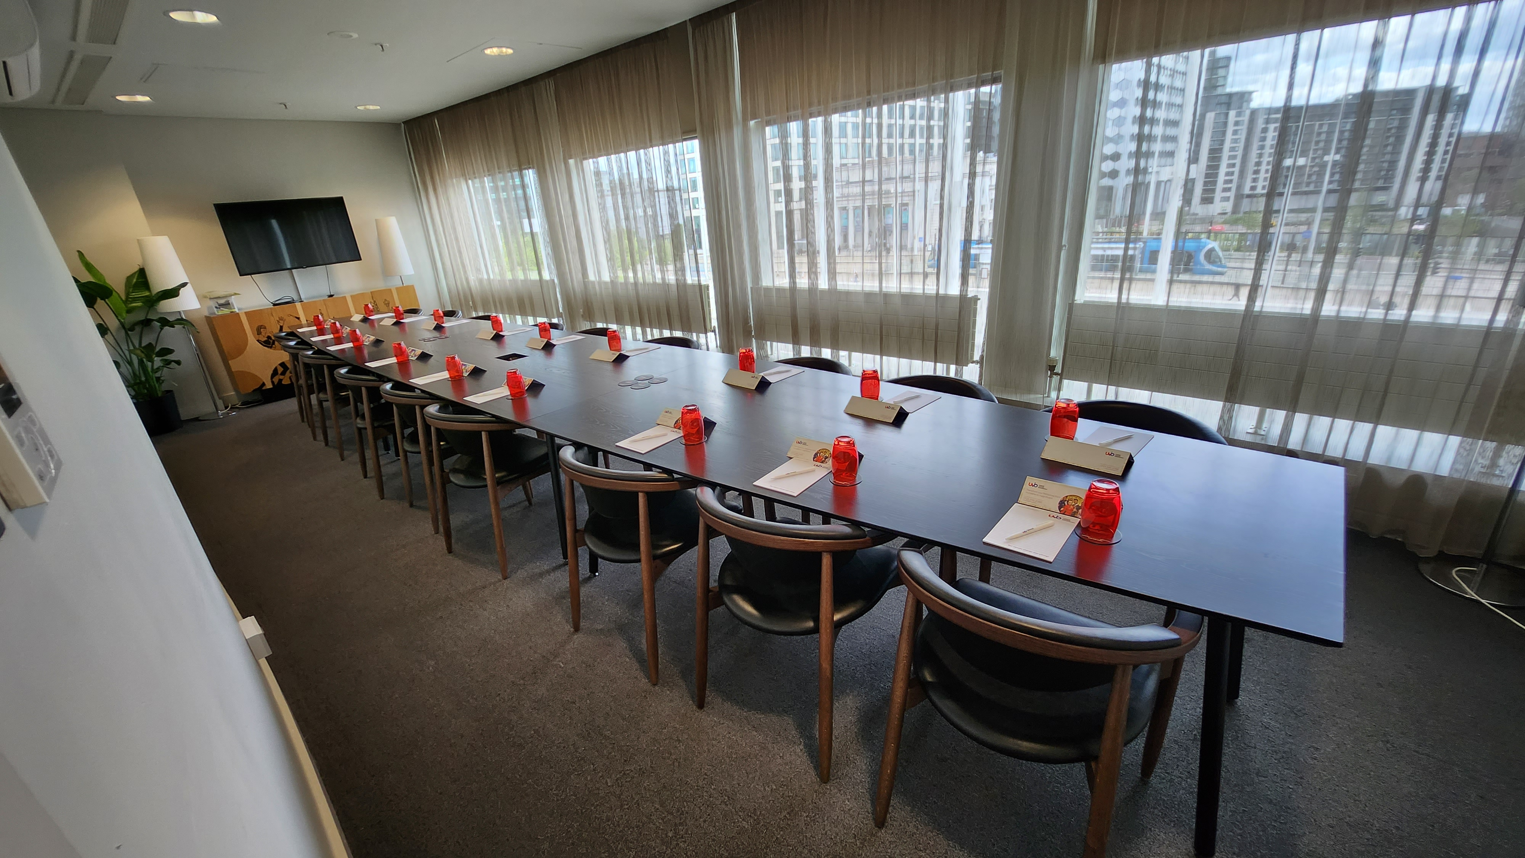
Conference 2026: Guide to other rooms at The Rep (Speaker preview room)
The speaker preview room is located in the Winteringham Room on the upper mezzanine level – two floors above the cafe – and is accessible via stairs or a lift.
Speakers at Conference can use this to access or check their slides, and speak to venue technicians.

Slide 28
Conference 2026: overview of social events
Your in-person ticket includes attending our social events on the day/s selected.
Monday 4 November | Opening party at Thinktank Birmingham Science Museum (1800-2000)
Tuesday 5 November | Main party at Birmingham Museum & Art Gallery (1830-2000)
Wednesday 6 November | Closing party at The Exchange (1815-2000)

Slide 29
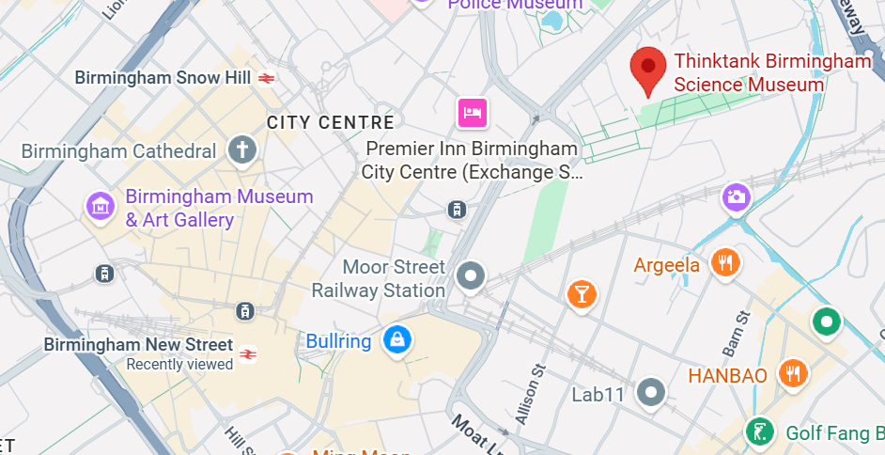
Conference 2026: Monday 2 November | Opening party at Thinktank (travel information)
Thinktank is located at Millennium Point, B4 7XG
It is approximately a 15-minute walk from central Birmingham New Street station – use Google Maps to plot your route
The closest car park is Millennium Point car park (Sat Nav postcode B4 7AP). Blue Badge parking is free.
You can catch buses or the tram from Birmingham city centre to Thinktank – see Thinktank’s website for detailed travel information.

Slide 30
Conference 2026: Monday 2 November | Opening party at Thinktank (venue accessibility)
The entrance to Thinktank is on the ground floor (level 0).
There are central lifts to all floors within Thinktank and Millennium Point as well as stairs.
The floor surface of the museum is smooth, plastic coated and non-slip. In some places there are carpet tiles.
There are accessible toilets on all levels. The adult changing facility on Level 1 includes a hydraulic changing table (no hoist).
Some parts of the museum have low-lighting including our Planetarium and Futures Gallery. Braille signs are used extensively around the museum.
Some area of have fixed hearing loops installed.
There is seating available in all areas.
You can download a floor plan of the museum or explore 360 degree tour
More access information is available on Thinktank’s website

Slide 31
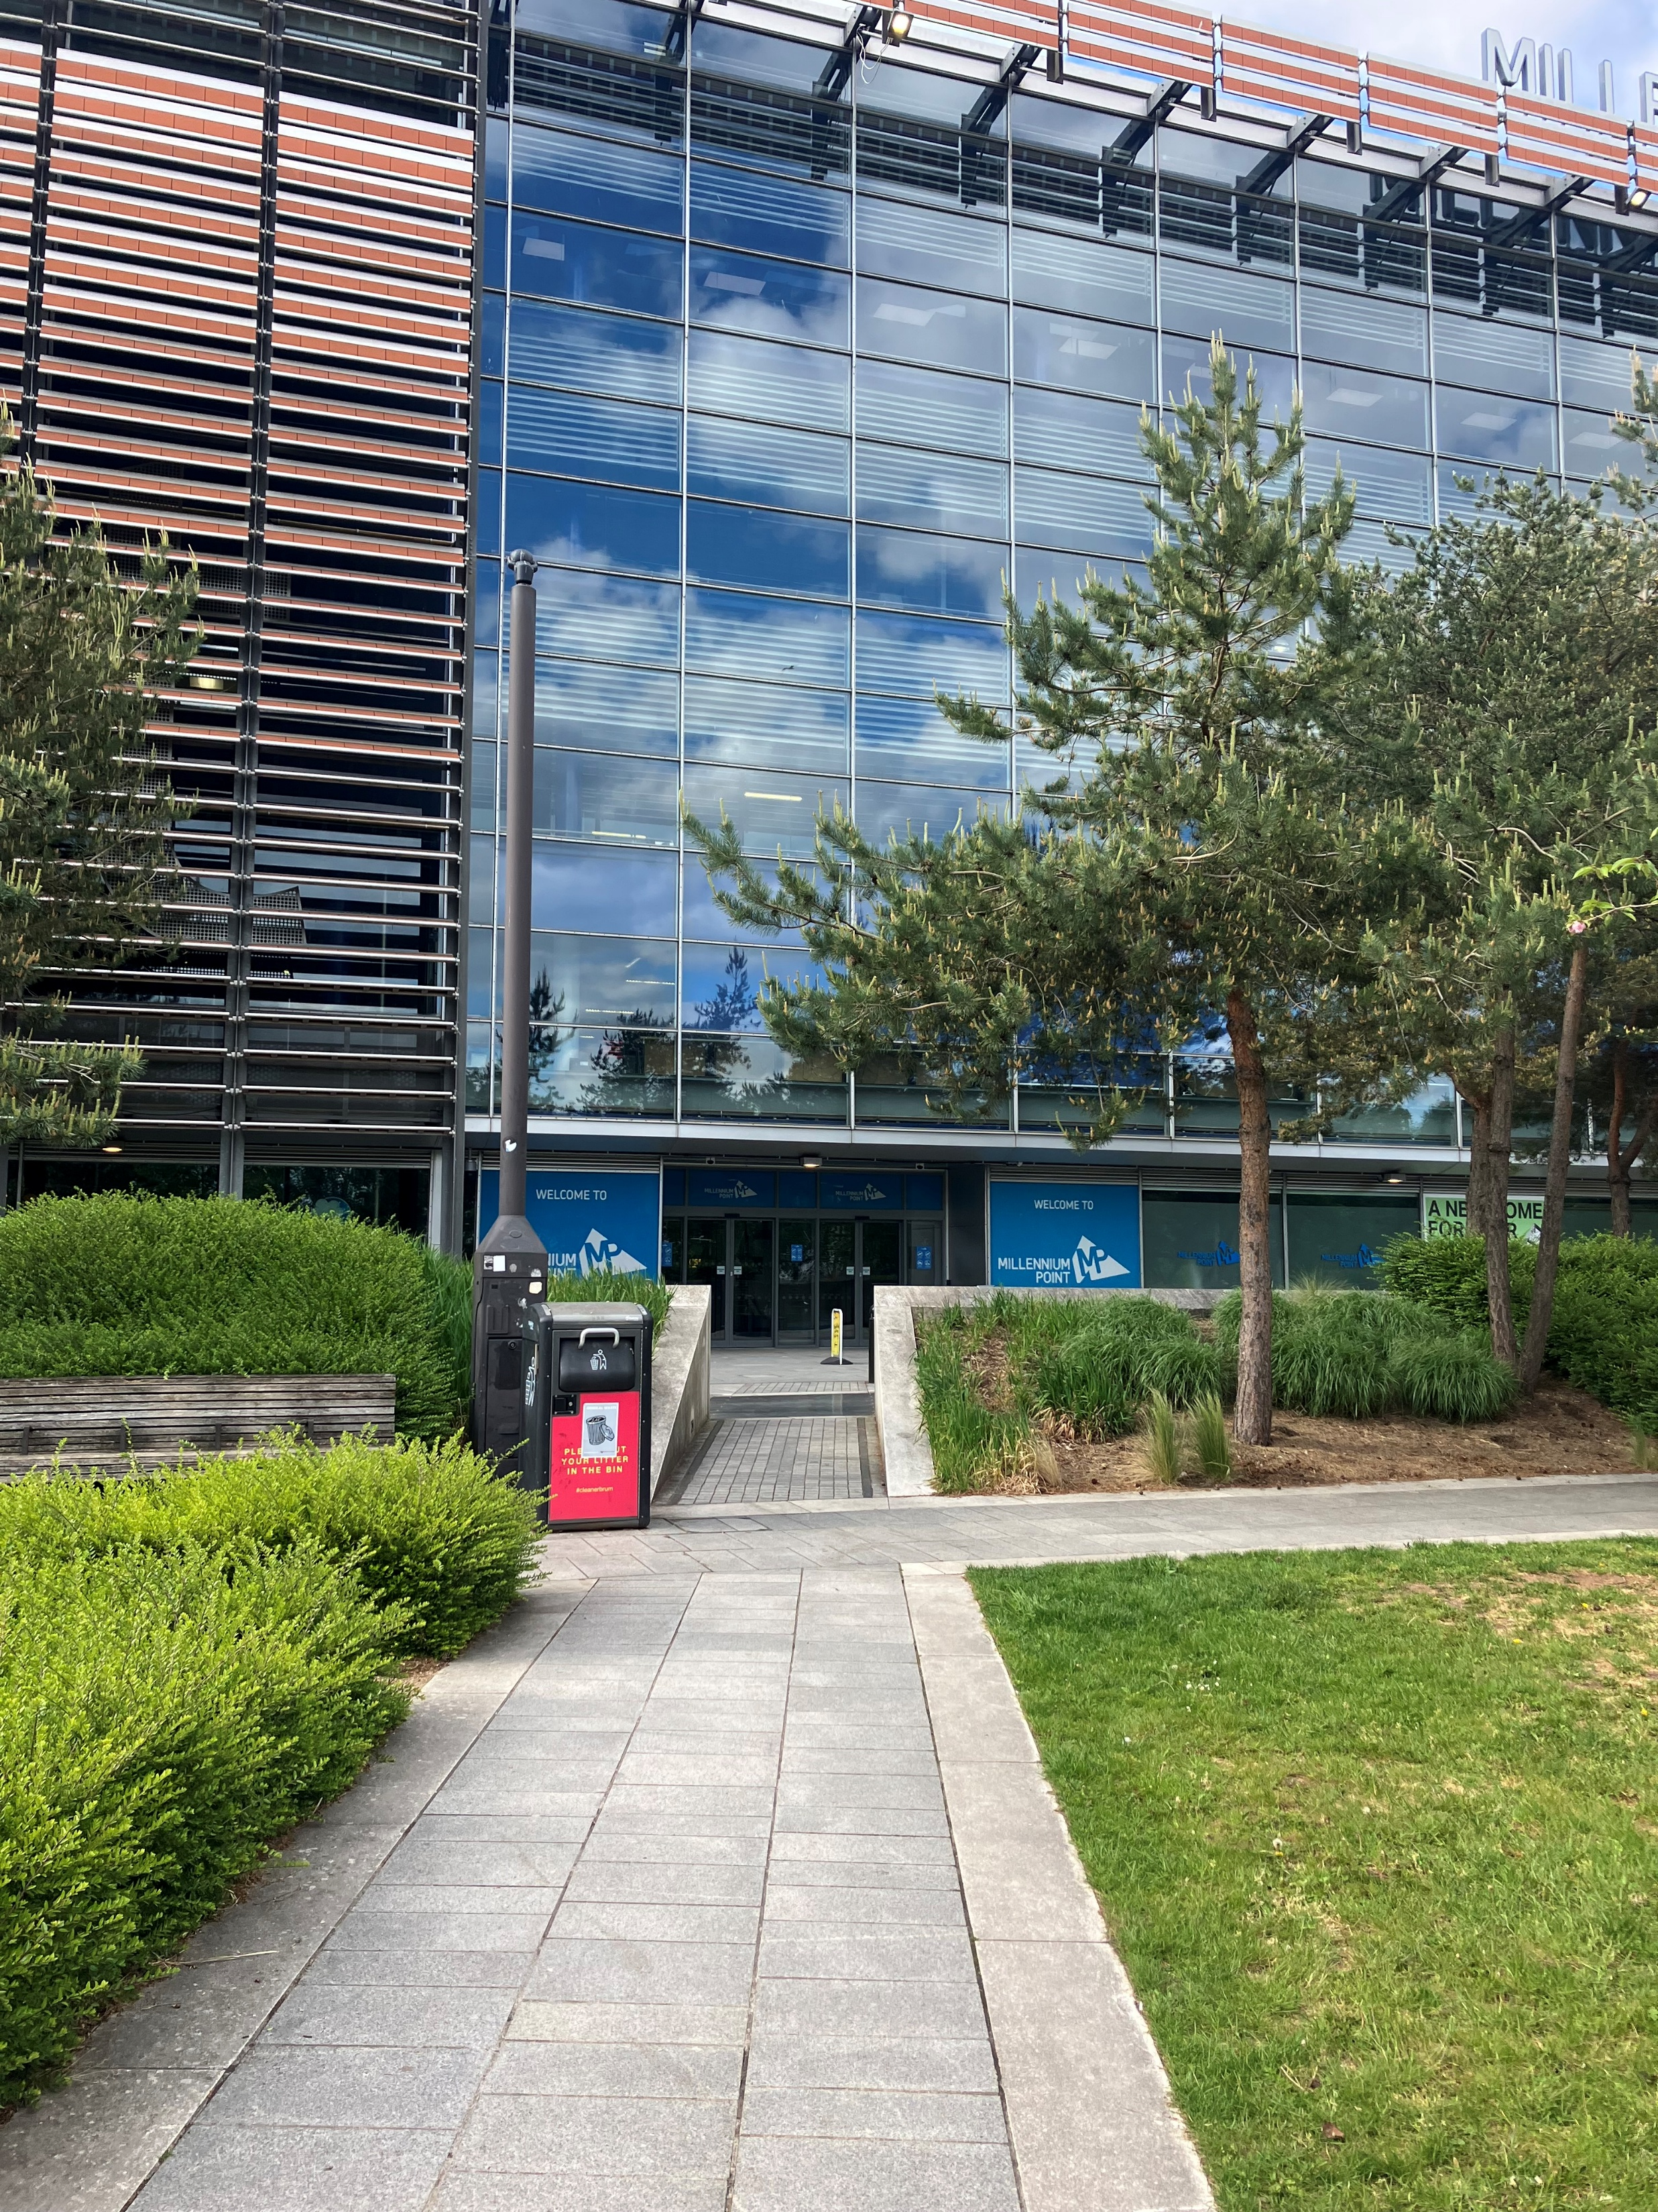
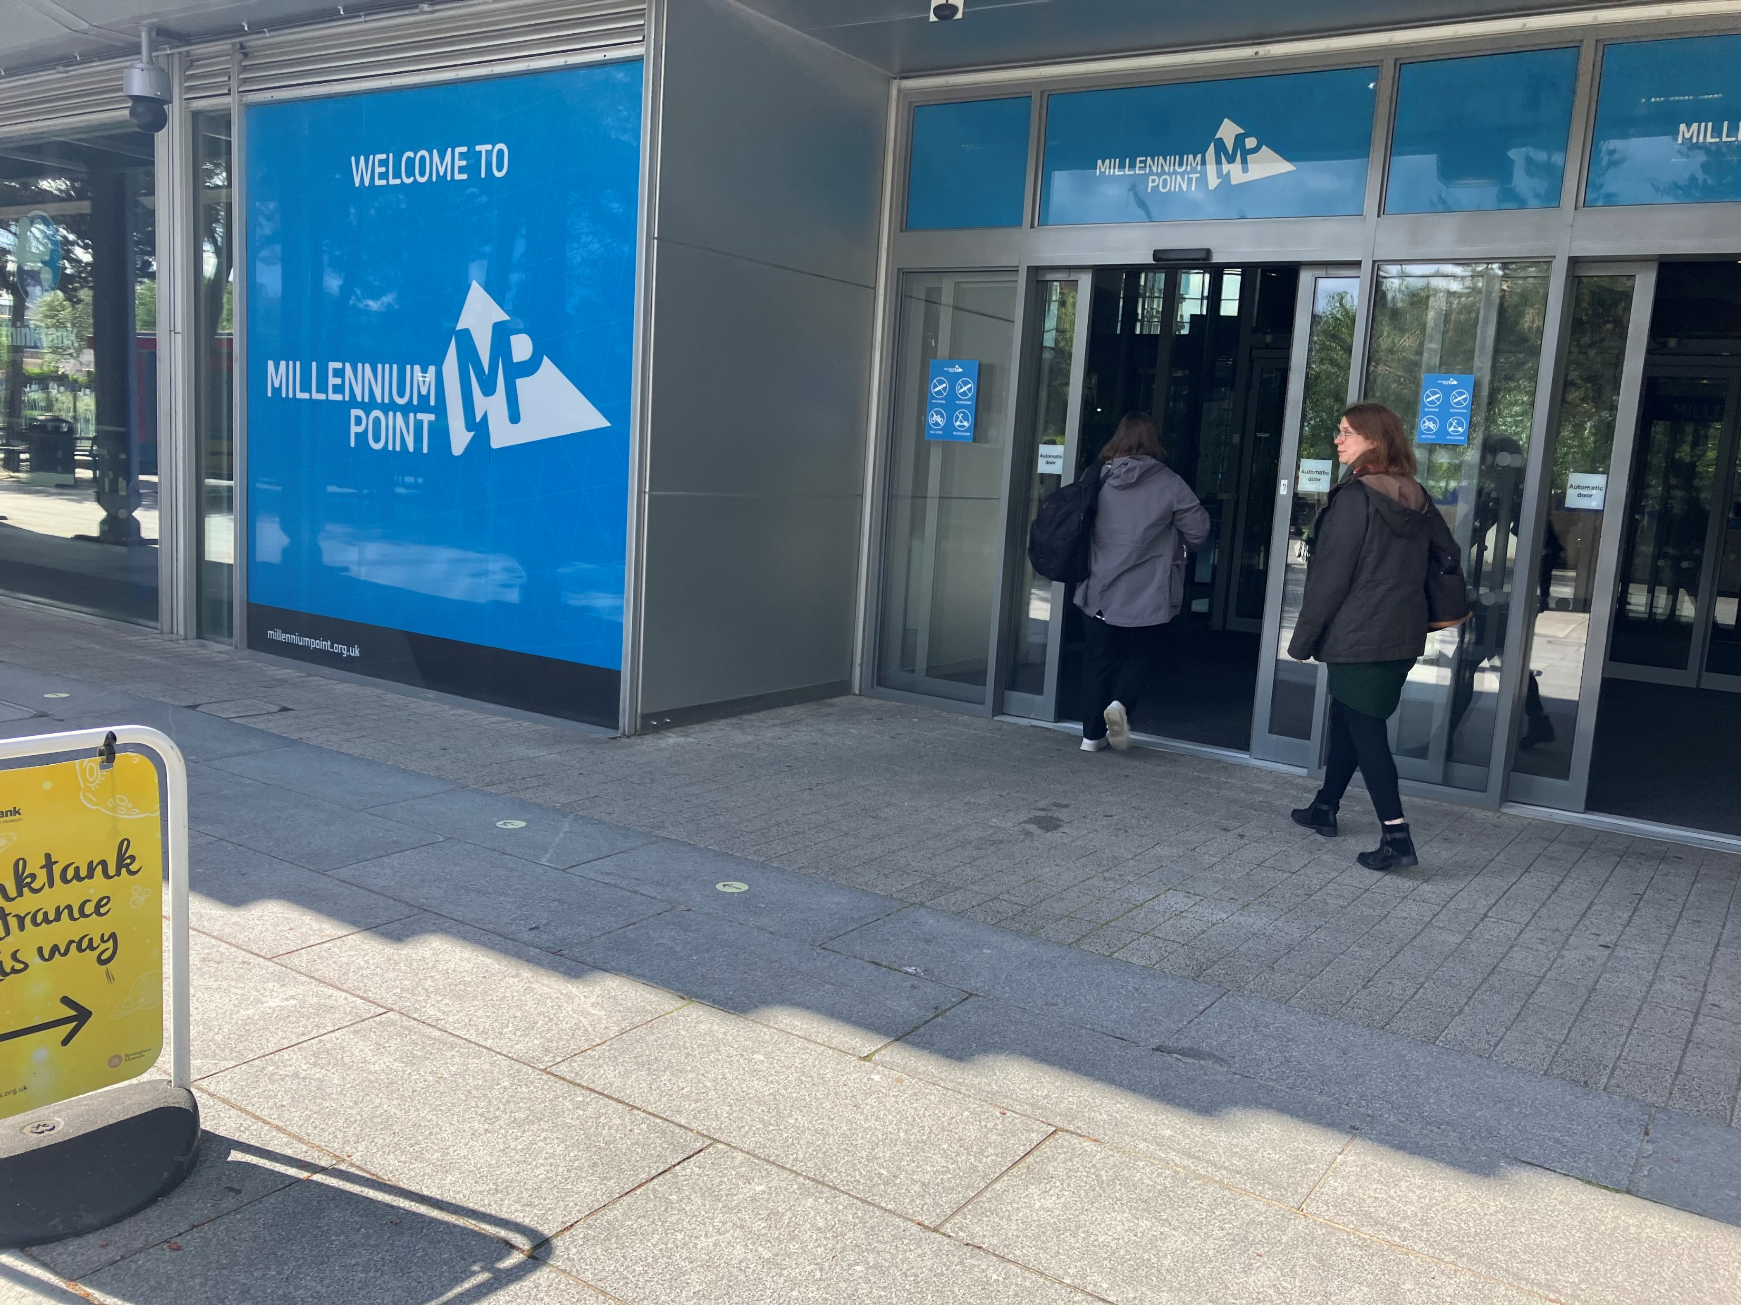
Conference 2026: Monday 2 November | Opening party at Thinktank (entrance photos)
Left: from Curzon Stret, cross the grassy area
(level pathway) to reach the entrance to Thinktank (via Millenium Point)
Right: Go through the
automatic doors to
enter the museum

Slide 32
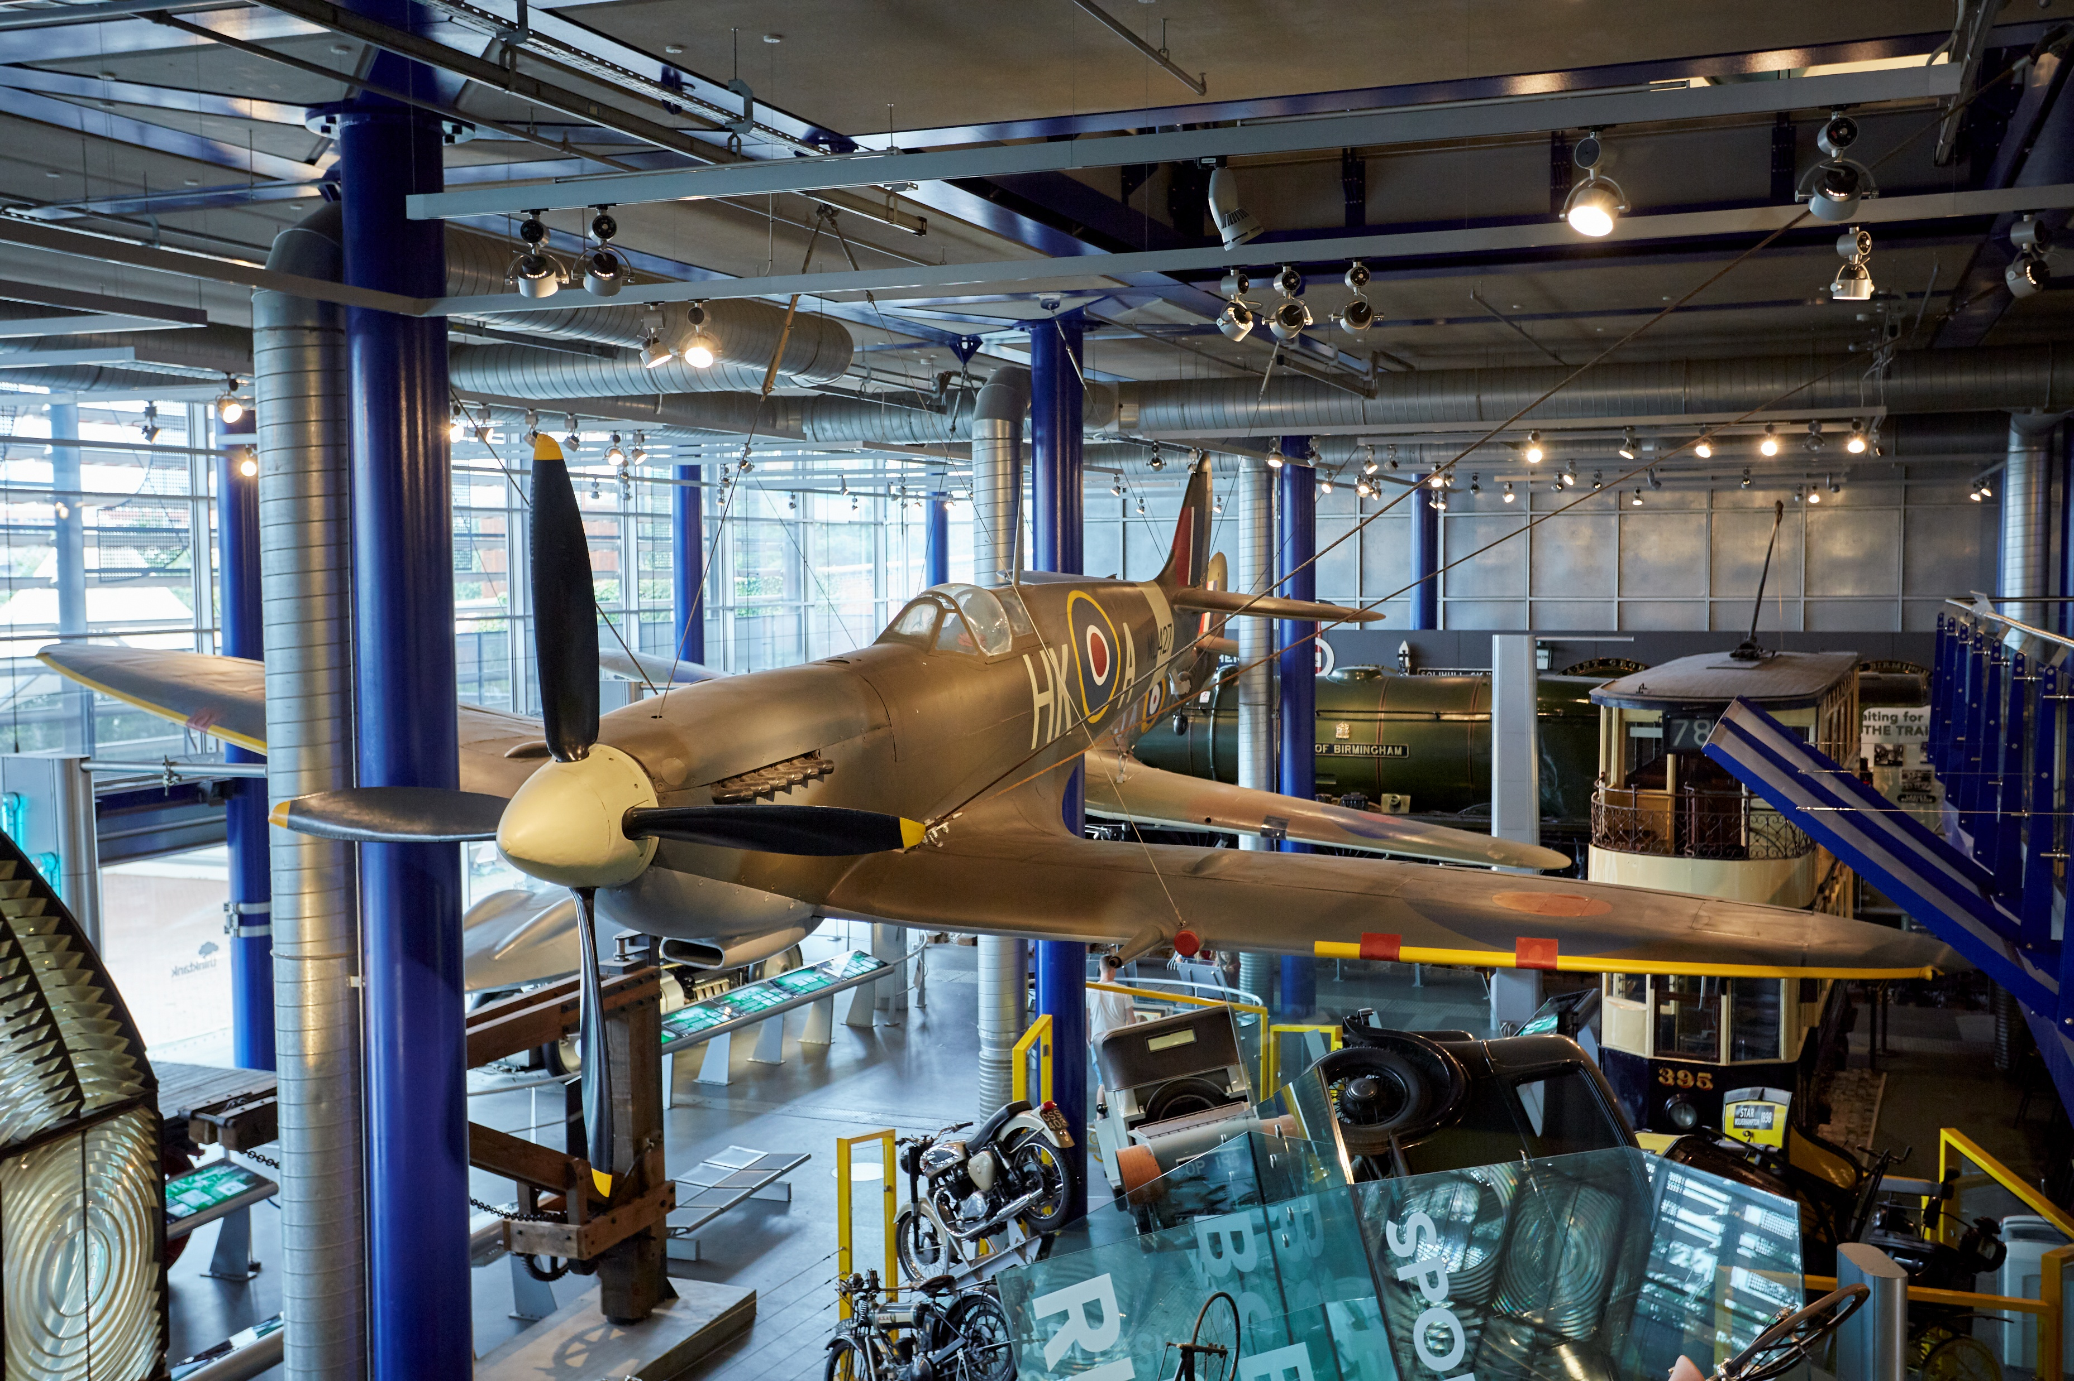
Conference 2026: Monday 2 November | Opening party at Thinktank (gallery photo)
The Spitfire exhibit
on level 1

Slide 33
Conference 2026: Monday 2 November | Opening party at Thinktank (what to expect)
Coming soon

Slide 34
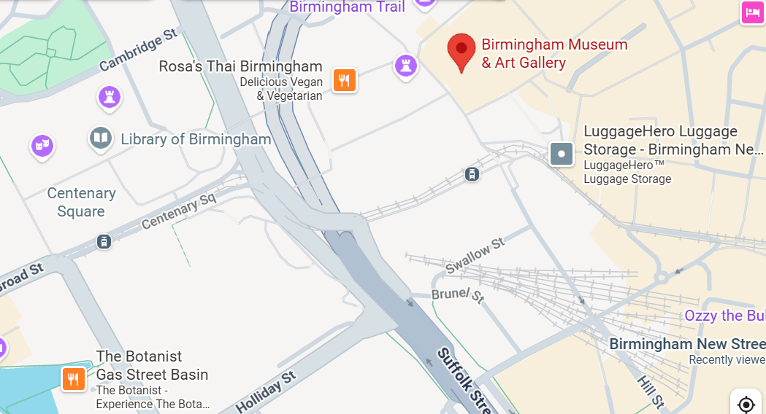
Conference 2026: Tuesday 3 November | Main party at Birmingham Museum & Art Gallery (travel information)
Birmingham Museum is located on Chamberlain Square, B3 3DH
It is approximately a 6-minute walk from the Rep – use Google Maps to plot your route
The main entrance on Chamberlain Square contains two flights of stairs. There is a lift entrance at the Gas Hall on Edmund Street.
See the museum website for detailed travel information.

Slide 35
Conference 2026: Tuesday 3 November | Main party at Birmingham Museum & Art Gallery (access information)
Please note that the main entrance on Chamberlain Square includes 10 external steps followed by an additional 42 steps to reach the galleries.
There lift entrance at the Gas Hall on Edmund Street which provides lift access to the main building and Gas Hall. The Lift door width is 43” or 109cm.
The museum is a historic building with smooth flooring, primarily consisting of Victorian tiles. The galleries are light, airy, and spacious.
The museum includes a dedicated accessible toilet at the back of the Gas Hall – the first entrance door is 80cm wide, the toilet door is 91cm wide, and the toilet space measures is 150cm wide and 202cm in length.
This is also an accessible toilet is near the Edmund Street lift entrance.
There is seating throughout the museum.
You can download a floor plan of the museum or its social story (aimed at school groups)
More access information is available on Birmingham Museum & Art Gallery's website

Slide 36
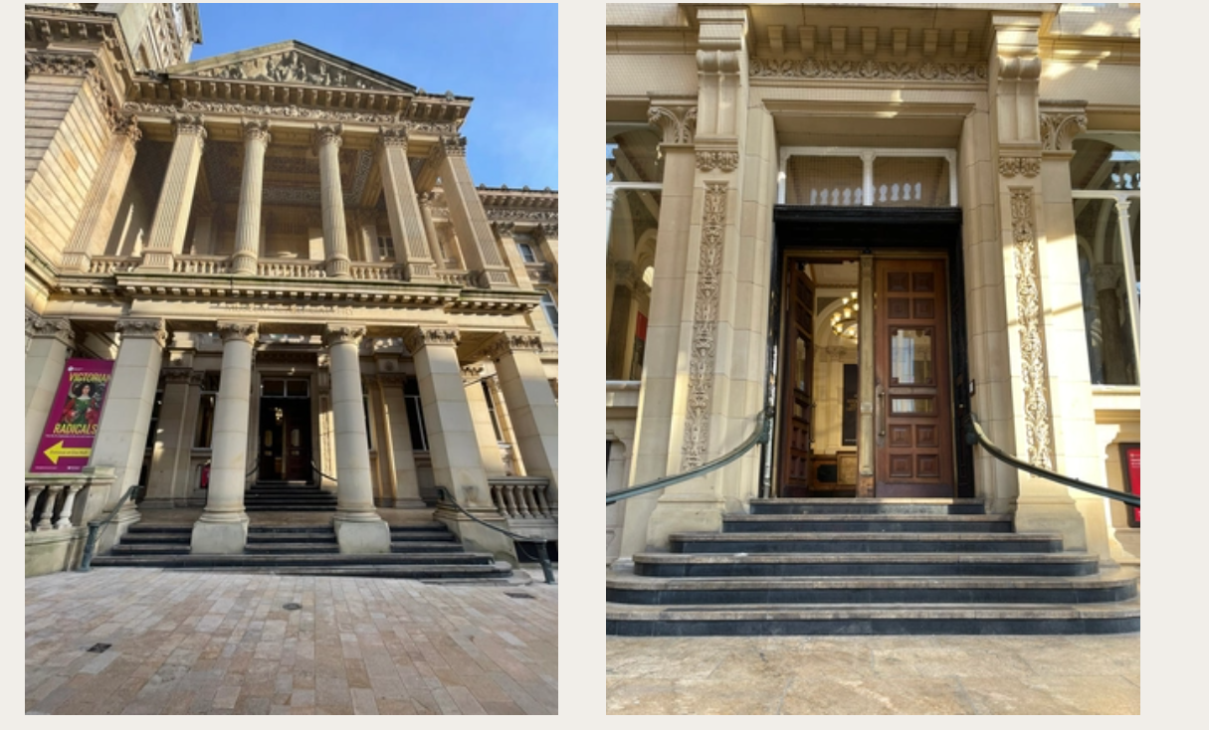
Conference 2026: Tuesday 3 November | Main party at Birmingham Museum & Art Gallery (entrance photos)
The two photos to the right show the external view of the museum from the main entrance on Chamberlain Street – there are 10 stone steps from the flat pavement area and historical wooden doors (non-automatic)

Slide 37
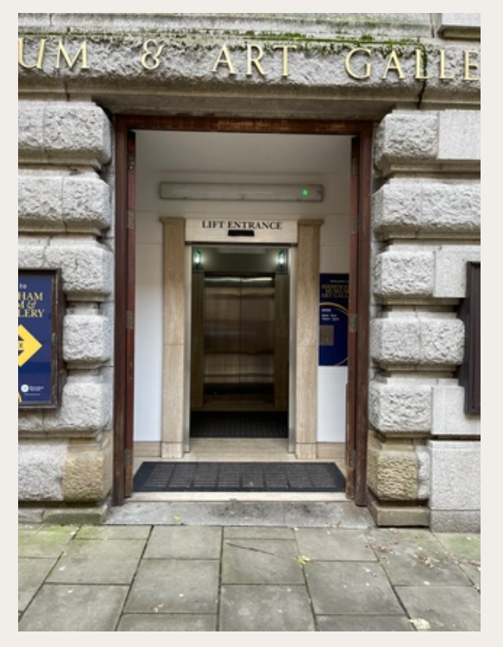
Conference 2026: Tuesday 3 November | Main party at Birmingham Museum & Art Gallery (entrance photos – lift access)
There lift entrance at the Gas Hall on Edmund Street which provides lift access to the main building and Gas Hall. The Lift door width is 43” or 109cm.

Slide 38
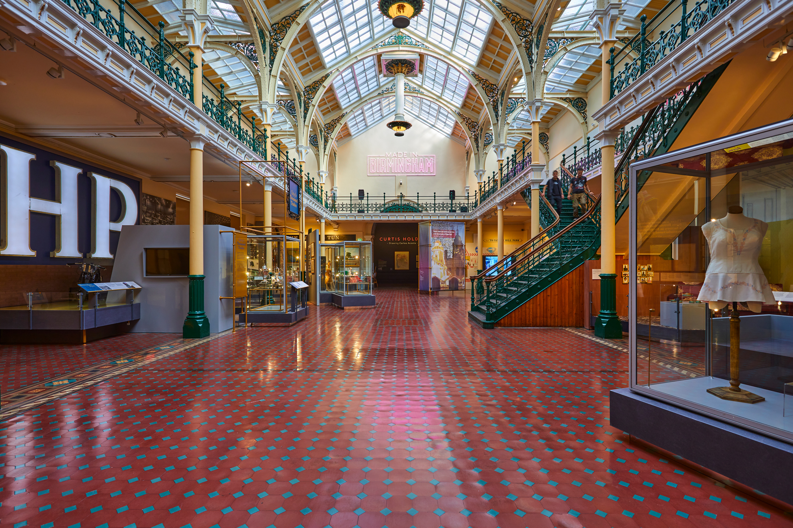
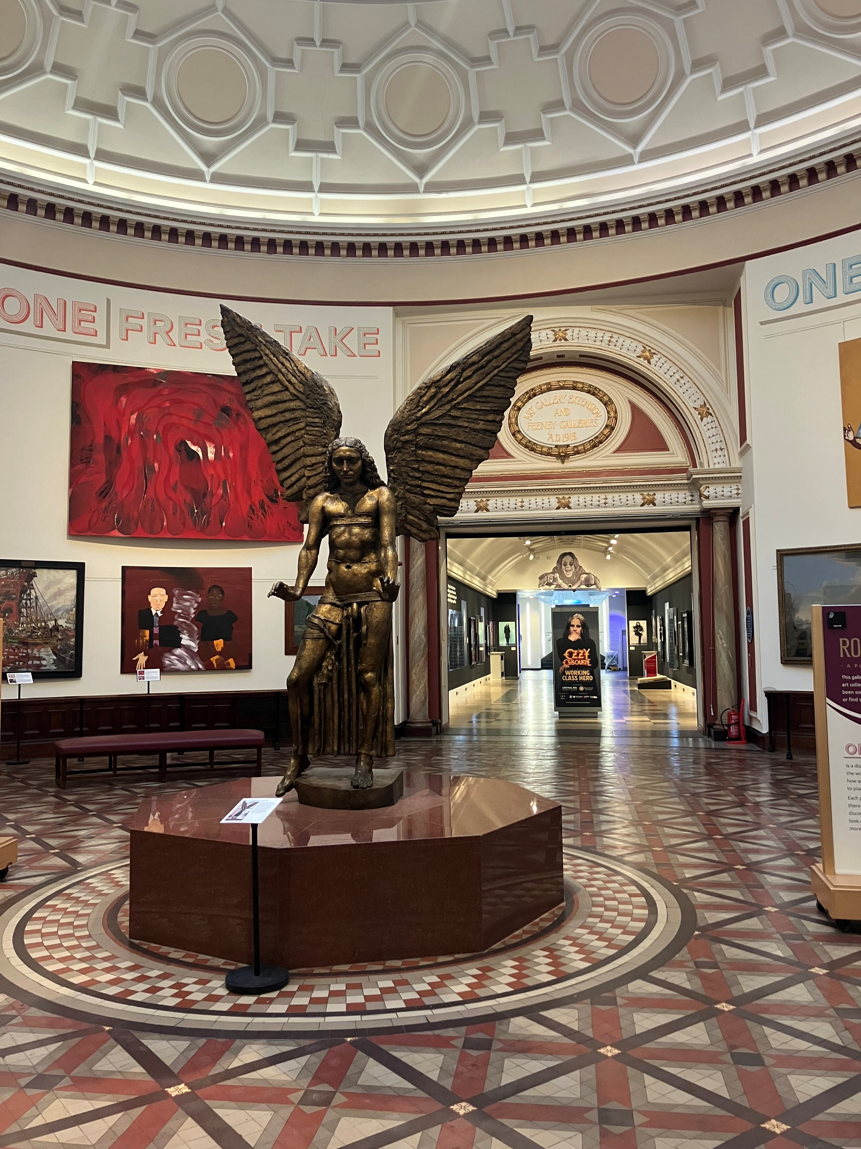
Conference 2026: Tuesday 3 November | Main party at Birmingham Museum & Art Gallery (gallery photos)
Left: The Industrial Gallery on Level 2
Right: The Round
Room on Level 2

Slide 39
Conference 2026: Tuesday 3 November | Main party at Birmingham Museum & Art Gallery (what to expect)
Coming soon

Slide 40
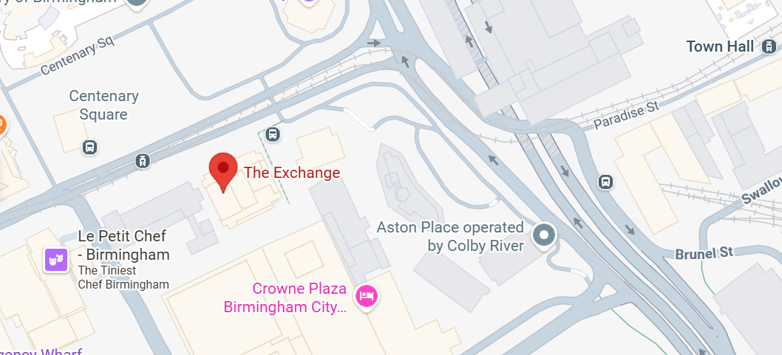
Conference 2026: Wednesday 4 November | Closing party at The Exchange(travel information)
The Exchange is located at 3 Centenary Square, B1 2DR, directly opposite the Rep – it’s approximately a one-minute walk and involves crossing a road.
From the Exchange, it’s about an 11-minute walk to Birmingham New Street.
Use Google Maps to plot your route

Slide 41
Conference 2026: Wednesday 4 November | Closing party at The Exchange(access information)
There is ramped/sloped and stepped access at the building entrance.
Once inside, the area is level with lift and stair access to all floors.
There are accessible toilets on all floors, as well as a Changing Places toilet on the basement level.
There is detailed accessibility information about the building on AccessAble

Slide 42
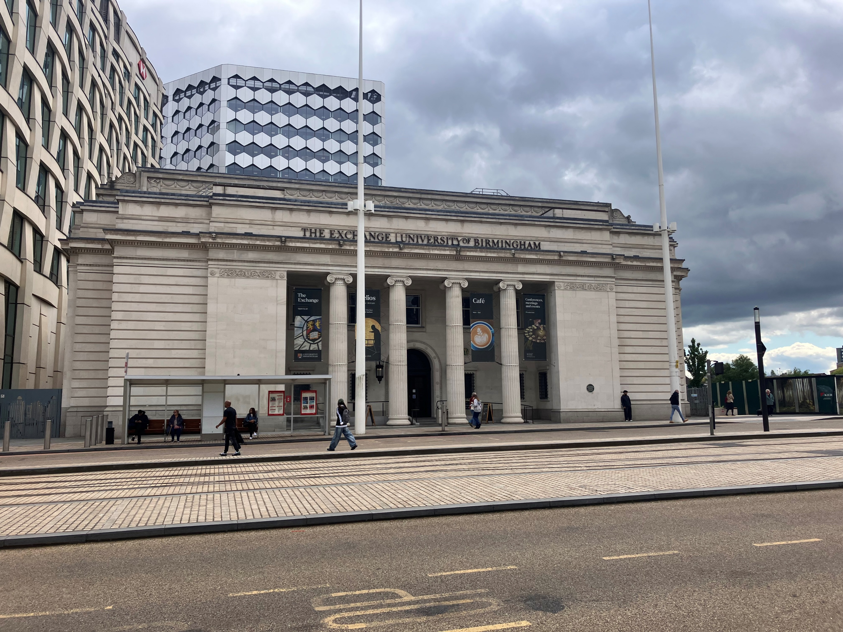
Conference 2026: Wednesday 4 November | Closing party at The Exchange (entrance photos)
External view of the Exchange from the main road / Centenary Square

Slide 43
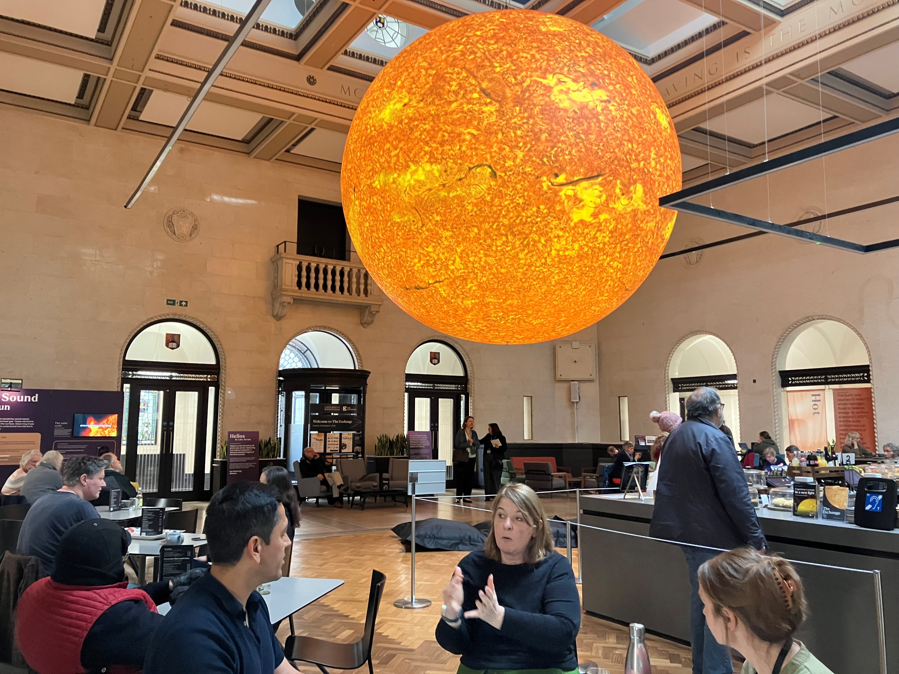
Conference 2026: Wednesday 4 November | Closing party at The Exchange (internal photos)
Once inside, the Exchange is a large square space - Luke Jerram’s artwork Helios (illuminated sculpture of the sun) will be hanging from the ceiling

Slide 44
Conference 2026: Wednesday 4 November | Closing party at The Exchange (what to expect)
Coming soon

