Slide 1

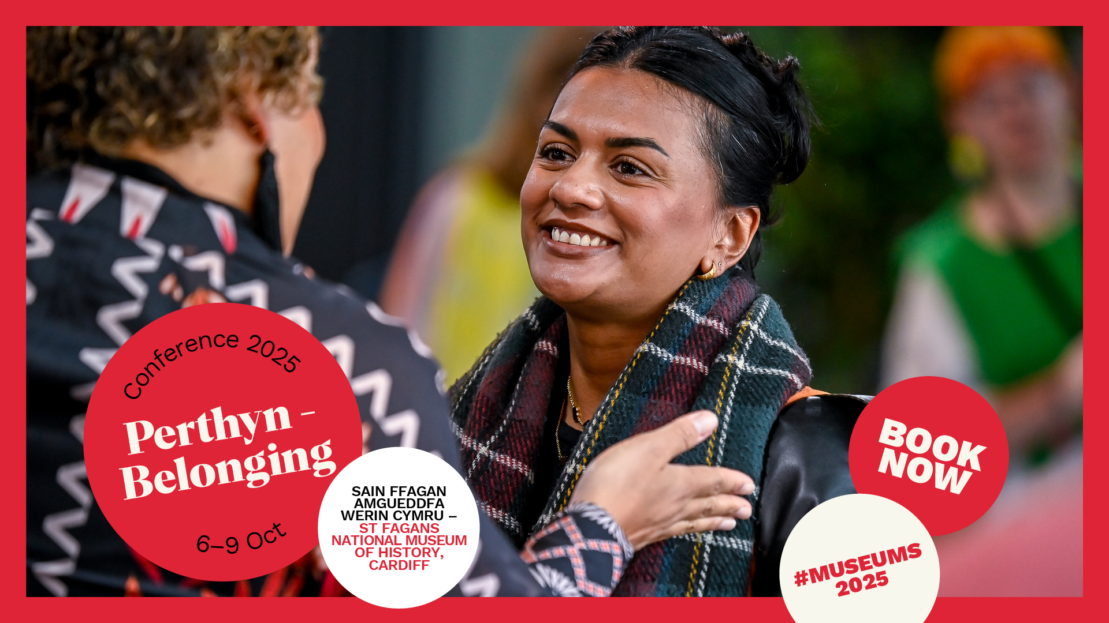
Welcome to Conference 2025: Perthyn – Belonging
6-9 October 2025
Sain Ffagan Amgueddfa Werin Cymru – St Fagans National Museum of History, Cardiff and online

Slide 2
This visual journey will…
Look at what you can do ahead of Conference (slides 3 to 5)
Take you through the three-day event with key information / details of what to expect (slides 6 to 21)
Provide additional information on the St Fagans site and the areas we are using (22 to 34)
Share some key accessibility measures in place (slides 35 to 38)

Slide 3
What to do before Conference | Book travel and accommodation
Cardiff is the closest urban area to St Fagans with lots of hotels and other city amenities
Many train routes go through the city’s main train station, Cardiff Central. Access information for this station is available via the National Rail website
You can find discounts on train fares and preferential hotel rates for delegates on our website

Slide 4
What to do before Conference | Register for Swapcard
Swapcard is the digital platform and app for Conference 2025
You can use it to browse the programme, plan your agenda and connect with other delegates
Online delegates also use the platform to watch streamed sessions live

Slide 5
What to do before Conference | Register for Swapcard
To use Swapcard you need to activate the magic link emailed to you from Swapcard
Links expire after 48 hours
Remember to use the same email address you used when you registered for Conference
Email events@museumsassociation.org if you require help

Slide 6
Conference 2025: At a glance…
Social events on Monday, Tuesday and Wednesday nights in Cardiff city centre
Conference sessions on Tuesday and Wednesday at St Fagans
Site tours across Cardiff/South Wales on Thursday

Slide 7
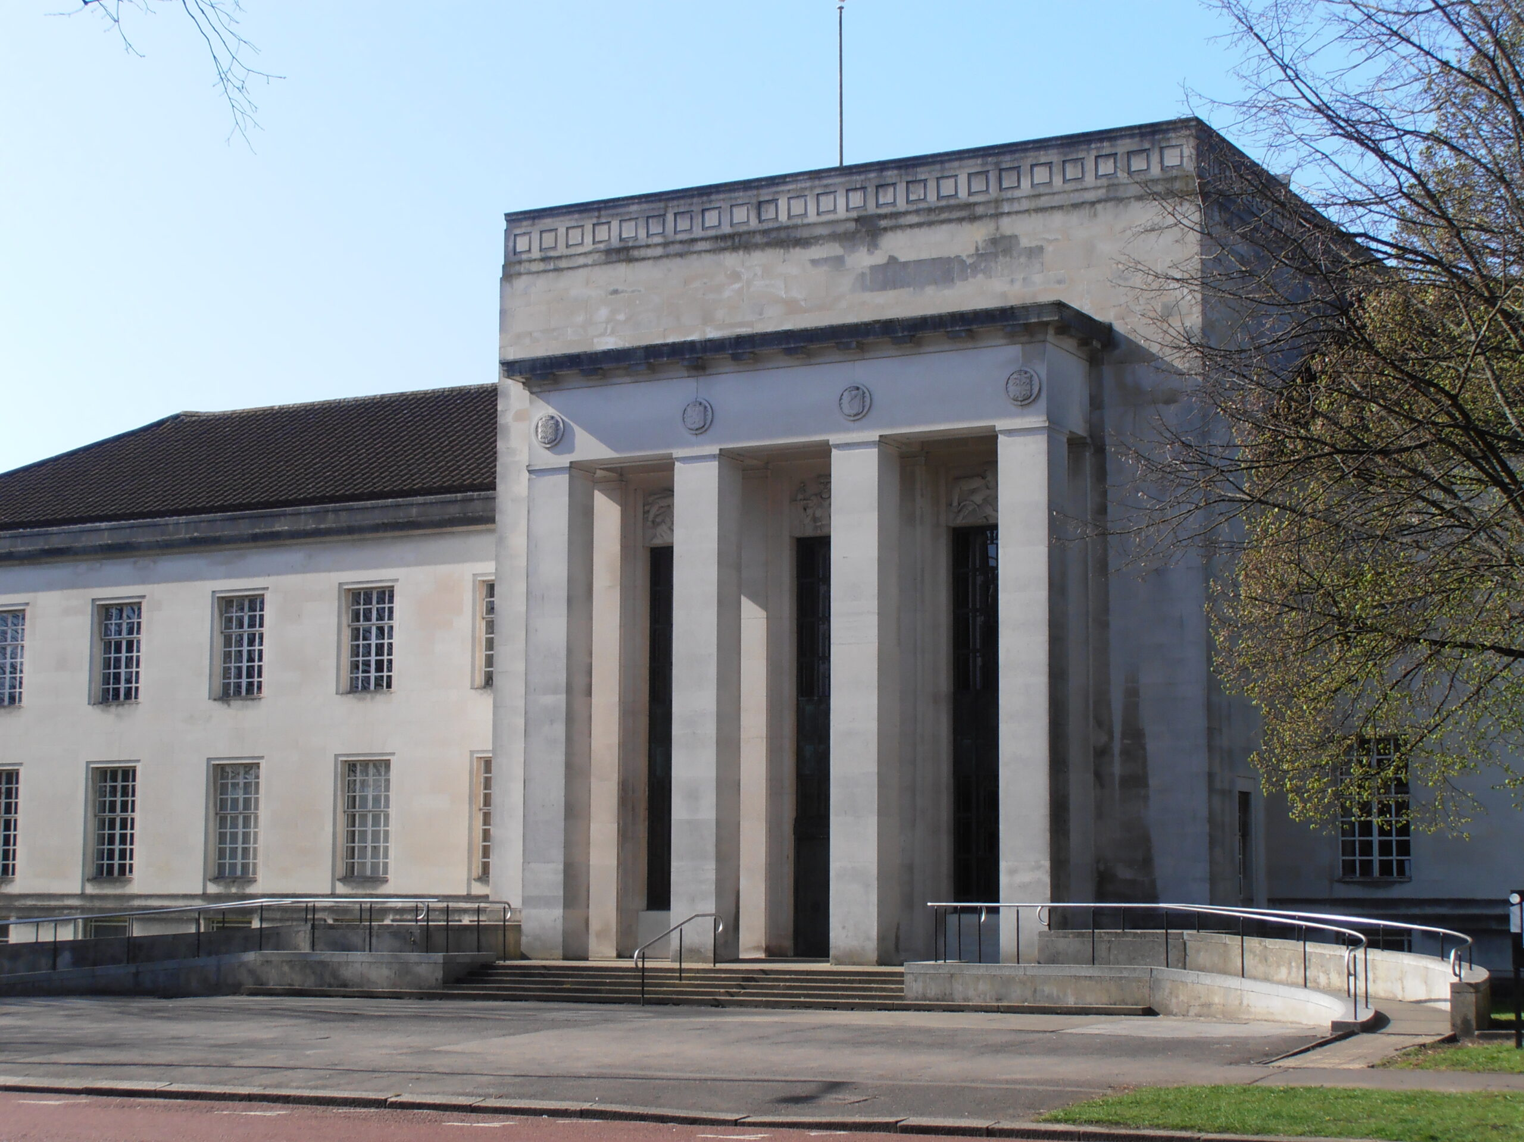
Monday 6 October: Opening drinks reception
Temple of Peace from 1800-2000
A welcome drink (alcoholic and non-alcoholic) is available on arrival, followed by a cash bar
There is a quiet room available
While the main reception space in the Marble Hall is step-free, the Crypt is only accessible by stairs
Further photos, maps and access info can be found via AccessAble website

Slide 8
Tuesday 7 October: Getting to St Fagans with Mainline Coaches
Coaches will leave from National Museum Cardiff and Cardiff Central Station between 0815-0930 – this will enable delegates to arrive at St Fagans for our 0900-1000 coffee and networking, and ahead of the 1000 opening session
You may be asked to show your badge or your name on Swapcard before boarding
All coaches will depart when they reach capacity. Delegates are asked to be patient while people board/exit coaches
Four coaches include wheelchair access – you can watch a short recording of how chairs are lifted onto the coach
Our coach timetable and a shuttle bus timetable are available online

Slide 9
Tuesday 7 October: Other ways to get to St Fagans
St Fagans is four miles west of Cardiff city centre, just off the A4232. The postcode is CF5 6XB
The car park costs £7 per day. There is free parking for disabled blue badge holders and motorbikes
Cars may be left in the car park overnight but you must let the venue know by emailing your reg number to stfagans@museumwales.ac.uk
Bike racks are available and cycle trails are available
The nearest rail station is Waun-Gron Park, two miles from St Fagans
The Cardiff Bus 32 service stops in the museum car park
First Cymru 320 service stops in St Fagans village (about half a mile from the museum or approximately an 11-minute walk)
The taxi ride from Cardiff city centre to St Fagans costs between £15-£20. VisitCardiff provides more information on taxi services in the city

Slide 10
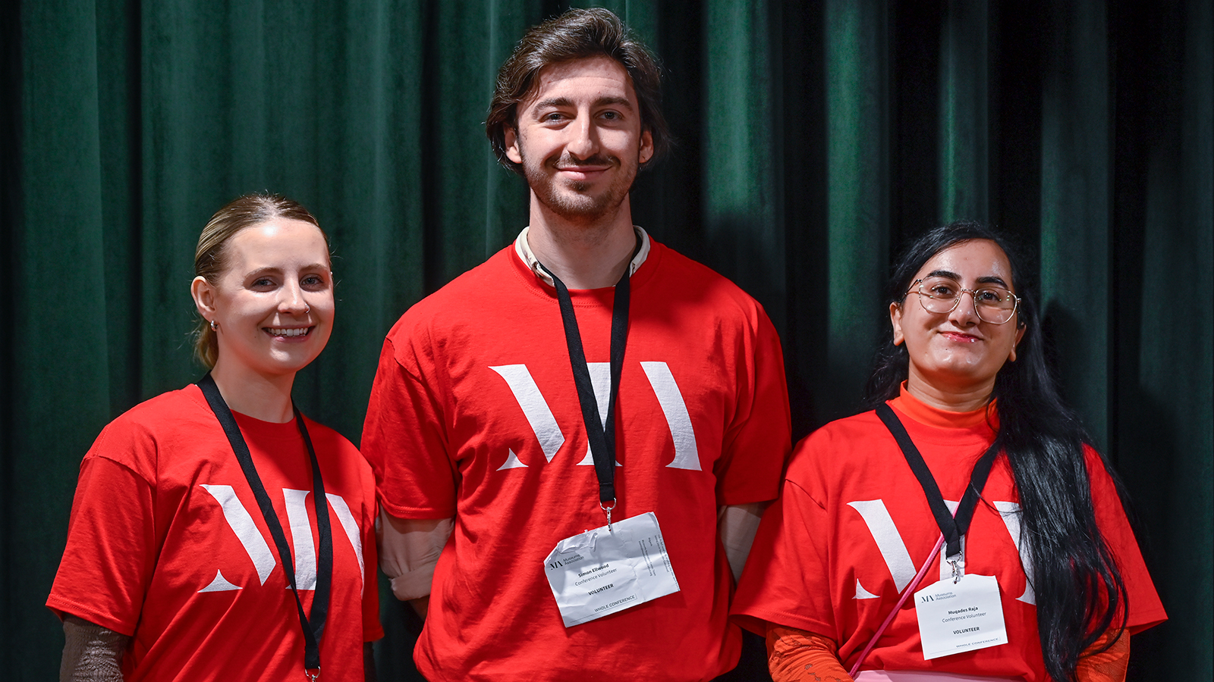
Tuesday 7 October: What to expect when you arrive at St Fagans
Volunteers will be available to welcome you and give you directions – they will be wearing red t-shirts as in the photo to the right
If you don’t have your badge, you can collect this at the MA Help Desk located in the cafe in the main museum building
There is a free cloakroom available on the first floor of the main museum building (lift and stair accessible)
Coffee will be served between 0900-1000 in our catering and networking marquee

Slide 11
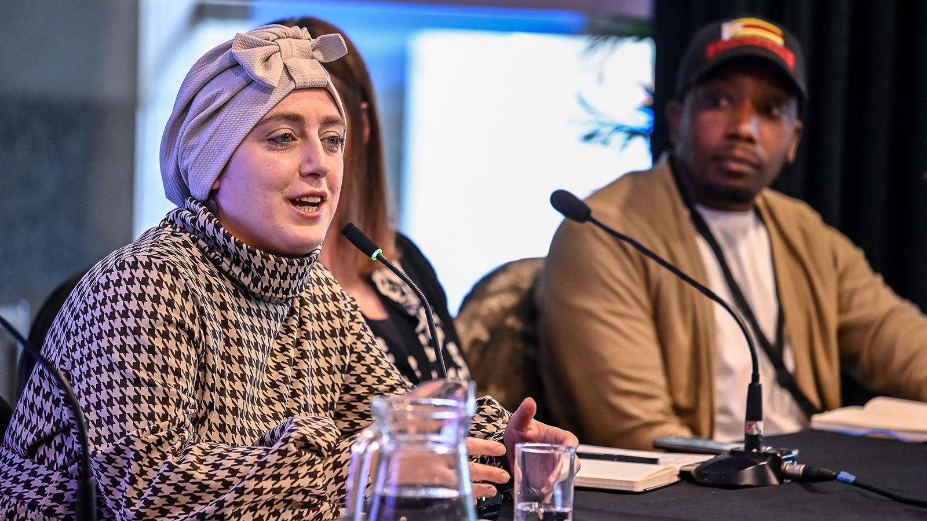
Tuesday 7 October: The Conference Programme at a glance
Sessions will run from 1000 until 1800
Core Sessions and In Practice sessions are being recorded and streamed online
There are four smaller rooms for breakout sessions and training sessions
Network meet-ups will take place throughout the day
A range of activities, called Exploring St Fagans, provide an opportunity to get out into the site. Please be aware that these sessions may not be accessible for all
You can browse the full Conference programme on our website

Slide 12
Tuesday 7 October: Getting back to Cardiff with Mainline Coaches
Coaches will be provided between 1800-1900 to transport delegates from St Fagans to National Museum Cardiff (for our evening party) or Cardiff Central Station
All coaches will depart when they reach capacity. Delegates are asked to be patient while people board/exit coaches
Four coaches include wheelchair access – you can watch a short recording of how chairs are lifted onto the coach
Our coach timetable and a shuttle bus timetable are available online

Slide 13
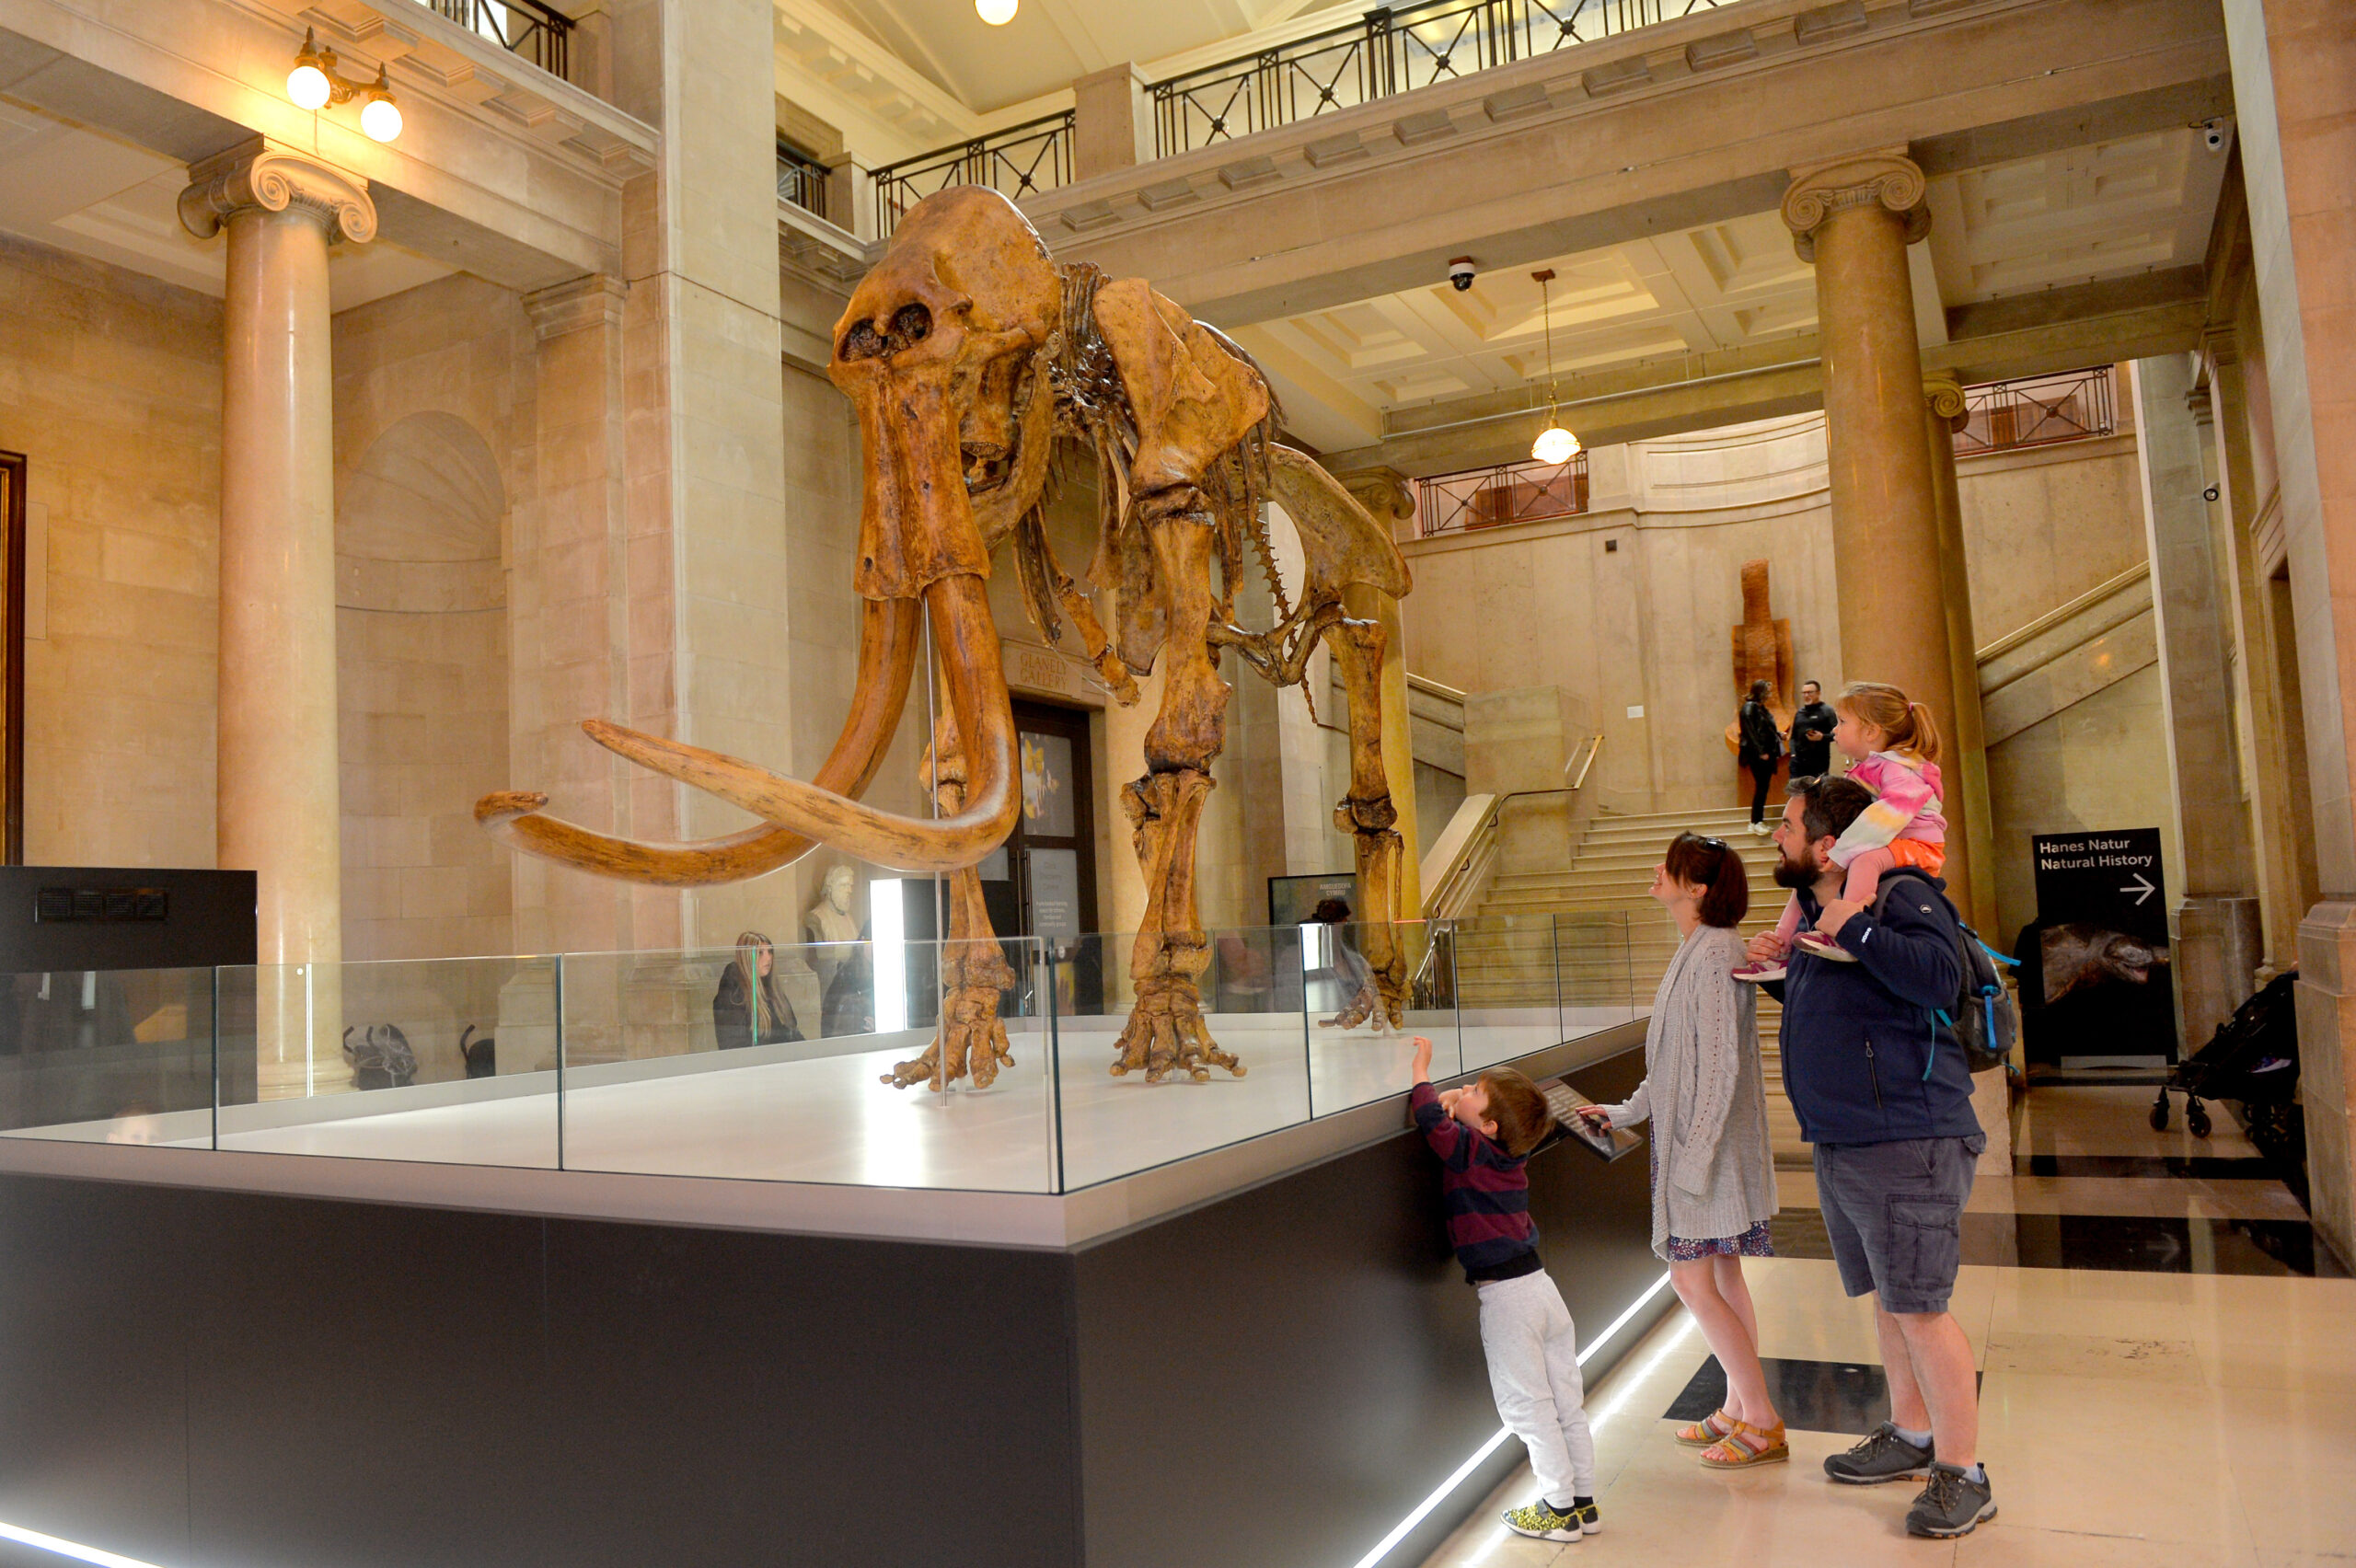
Tuesday 7 October: Main drinks reception at Amgueddfa Genedlaethol Caerdydd – National Museum Cardiff from 1830-2000
A welcome drink (alcoholic and non-alcoholic) is available on arrival, followed by a cash bar
Canapes will be served during the event
There is a quiet room available
Click here for more photos, maps and access info

Slide 14
Wednesday 8 October: Getting to St Fagans with Mainline Coaches
Coaches will leave from National Museum Cardiff and Cardiff Central Station between 0815-0930 – this will enable delegates to arrive at St Fagans for our 0900-1000 coffee and networking, and ahead of the 1000 opening session
You may be asked to show your badge or your name on Swapcard before boarding
All coaches will depart when they reach capacity. Delegates are asked to be patient while people board/exit coaches
Four coaches include wheelchair access – you can watch a short recording of how chairs are lifted onto the coach
Our coach timetable and a shuttle bus timetable are available online

Slide 15
Wednesday 8 October: Other ways to get to St Fagans
St Fagans is four miles west of Cardiff city centre, just off the A4232. The postcode is CF5 6XB
The car park costs £7 per day. There is free parking for disabled blue badge holders and motorbikes
Cars may be left in the car park overnight but you must let the venue know by emailing your reg number to stfagans@museumwales.ac.uk
Bike racks are available and cycle trails are available
The nearest rail station is Waun-Gron Park, two miles from St Fagans
The Cardiff Bus 32 service stops in the museum car park
First Cymru 320 service stops in St Fagans village (about half a mile from the museum or approximately an 11-minute walk)
The taxi ride from Cardiff city centre to St Fagans costs between £15-£20. VisitCardiff provides more information on taxi services in the city

Slide 16
Wednesday 8 October: What to expect when you arrive at St Fagans
Volunteers will be available to welcome you and give you directions – they will be wearing red t-shirts as in the photo to the right
If you don’t have your badge, you can collect this at the MA Help Desk located in the cafe in the main museum building
There is a free cloakroom available on the first floor of the main museum building (lift and stair accessible)
Coffee will be served between 0900-1000 in our catering and networking marquee

Slide 17
Wednesday 8 October: The Conference Programme at a glance
Sessions will run from 1000 until 1800
Core Sessions and In Practice sessions are being recorded and streamed online
There are four smaller rooms for breakout sessions and training sessions
Network meet-ups will take place throughout the day
A range of activities, called Exploring St Fagans, provide an opportunity to get out into the site. Please be aware that these sessions may not be accessible for all
You can browse the full Conference programme on our website

Slide 18
Wednesday 8 October: Getting back to Cardiff with Mainline Coaches
Coaches will be provided between 1800-1900 to transport delegates from St Fagans to National Museum Cardiff (a short walk from where our evening party takes place) or Cardiff Central Station
All coaches will depart when they reach capacity. Delegates are asked to be patient while people board/exit coaches
Four coaches include wheelchair access – you can watch a short recording of how chairs are lifted onto the coach
Our coach timetable and a shuttle bus timetable are available online

Slide 19
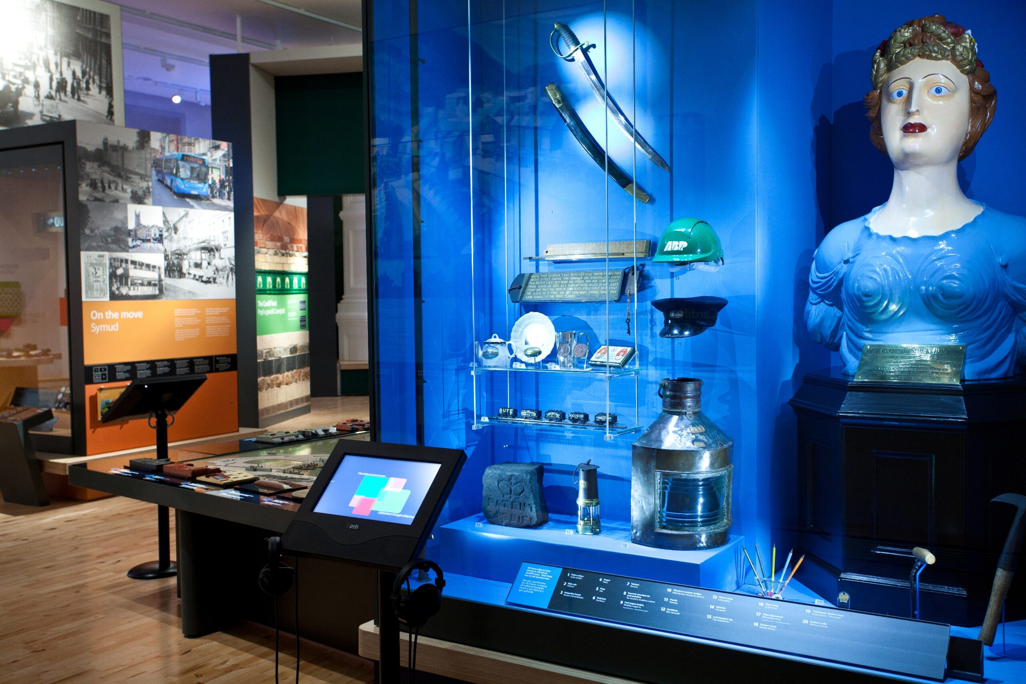
Wednesday 8 October: Closing drinks reception at Museum of Cardiff from 1830-2030
A welcome drink (alcoholic and non-alcoholic) is available on arrival, followed by a cash bar
There is a quiet room available
Click here for more photos, maps and access info

Slide 20
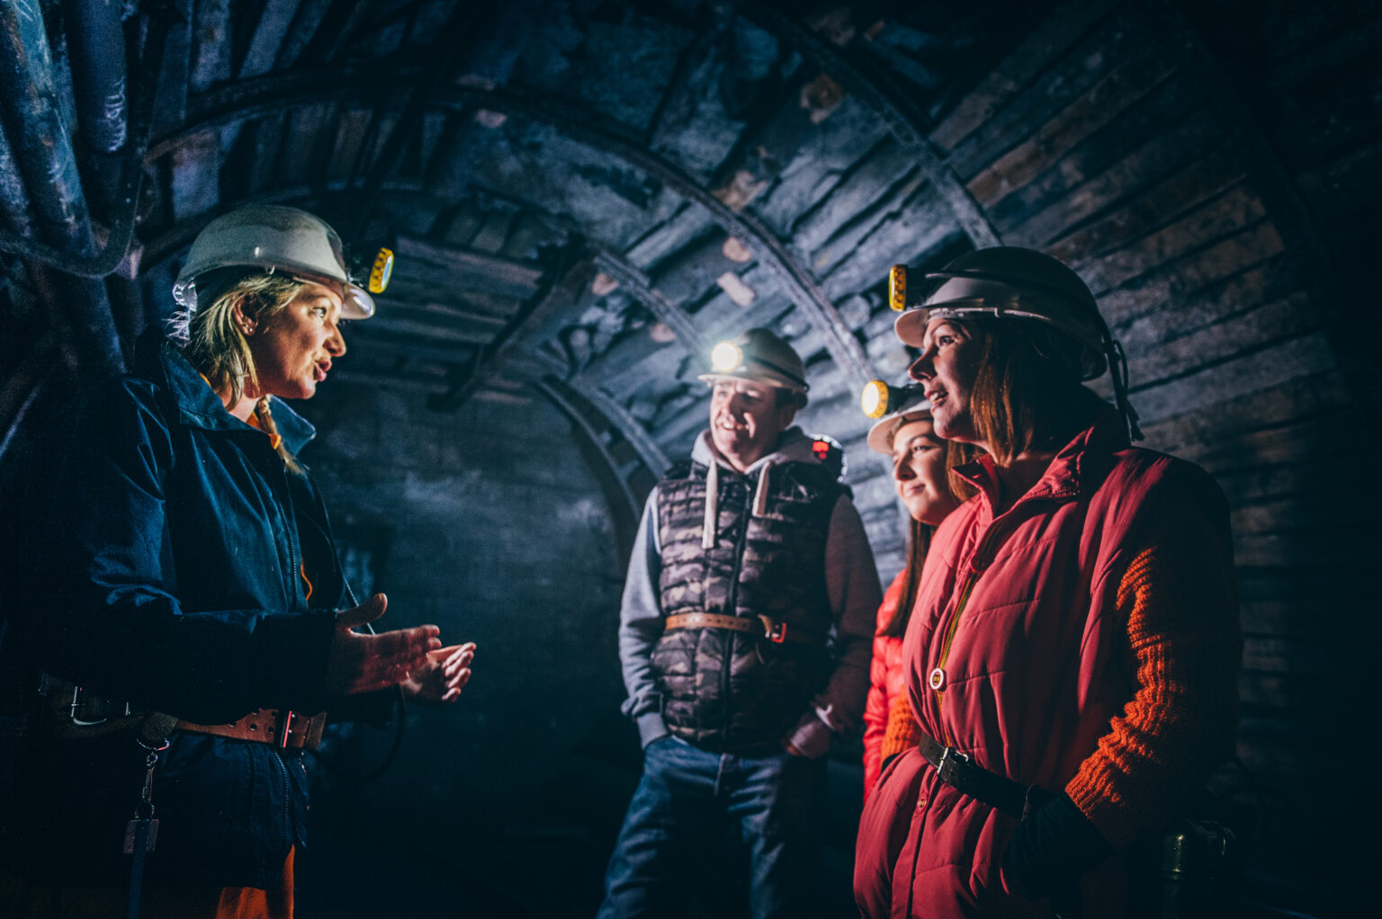
Thursday 9 October: Free heritage tours
We have put together a programme of free tours on Thursday 9 October for in-person delegates.
All tours are wheelchair accessible but please email events@museumsassociation.org if you have any other access requirements
A small number of tours require advance booking
All other tours are first come, first served, with no need to book
You can browse the full programme on our website

Slide 21
Exploring St Fagans: At a glance…
Exploring St Fagans is a programme of less formal sessions hosted by Amgueddfa Cymru
These take place across the St Fagans site and aim to introduce delegates to the collection and wider work of the museum group
These sessions are informal – there is no AV support and they may not be accessible to all delegates
The locations of sessions are available on our Conference programme via the Swapcard app
If you want to know further information about any of the locations, please email events@museumsassociation.org

Slide 22
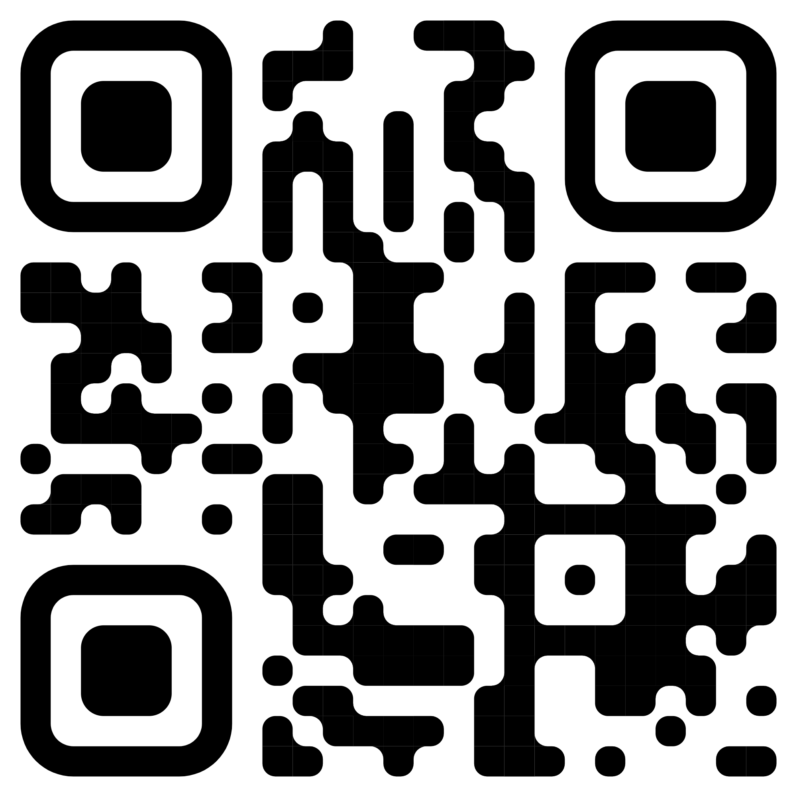
Additional information about the St Fagans site: At a glance
St Fagans is a large open-air museum with many historical buildings, outdoor areas and modern facilities
Due to the historic nature of the museum, there are uneven floors and surfaces. Some of the paths on the castle side of the museum are steep and uneven
We recommend people explore the map of St Fagans via the QR code to the right and online
The map has been also reproduced on the next slide
Physical copies of the map will be available at the MA Help Desk and a digital version is available via the Swapcard app

Slide 23
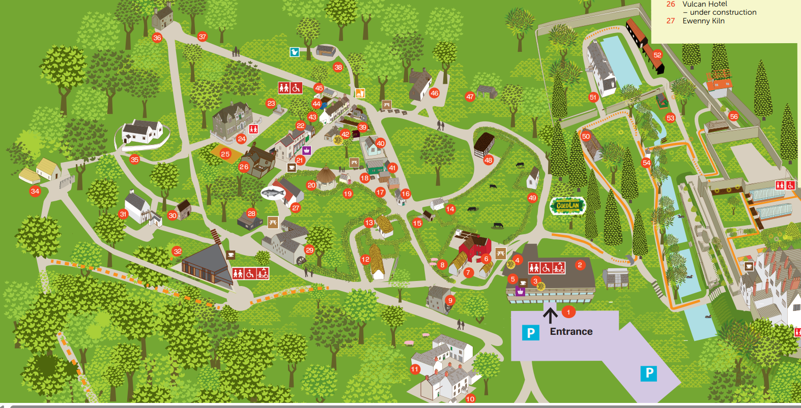
Map of St Fagans: full map can be accessed as a PDF online

Slide 24
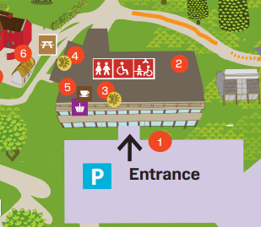
Guide to the St Fagans site: Main Museum Building
Most Conference sessions take place in the Main Museum Building (number 1 on the map), including:
Core Sessions in the Atrium
In Practice Sessions in the Lecture Theatre
Breakout Sessions in Studio 2 and 3
Training in Studio 1
Workshops in the Temporary Exhibition Space
The Main Museum Building is also where you’ll find:
The MA Help Desk
A free cloakroom
Quiet and prayer rooms
A paid cafe
Relaxed networking area
Accessible catering point

Slide 25
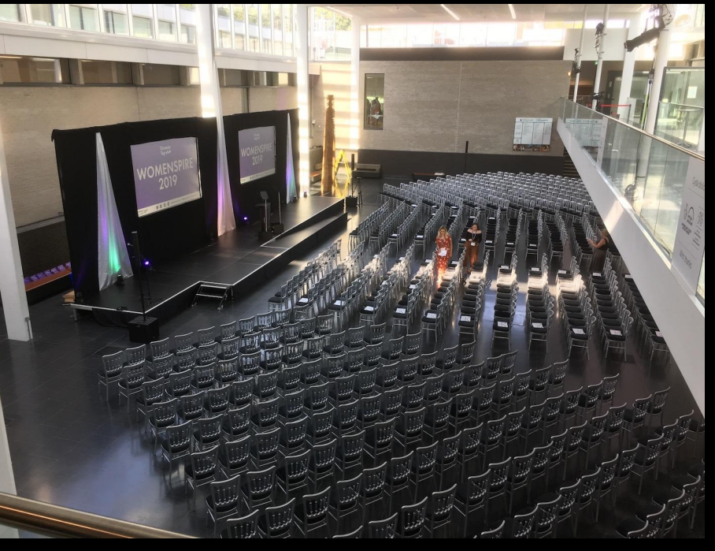
Guide to the St Fagans site: Atrium
Core Sessions take place in the Atrium on the ground floor of the Main Museum Building
This space has capacity for about 600 people and will be theatre style seating
Sessions in this room are streamed for online delegates and recorded
Sessions will be captioned

Slide 26
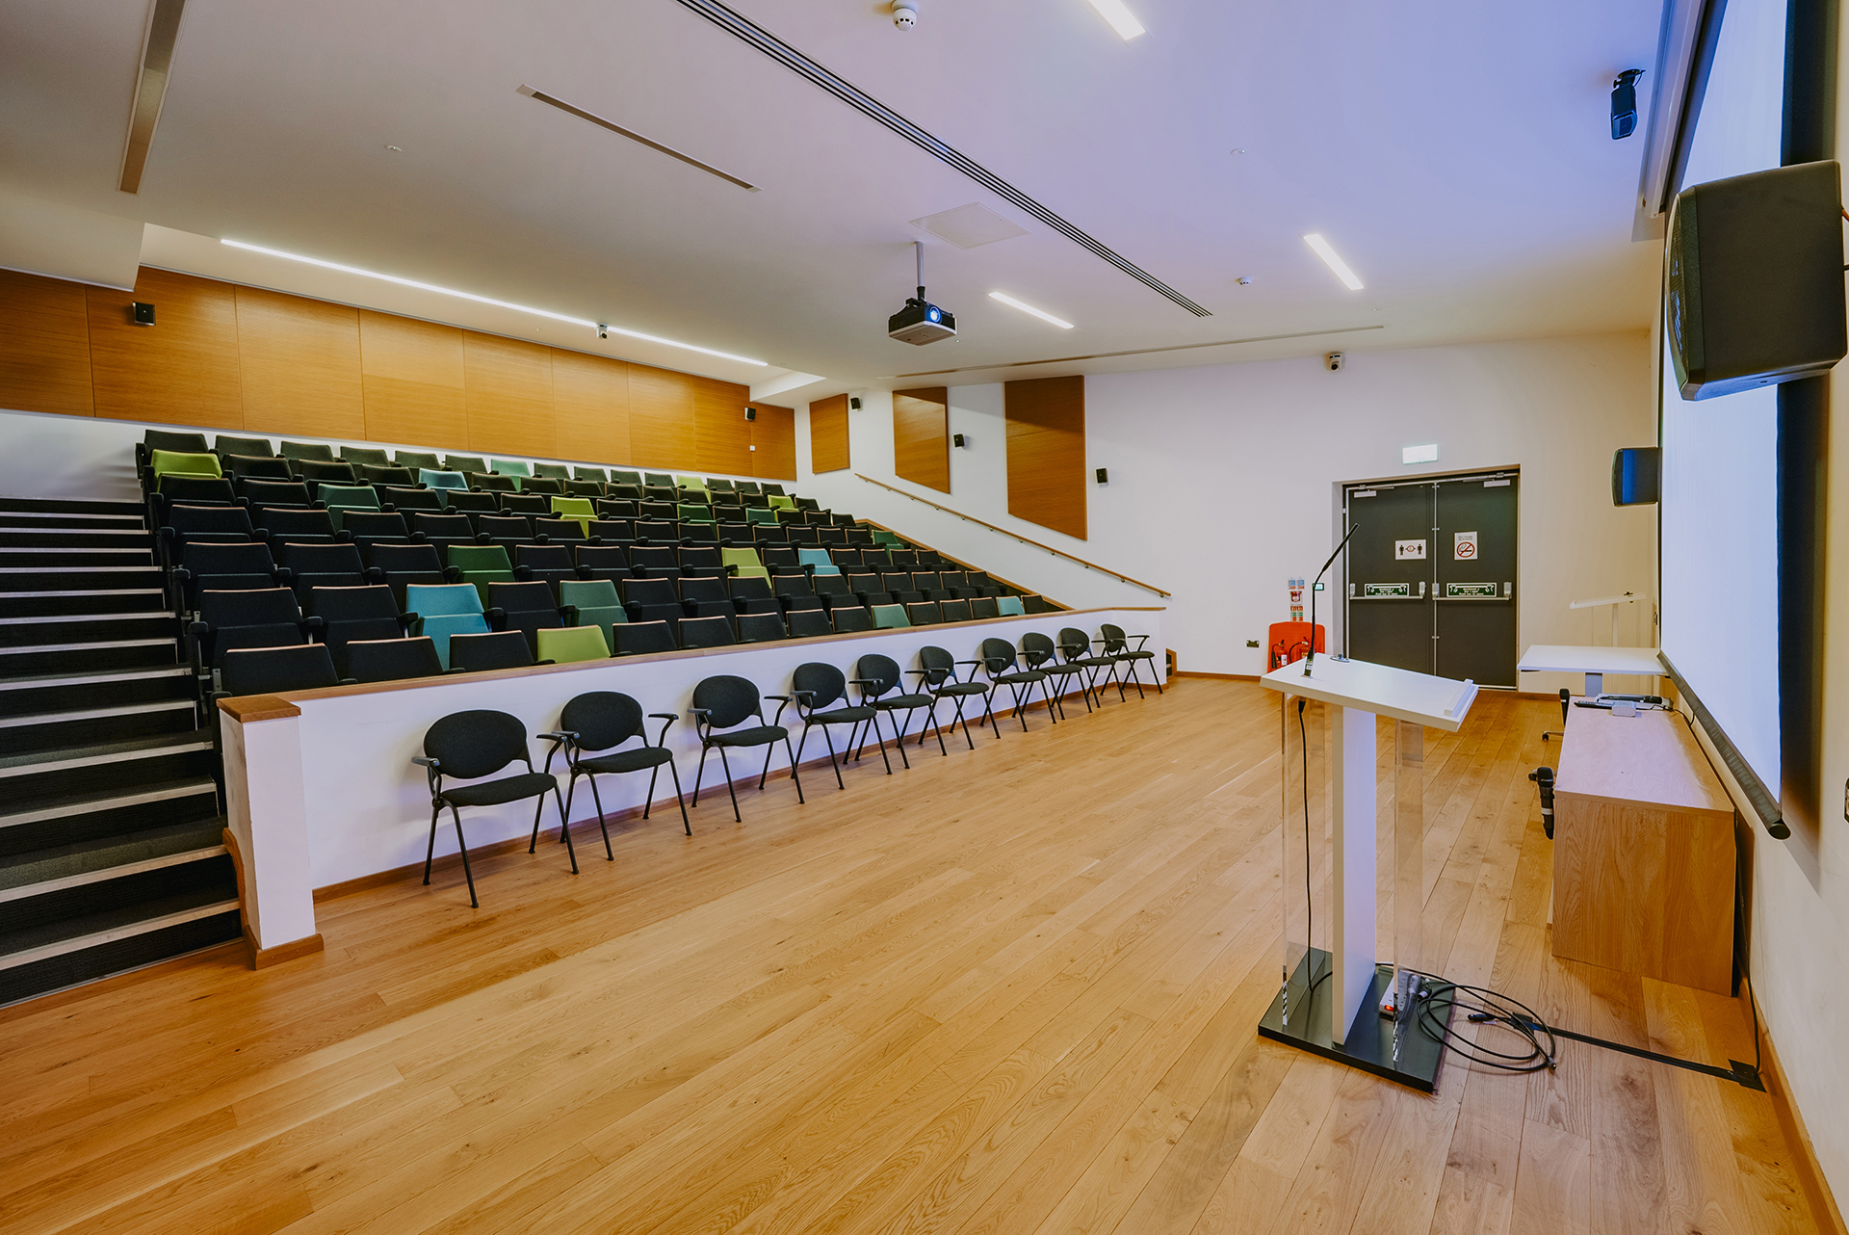
Guide to the St Fagans site: Lecture Theatre
In Practice and Supporter Sessions take place in the Lecture Theatre on the first floor of the Main Museum Building
This space has capacity for about 120 people and will be fixed theatre style seating
Sessions in this room are streamed for online delegates and recorded
Sessions will be captioned

Slide 27
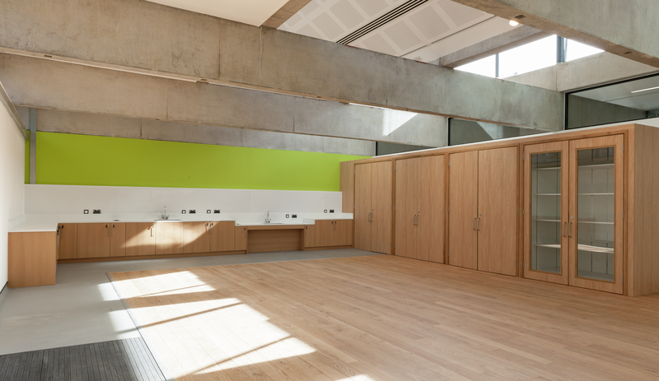
Guide to the St Fagans site: Studio/Stiwdio 1
Training Sessions take place in Studio/Stiwdio 1
This space has capacity for about 60 people in theatre style seating
Training sessions are repeated across day one and two to allow as many people as possible to attend
Sessions are not recorded or streamed
Sessions will be captioned

Slide 28
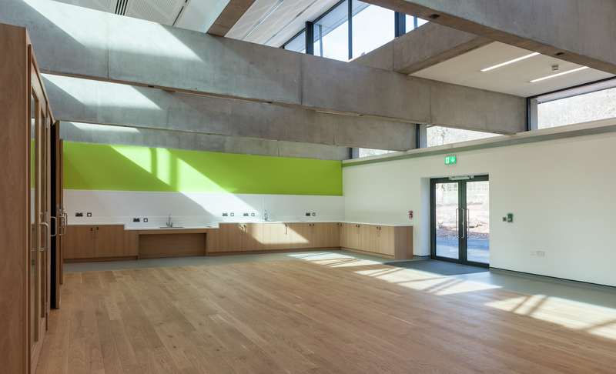
Guide to the St Fagans site: Studio/Stiwdio 2
Breakout Sessions take place in Studio/Stiwdio 2
This space has capacity for about 60 people in theatre style seating
Welsh-to-English translation is provided in this room (where relevant)
Sessions are not recorded or streamed
Sessions will be captioned

Slide 29
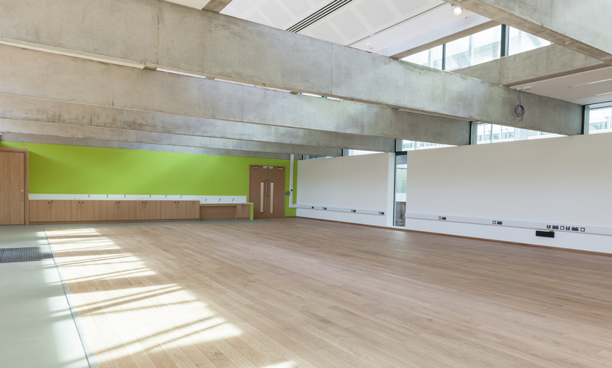
Guide to the St Fagans site: Studio/Stiwdio 3
Breakout Sessions take place in Studio/Stiwdio 3
This space has capacity for about 100 people in theatre style seating
Sessions are not recorded or streamed
Sessions will be captioned
Sponsored lunchtime sessions also take place in this room – lunch will be served for attending delegates

Slide 30
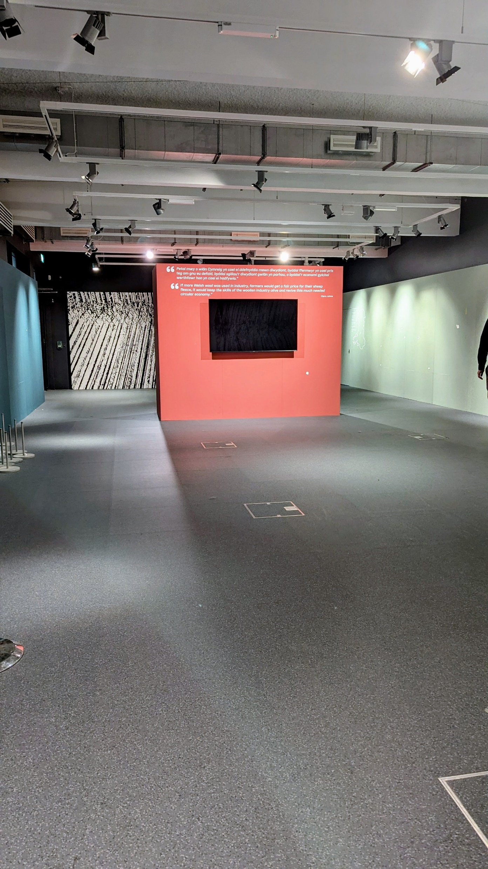
Guide to the St Fagans site: Temporary Exhibition Space
Workshops take place in the Temporary Exhibition Space
This space has capacity for about 100 people at round tables
Sessions are not recorded or streamed
Sessions will be captioned
The networking session for the Neurodiverse Museum will also take place in this room

Slide 31
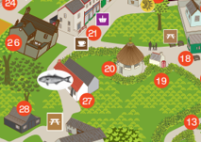
Guide to the St Fagans site: Catering and Exhibitor area
Coffee and lunch will be served in a marquee, which can be entered at point 20 on the map.
Please note that access to the marquee includes crossing a gravelled area of ground – a photo is available on our website
We will also have a wide range of exhibitor tabletops in this area
It is approximately a four-minute walk from the Main Museum Building
Transporter buggies will be available to those who require it
People can also request accessible lunch to be served within the cafe in the Main Museum Building (see slide 37)
The full map of St Fagans can be accessed online

Slide 32
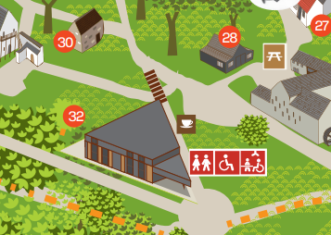
Guide to the St Fagans site: Gweithdy
The workshop at Gweithdy (number 32 on the map) will host some of our grassroot sector support networks meet-ups
This building has step free access and toilet provision (including a Changing Places toilet)
The workshop has a seated capacity of about 20 people
There will be no AV provision in this space during Conference

Slide 33
Guide to the St Fagans site: The Vulcan Hotel Pub
The back room of the Vulcan Hotel Pub (number 26 on the map) will also host some grassroot sector support networks meet-ups
Please note that this is a historic building and may not be accessible for all. Internal photos are available on the next slide
Alcoholic and non-alcoholic drinks will be sold in the front room of the pub throughout Conference

Slide 34
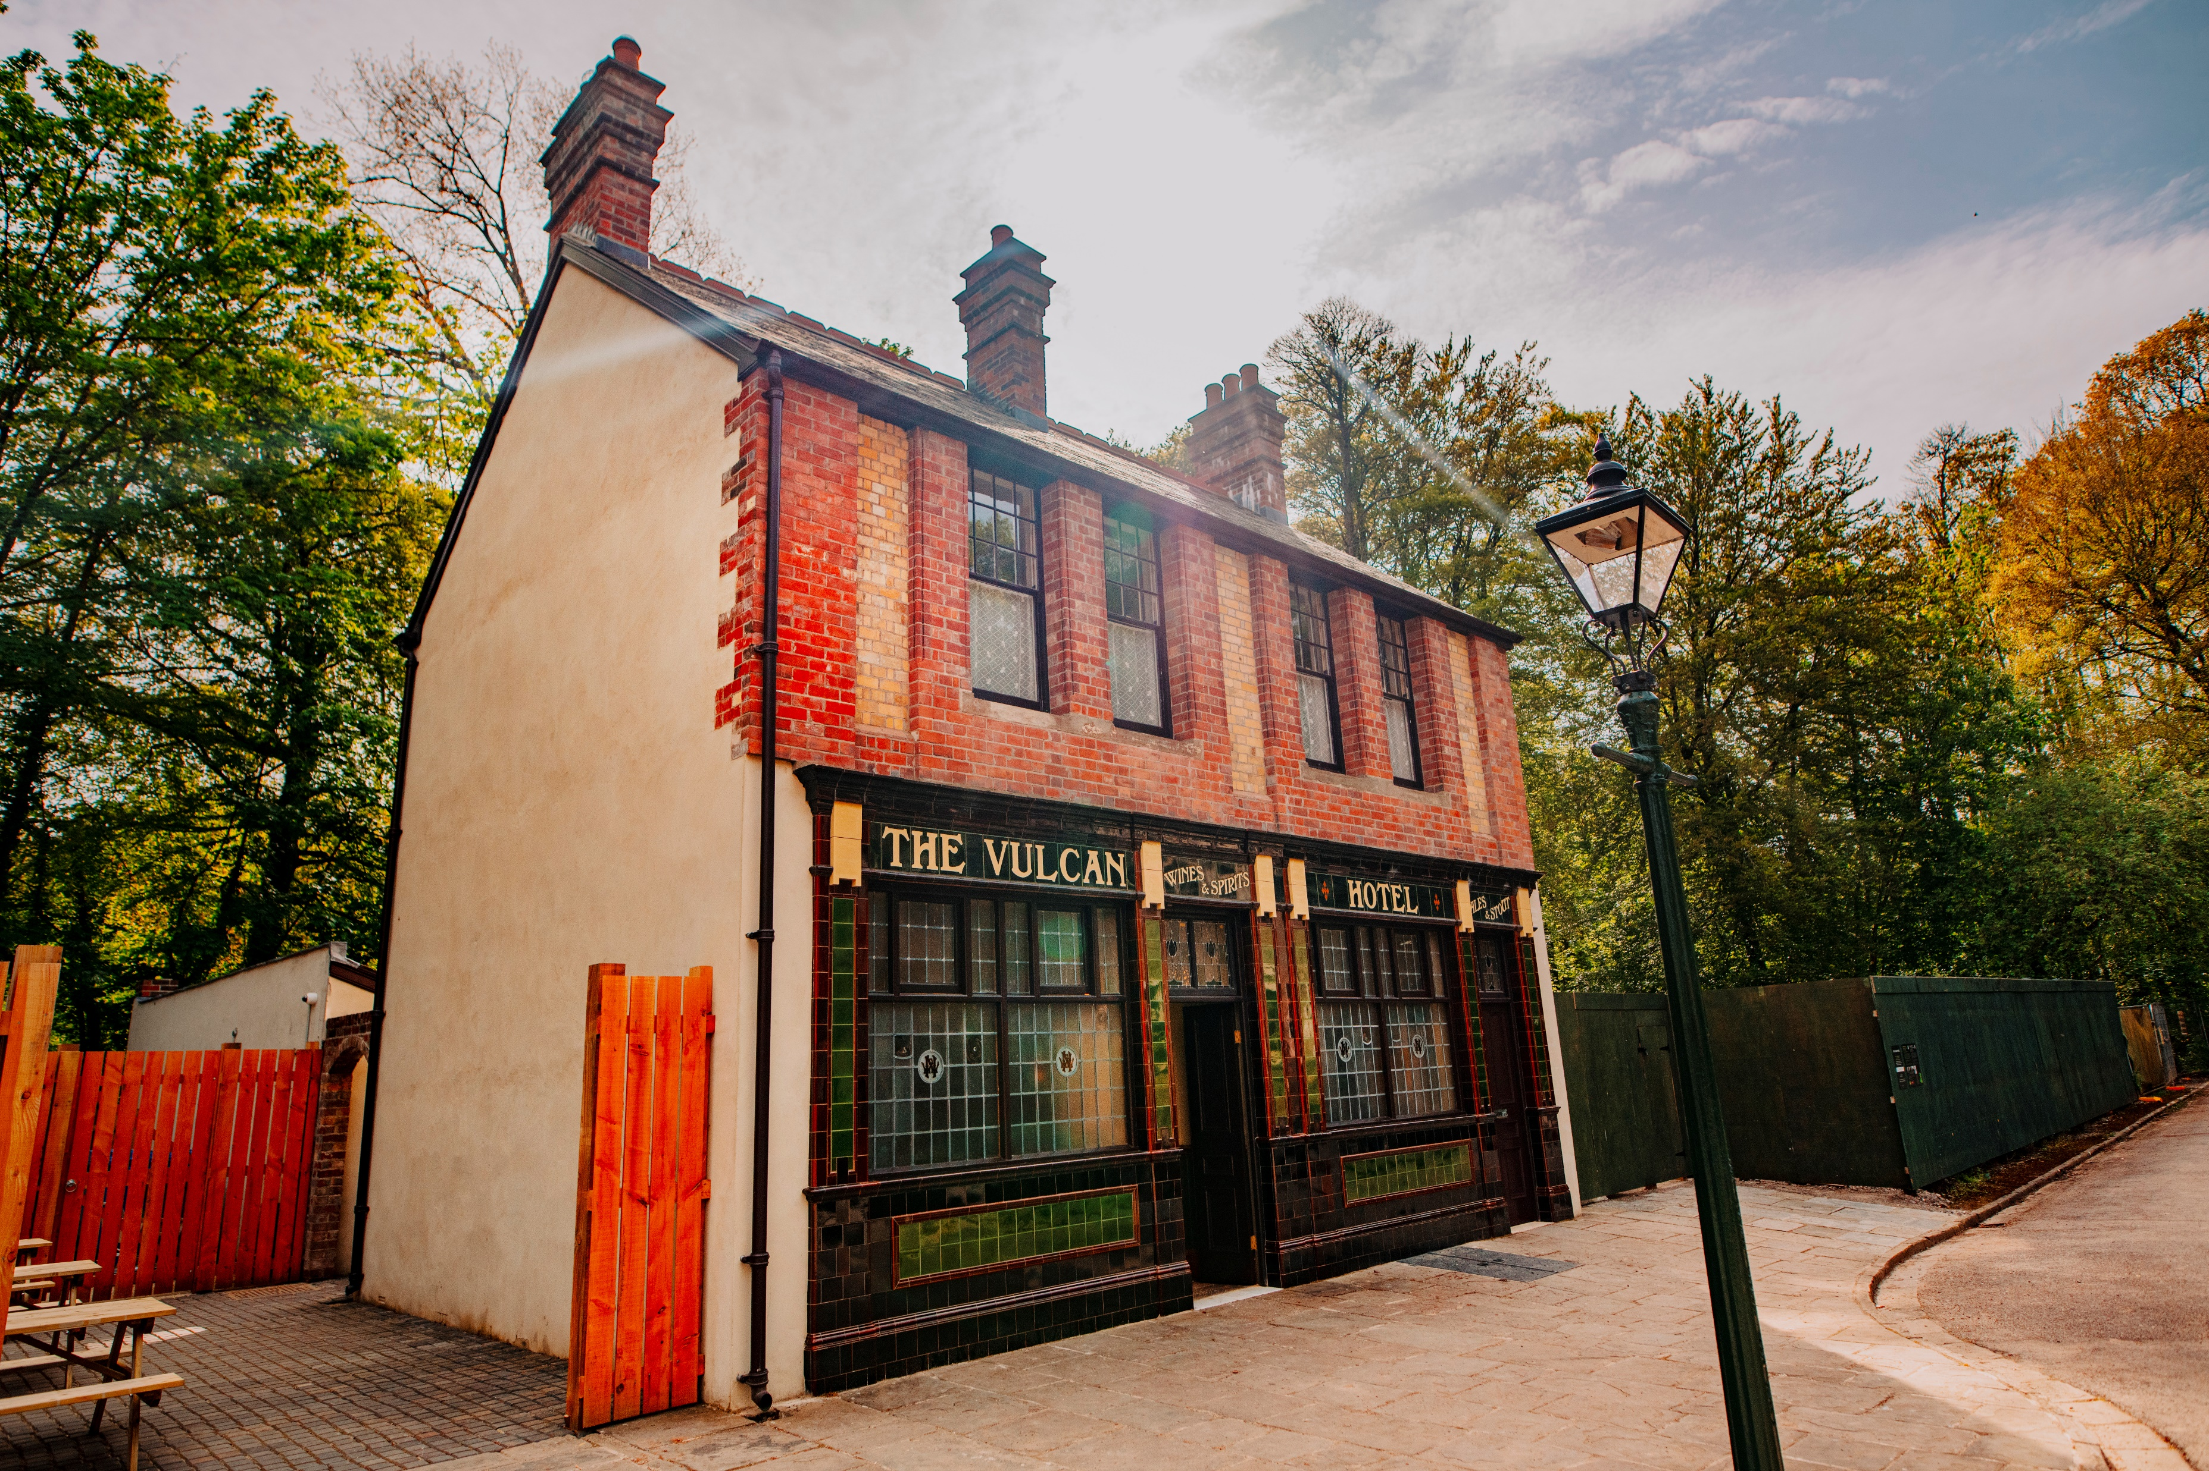
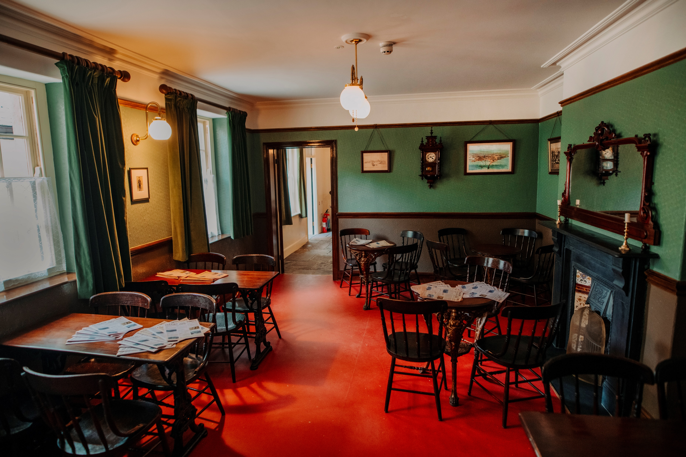
Guide to the St Fagans site: The Vulcan Hotel Pub
Internal view of the Vulcan Hotel Pub (below)
External view of the Vulcan Hotel Pub (above)

Slide 35
Accessibility at Conference 2025
All sessions taking place in the Main Museum Building will be captioned
Sessions taking place in the Atrium and Lecture Theatre will be streamed and recorded
Reserved seating in all rooms
A dedicated quiet room for in-person delegates
A prayer room for individuals to engage in prayer, reflection or quiet contemplation
Wheelchair accessible coaches
Accessible catering point (see slide 37)
Assistance dogs welcomed
Speakers are briefed to ensure that slides follow good accessibility guidance, based on advice from VocalEyes
A trained mental health first-aider (Alice) will be available on the MA Help Desk
Our Code of Conduct ensures our spaces are safe, welcoming and inclusive

Slide 36
Toilet provision at St Fagans
The Main Museum Building has single-sex toilet blocks on the ground floor. Smaller single-sex toilet blocks are also available on the second floor (accessible by stairs and lift) outside the Lecture Theatre
The Main Museum Building also has a Changing Places toilet on the ground floor.
Gweithdy has single-sex toilets, a gender-neutral accessible toilet and a Changing Places toilet. Please note the accessible toilet is in the basement and accessed via a lift
There are gender-neutral accessible toilets near Rhyd-y-car Terrace, in the castle grounds, and in Oakdale Workmen’s Institute
All toilets are marked on the map of St Fagans

Slide 37
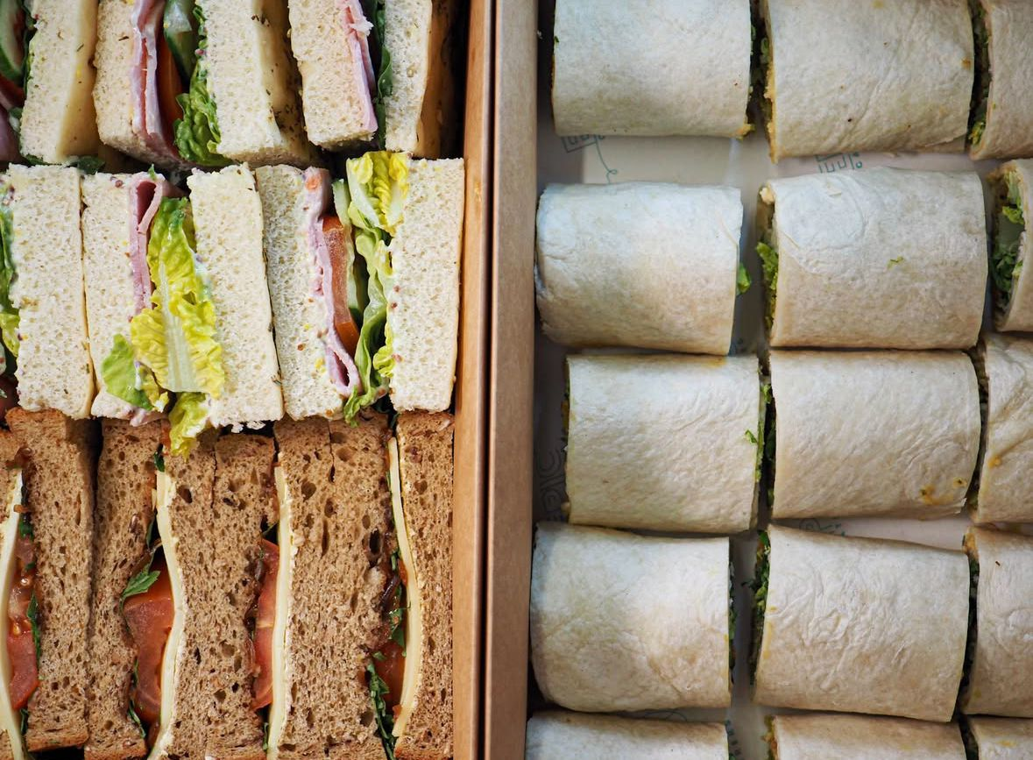
Lunch at Conference 2025: Picnic bag menu
Vegetarian and vegan sandwiches and wraps
Tuesday: Cheddar cheese, little gem, onion chutney and tomato
Tuesday: Lightly spiced falafel, hummus, gem lettuce (vegan)
Wednesday: Caramelised onion, goat cheese, rocket
Wednesday: Hummus, red pepper, carrot, green leaves (vegan)
Crisps
Fruit
Welsh cakes/bara brith

Slide 38
Lunch at Conference 2025: Catering points
Lunch will be served in a marquee (entry point at point 20 on the St Fagans map)
Tea, coffee and tap water will also be available
If you prefer a quieter place to get lunch, we will provide an accessible catering point in the cafe the main museum building – please let us know in advance by emailing events@museumsassociation.org
MA staff on the Help Desk will also be available to collect lunch for you if necessary

Slide 39
If you require further support…
We want Conference to be as accessible and inclusive to as many people as possible.
If there is anything we can do to support you, or if you require adjustments not covered in this guide, please contact us at events@museumsassociation.org.
In previous years we have:
Arranged pre-event Zoom meetings to discuss access and what to expect from Conference
Provided BSL translators
Sent further photographs illustrating the space
Put delegates in touch with the venue to discuss access in more detail
Arranged transport for delegates who require it

